Slide 1
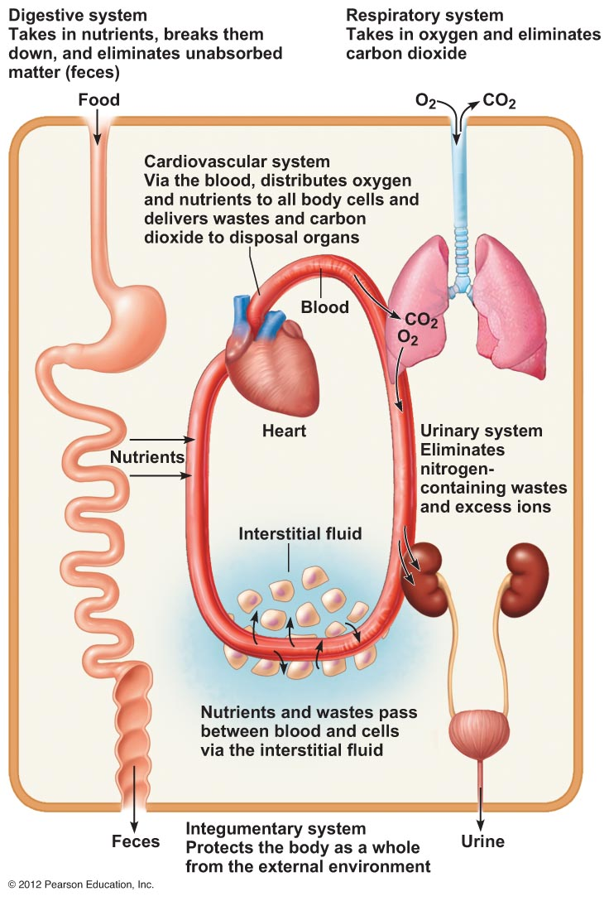

Slide 3
Types of Tissues
Epithelium
Nervous
tissue
Connective
Tissue
Neurons – nerve cells
Neuroglia – insulating cells
Muscle
tissue
Skeletal - voluntary
Smooth – involuntary, in organs
Cardiac – involuntary, heart

Slide 4
classified by

Slide 5
Epithelial Tissue
Forms outer layers and linings
Functions are protection, absorption, filtration, and secretion
Attaches to a basement membrane and connective tissue
Regenerates easily
Avascular – no blood vessels
classified by
Shapes
Layers
Cuboidal
Cube-shaped
Columnar
Tall and thin
Simple
Single layer
Stratified
> one layer
Squamous
“Scales”
Flattened cells

Slide 7
Functions of Epithelial Tissues
Cuboidal
Fairly rare -found lining the ducts of glands
Stratified squamous Epi.
High wear areas – skin, mouth, esophagus
Simple Squamous Epi.
Forms serous membranes
Which line the inside of body cavities and outside of organs
Columnar Epi.
Forms mucosa membranes that line surfaces exposed to the air
Contains goblet cells that produce mucus
Glandular Epi.
Secretes substances
Transitional Epi.
Stretchy tissue that changes shape
Mostly found in urinary system
Endocrine
“ductless”
Hormones used in the body
Exocrine
Ducts carry stuff out of the tissue
Sweat, oil, pancreas, liver

Slide 9
Connective Tissue
Cells embedded in extracellular matrix
Bones
Dense
Connective
Loose
Connective
Cartilage
Fibroblasts
Matrix of collagen fibers Regular - forms tendons and ligaments
Poor blood supply
Irregular - dermis
Osteocytes
Matrix of Ca salts and collagen fibers
Softer,
More cells
Loosely packed fibers
Chondrocytes
Matrix of cartilage types and fibers
Hardest
Softest

Slide 11
Cartilage
Avascular
no blood vessels
Chondrocytes
Matrix of cartilage types
Hyaline Cartilage
Harder, Glassy
Larynx, ribs to breastbone, ends of bones, fetal skeleton
Fibrocartilage
B/w backbone discs
Elastic Cartilage
Ears, nose

Slide 12
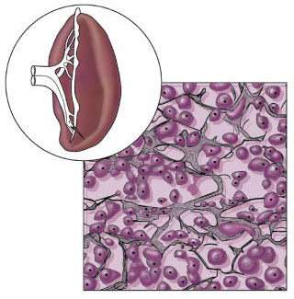
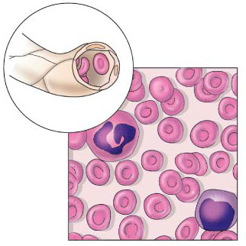

Slide 13
Loose Connective
Areolar
Reticular
“Small empty spaces”
Cushions and protects organs
Soaks up excess fluids
Interwoven fibers
Form framework of spleen, lymph nodes, and bone marrow
Adipose
Fat cells
Underneath skin,
around kidneys, hips,
belly, breasts
Insulates, stores energy
Blood
Plasma matrix
Protein clotting fibers

Slide 14
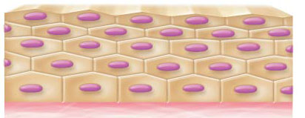
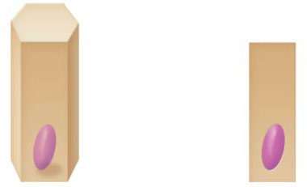
Squamous
Simple Squamous
Cuboidal
Stratified Squamous
Columnar

Slide 15
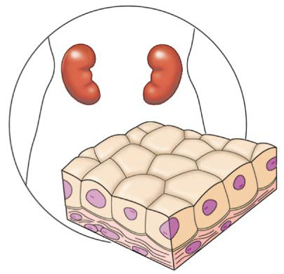
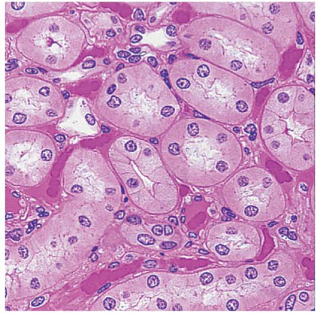
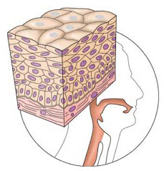
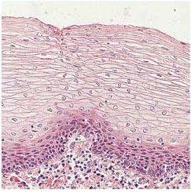
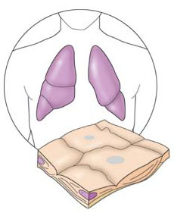
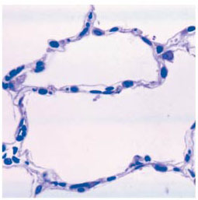
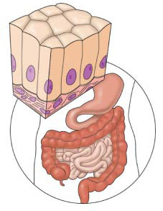
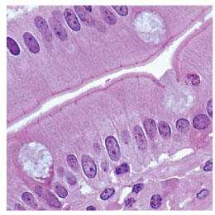
Stratified squamous
Cudoidal
Columnar
Simple squamous

Slide 16
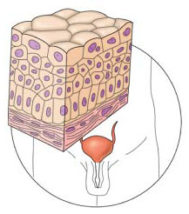
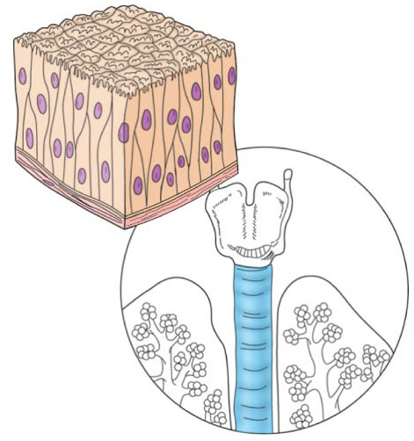
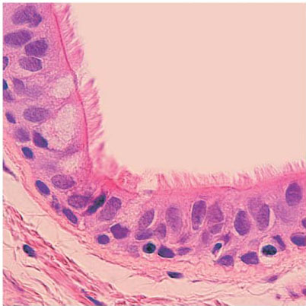
Transitional
Epithelium
Pseudostratified
ciliated columnar
epithelium

Slide 17
Bones
Osteocytes

Slide 18
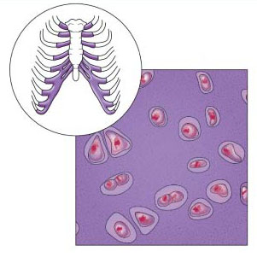
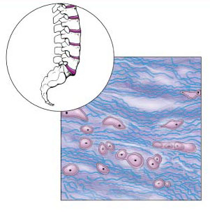
Hyaline
Cartilage
fibro-
cartilage

Slide 19
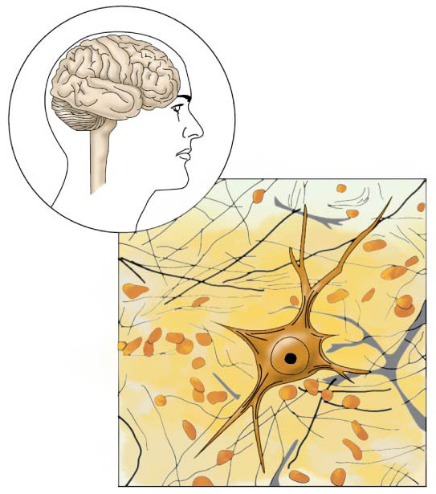
Nervous tissue

Slide 20
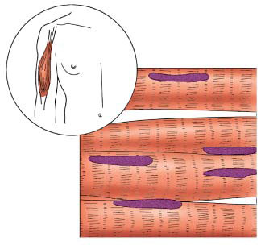
Skeletal
Muscle
Smooth
Muscle
Cardiac
Muscle

Slide 21
