Slide 1
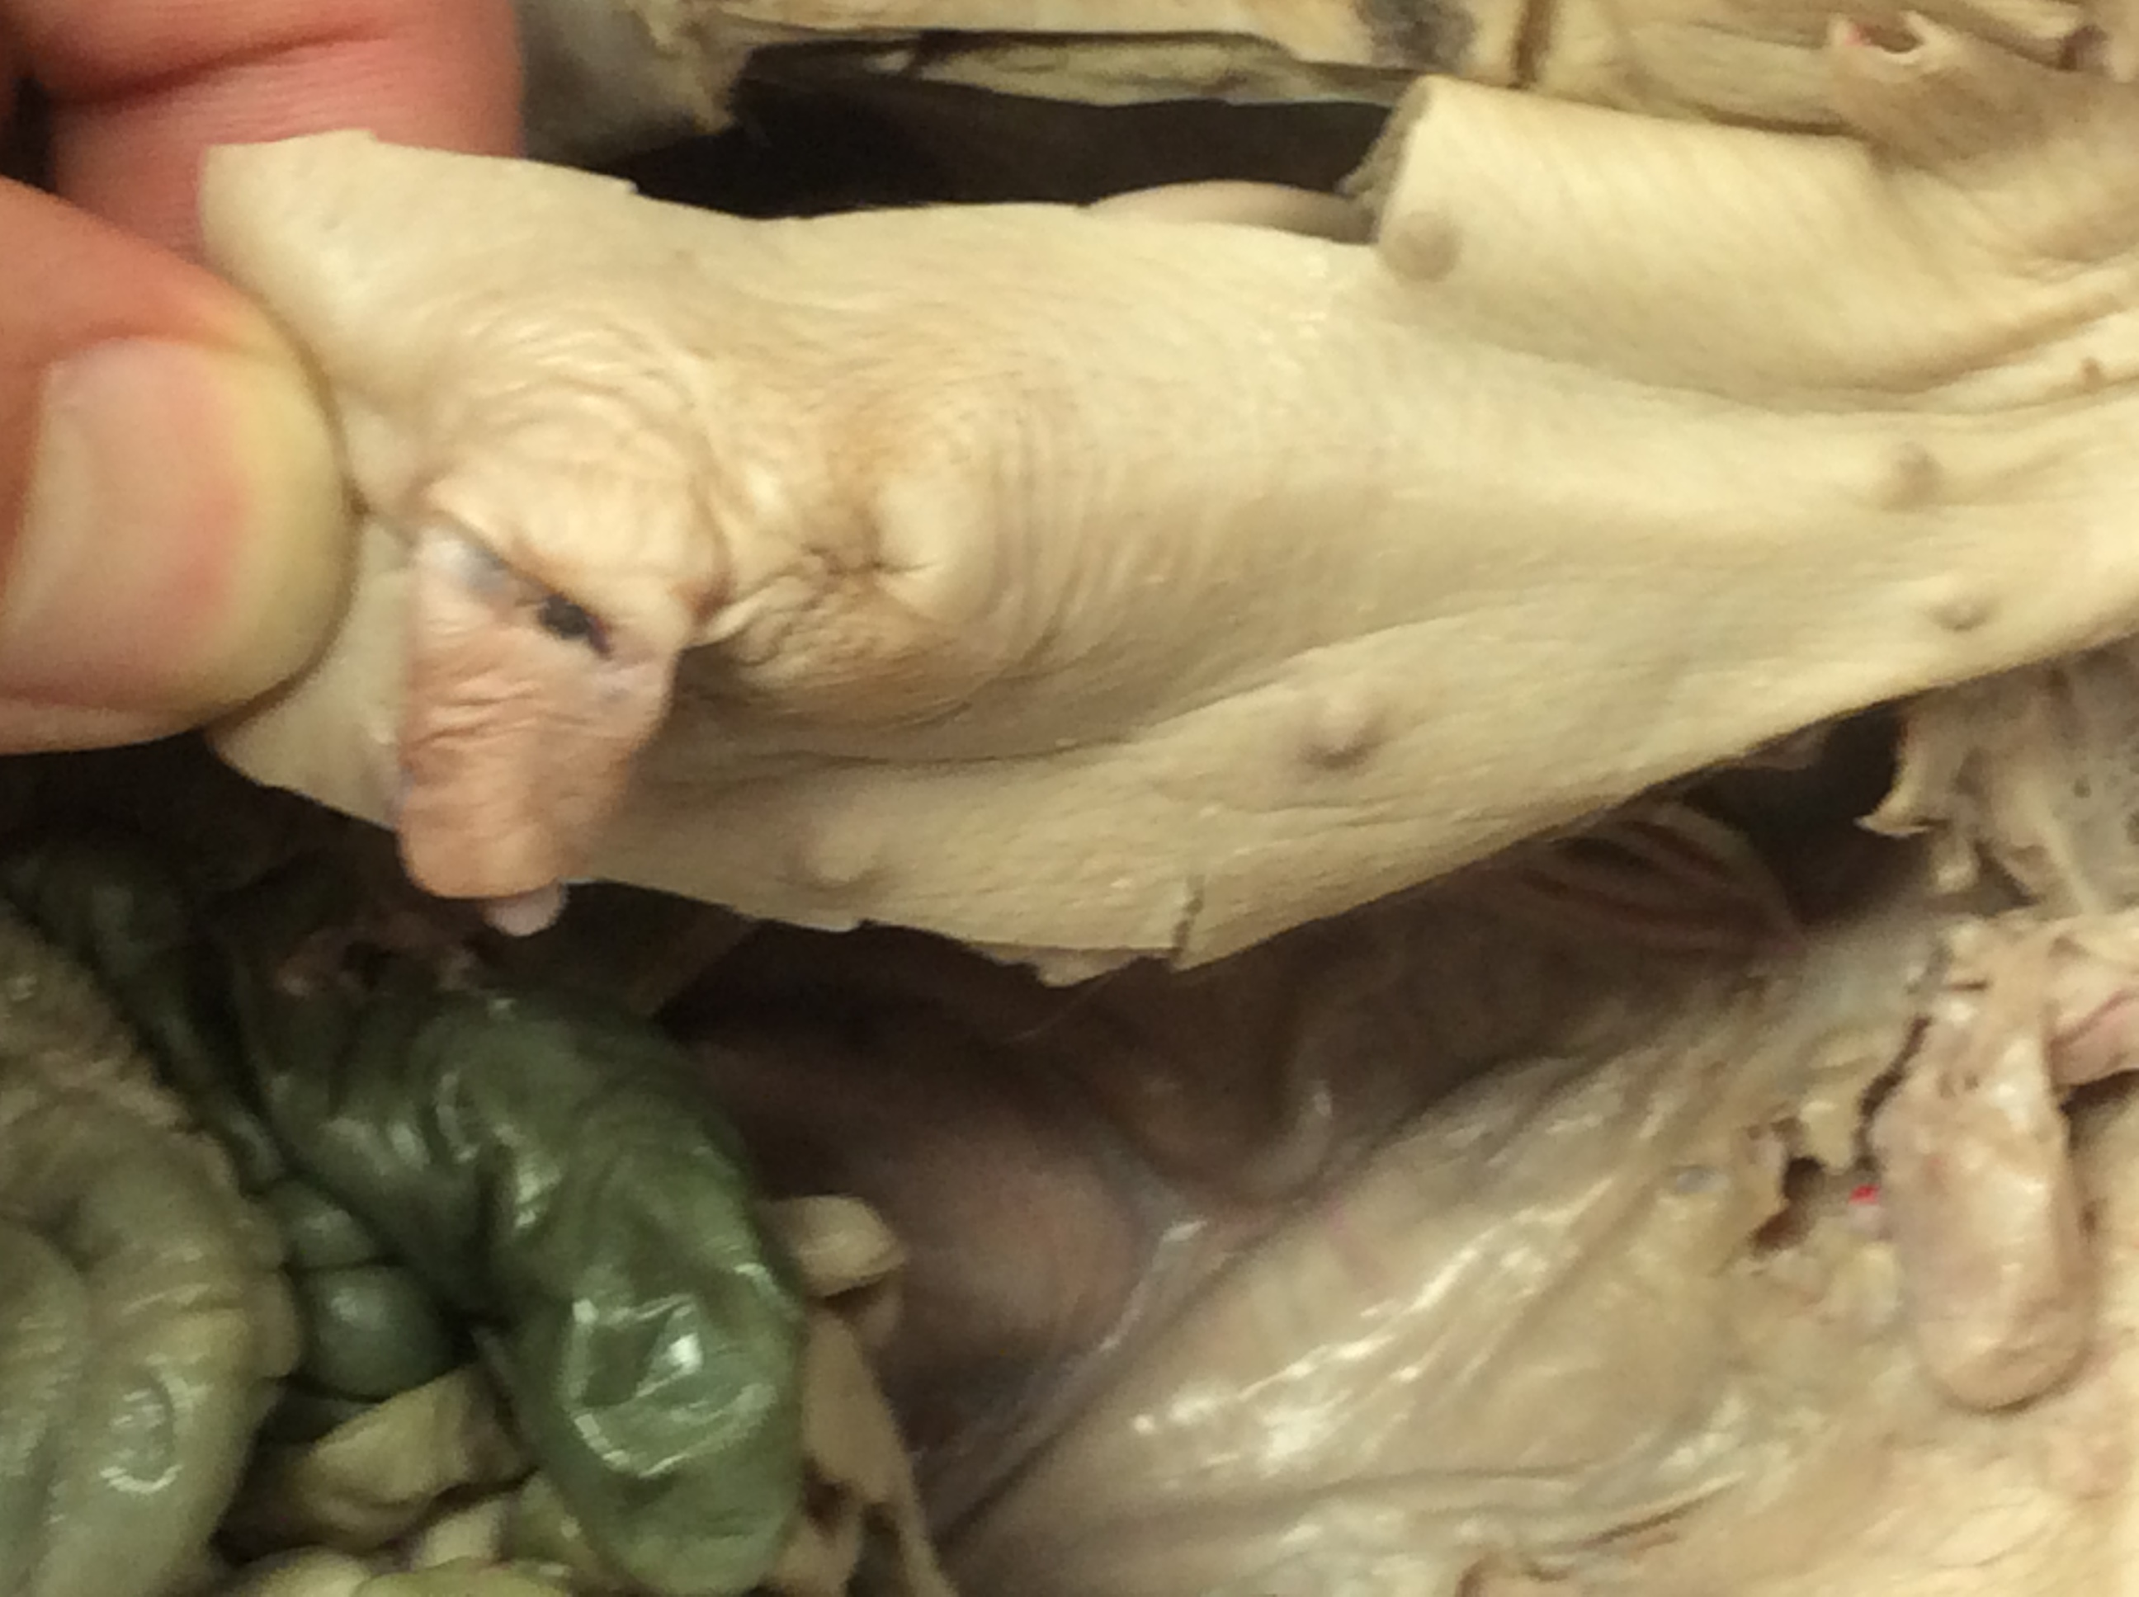
2
1
3
4. Sex or pig?

Slide 2
1. Mammillae papillae
2. Urogenital opening
3. Umbilical cord
4. Male

Slide 3
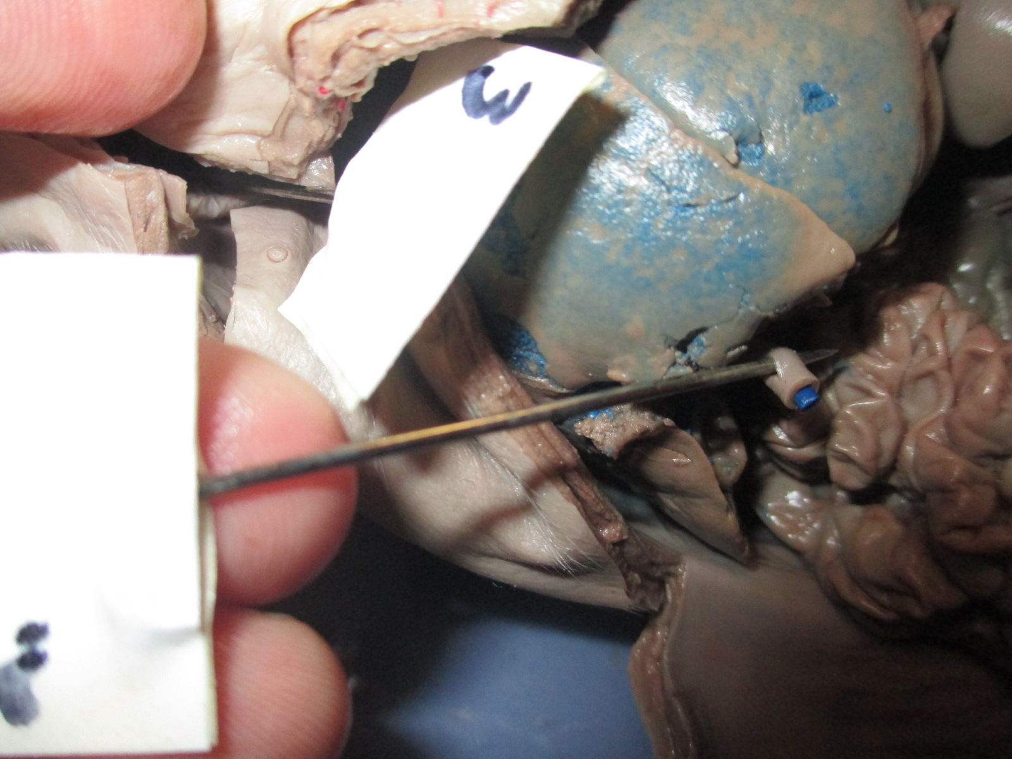
3
1
2

Slide 4
1. Umbilical vein
2. Peritoneum
3. Liver

Slide 5
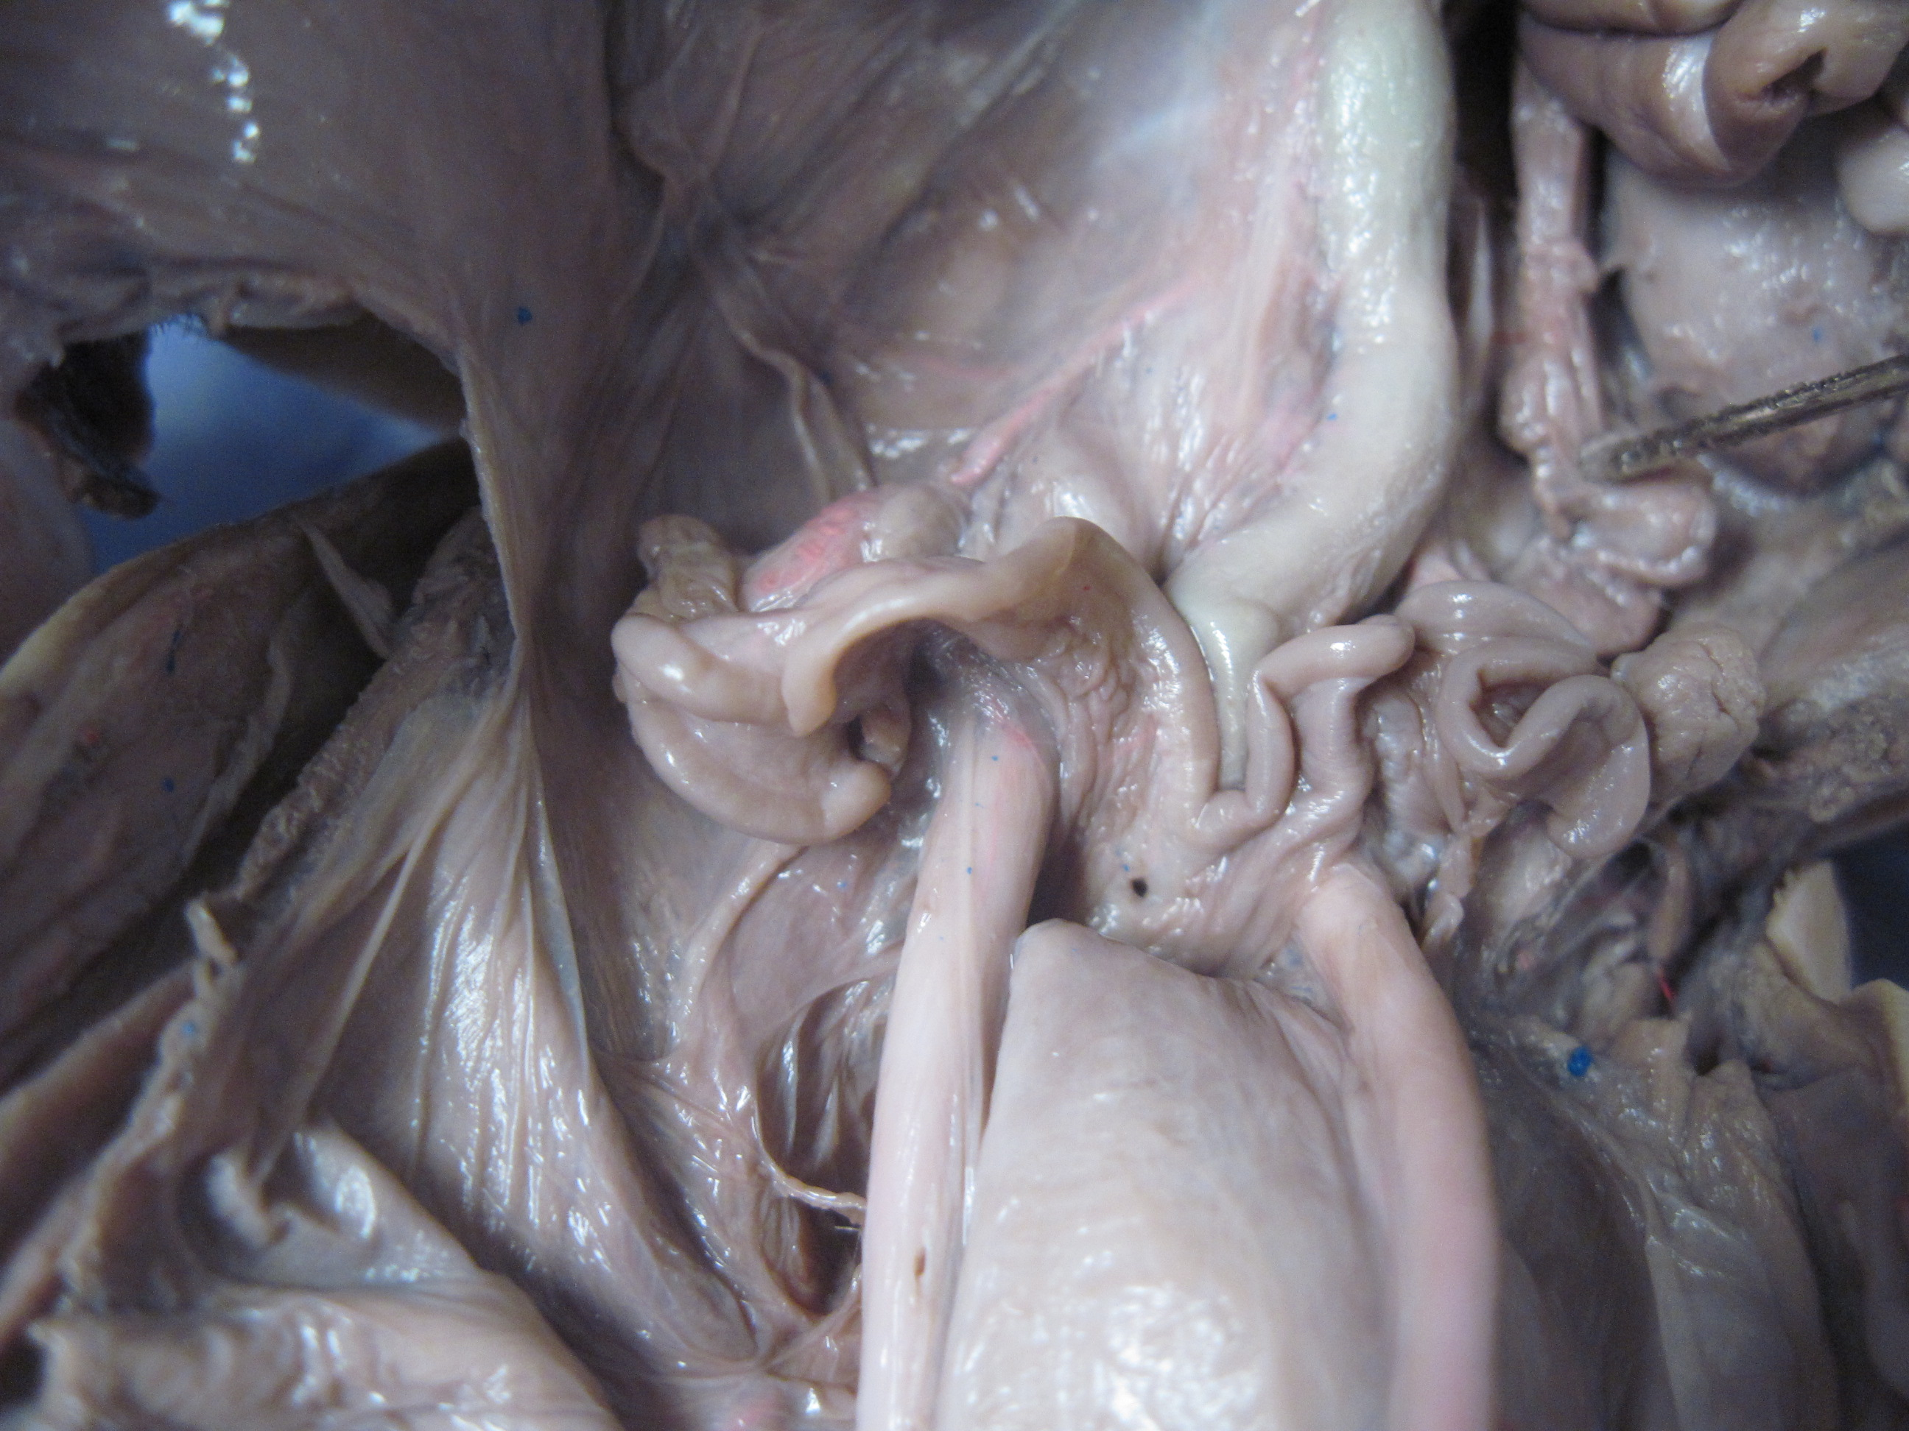
1
2
3

Slide 6
1. Ovary
2. Fallopian (uterine) tube
3. Uterus

Slide 7
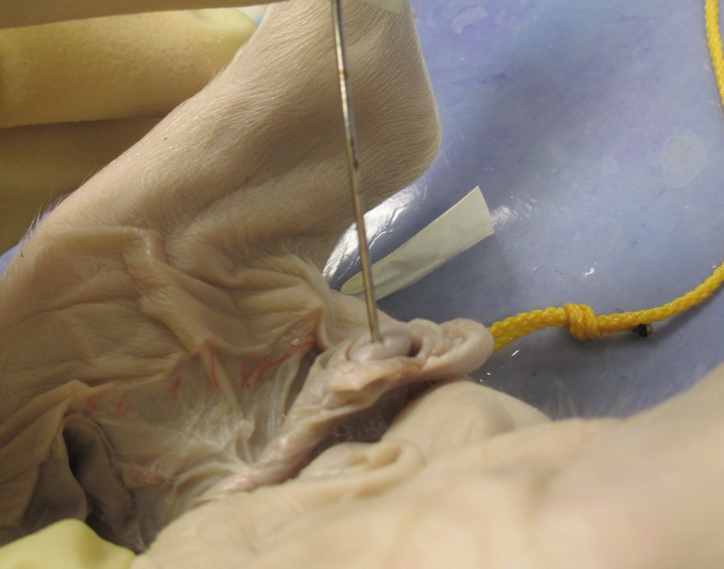
1
2
3

Slide 8
1. Testis
2. Epididymus
3. Scrotum

Slide 9
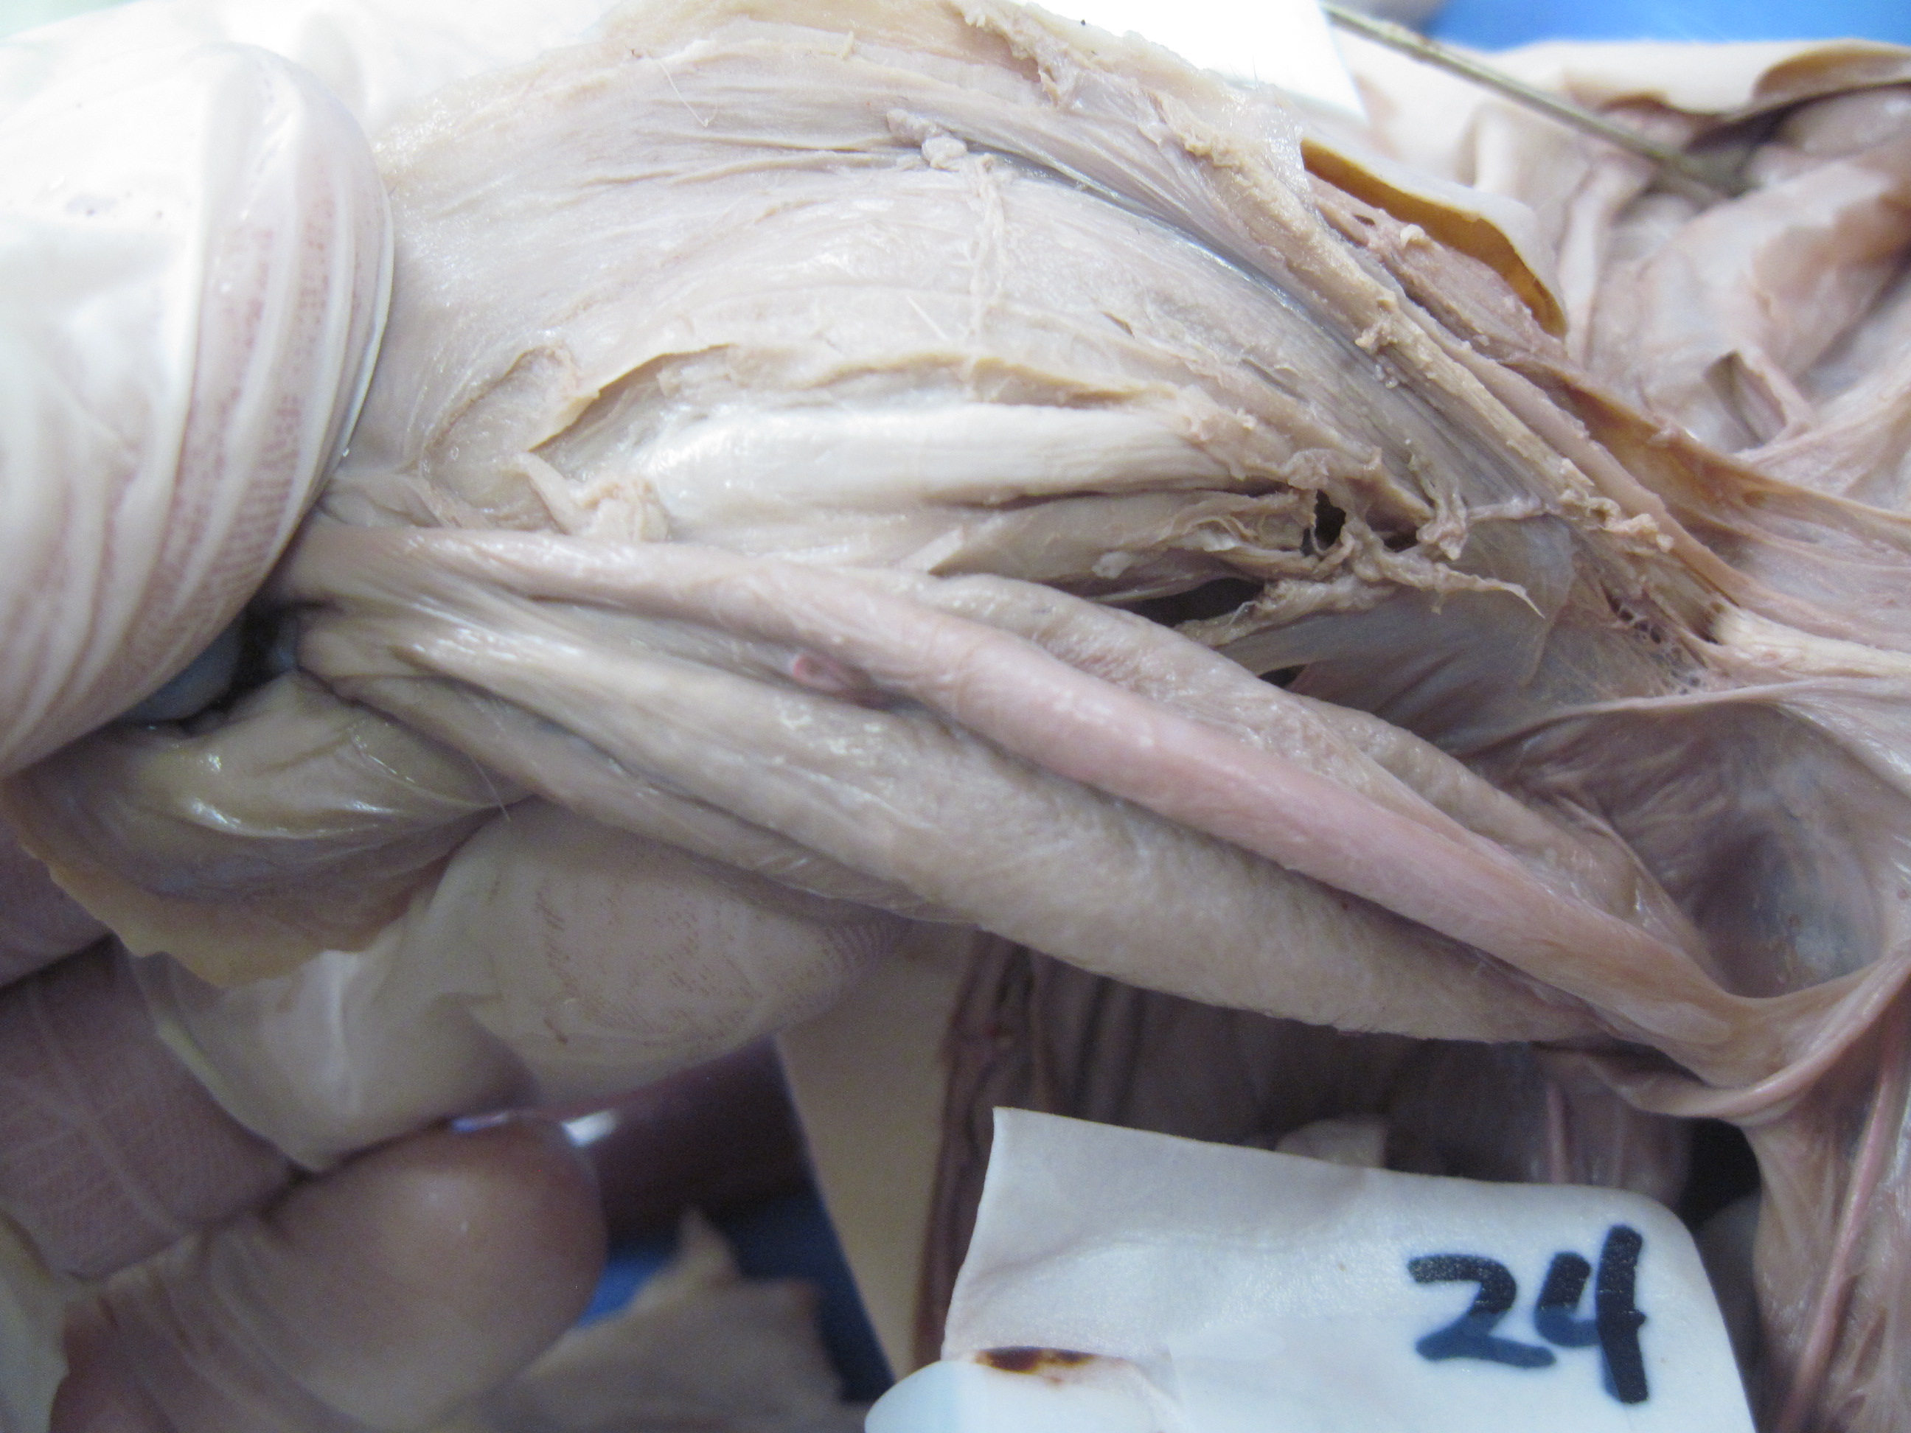
3.
2
1.

Slide 10
1. Penis
2. Umbilical artery
3. Urinary bladder

Slide 11
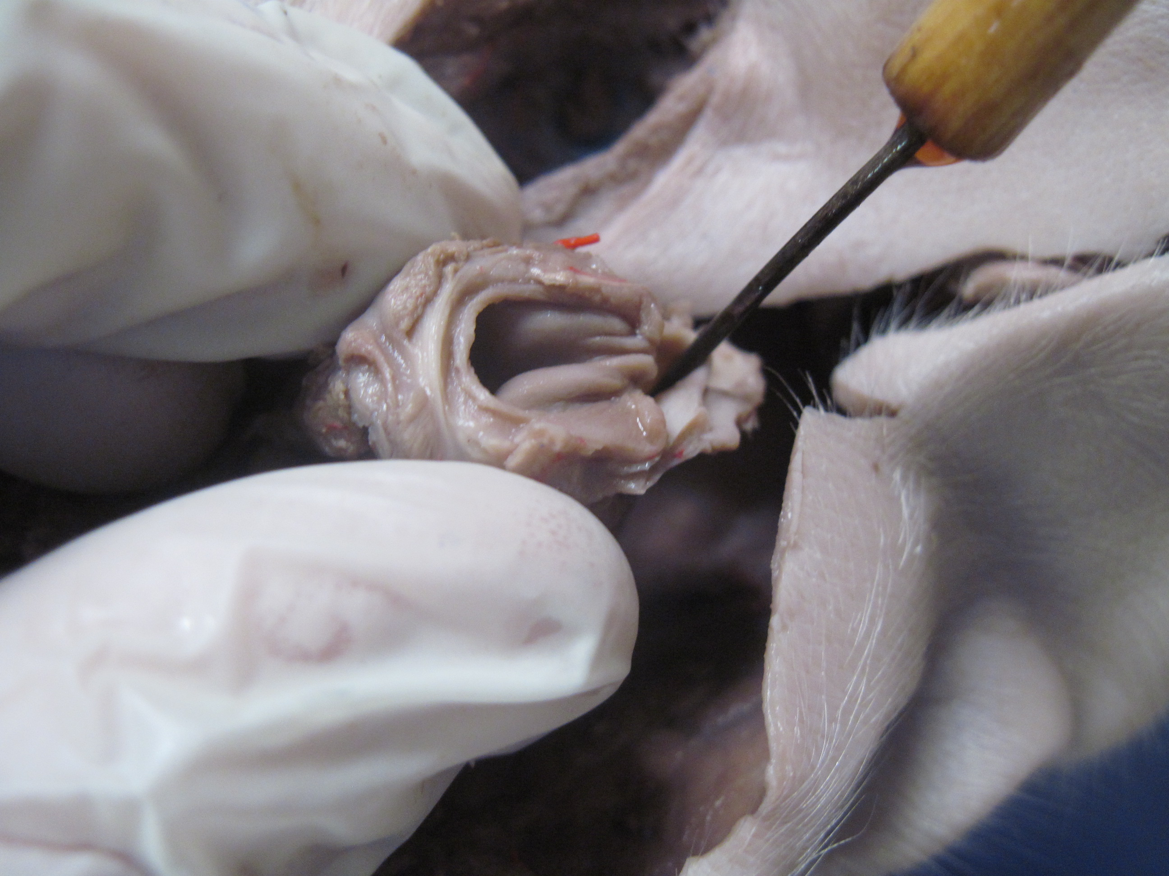
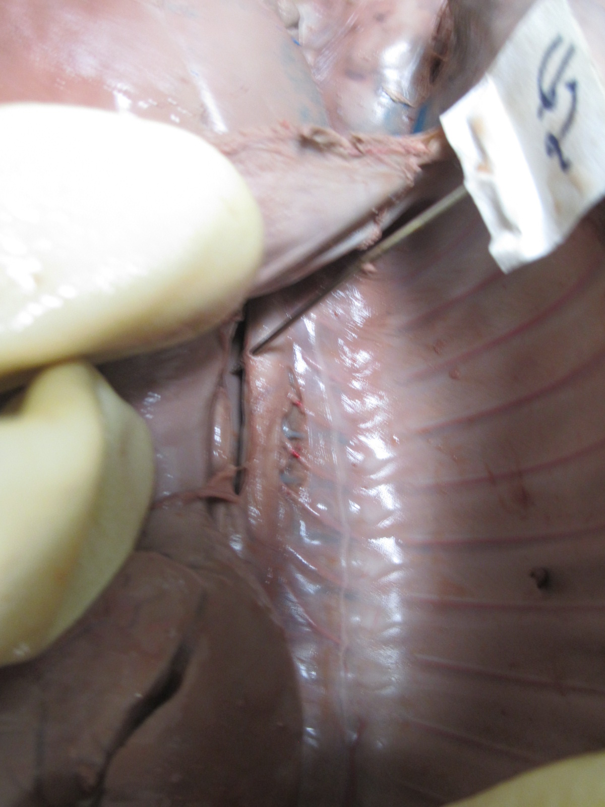
1
2
3

Slide 12
1. Vocal folds
2. Esophagus
3. Dorsal aorta

Slide 13
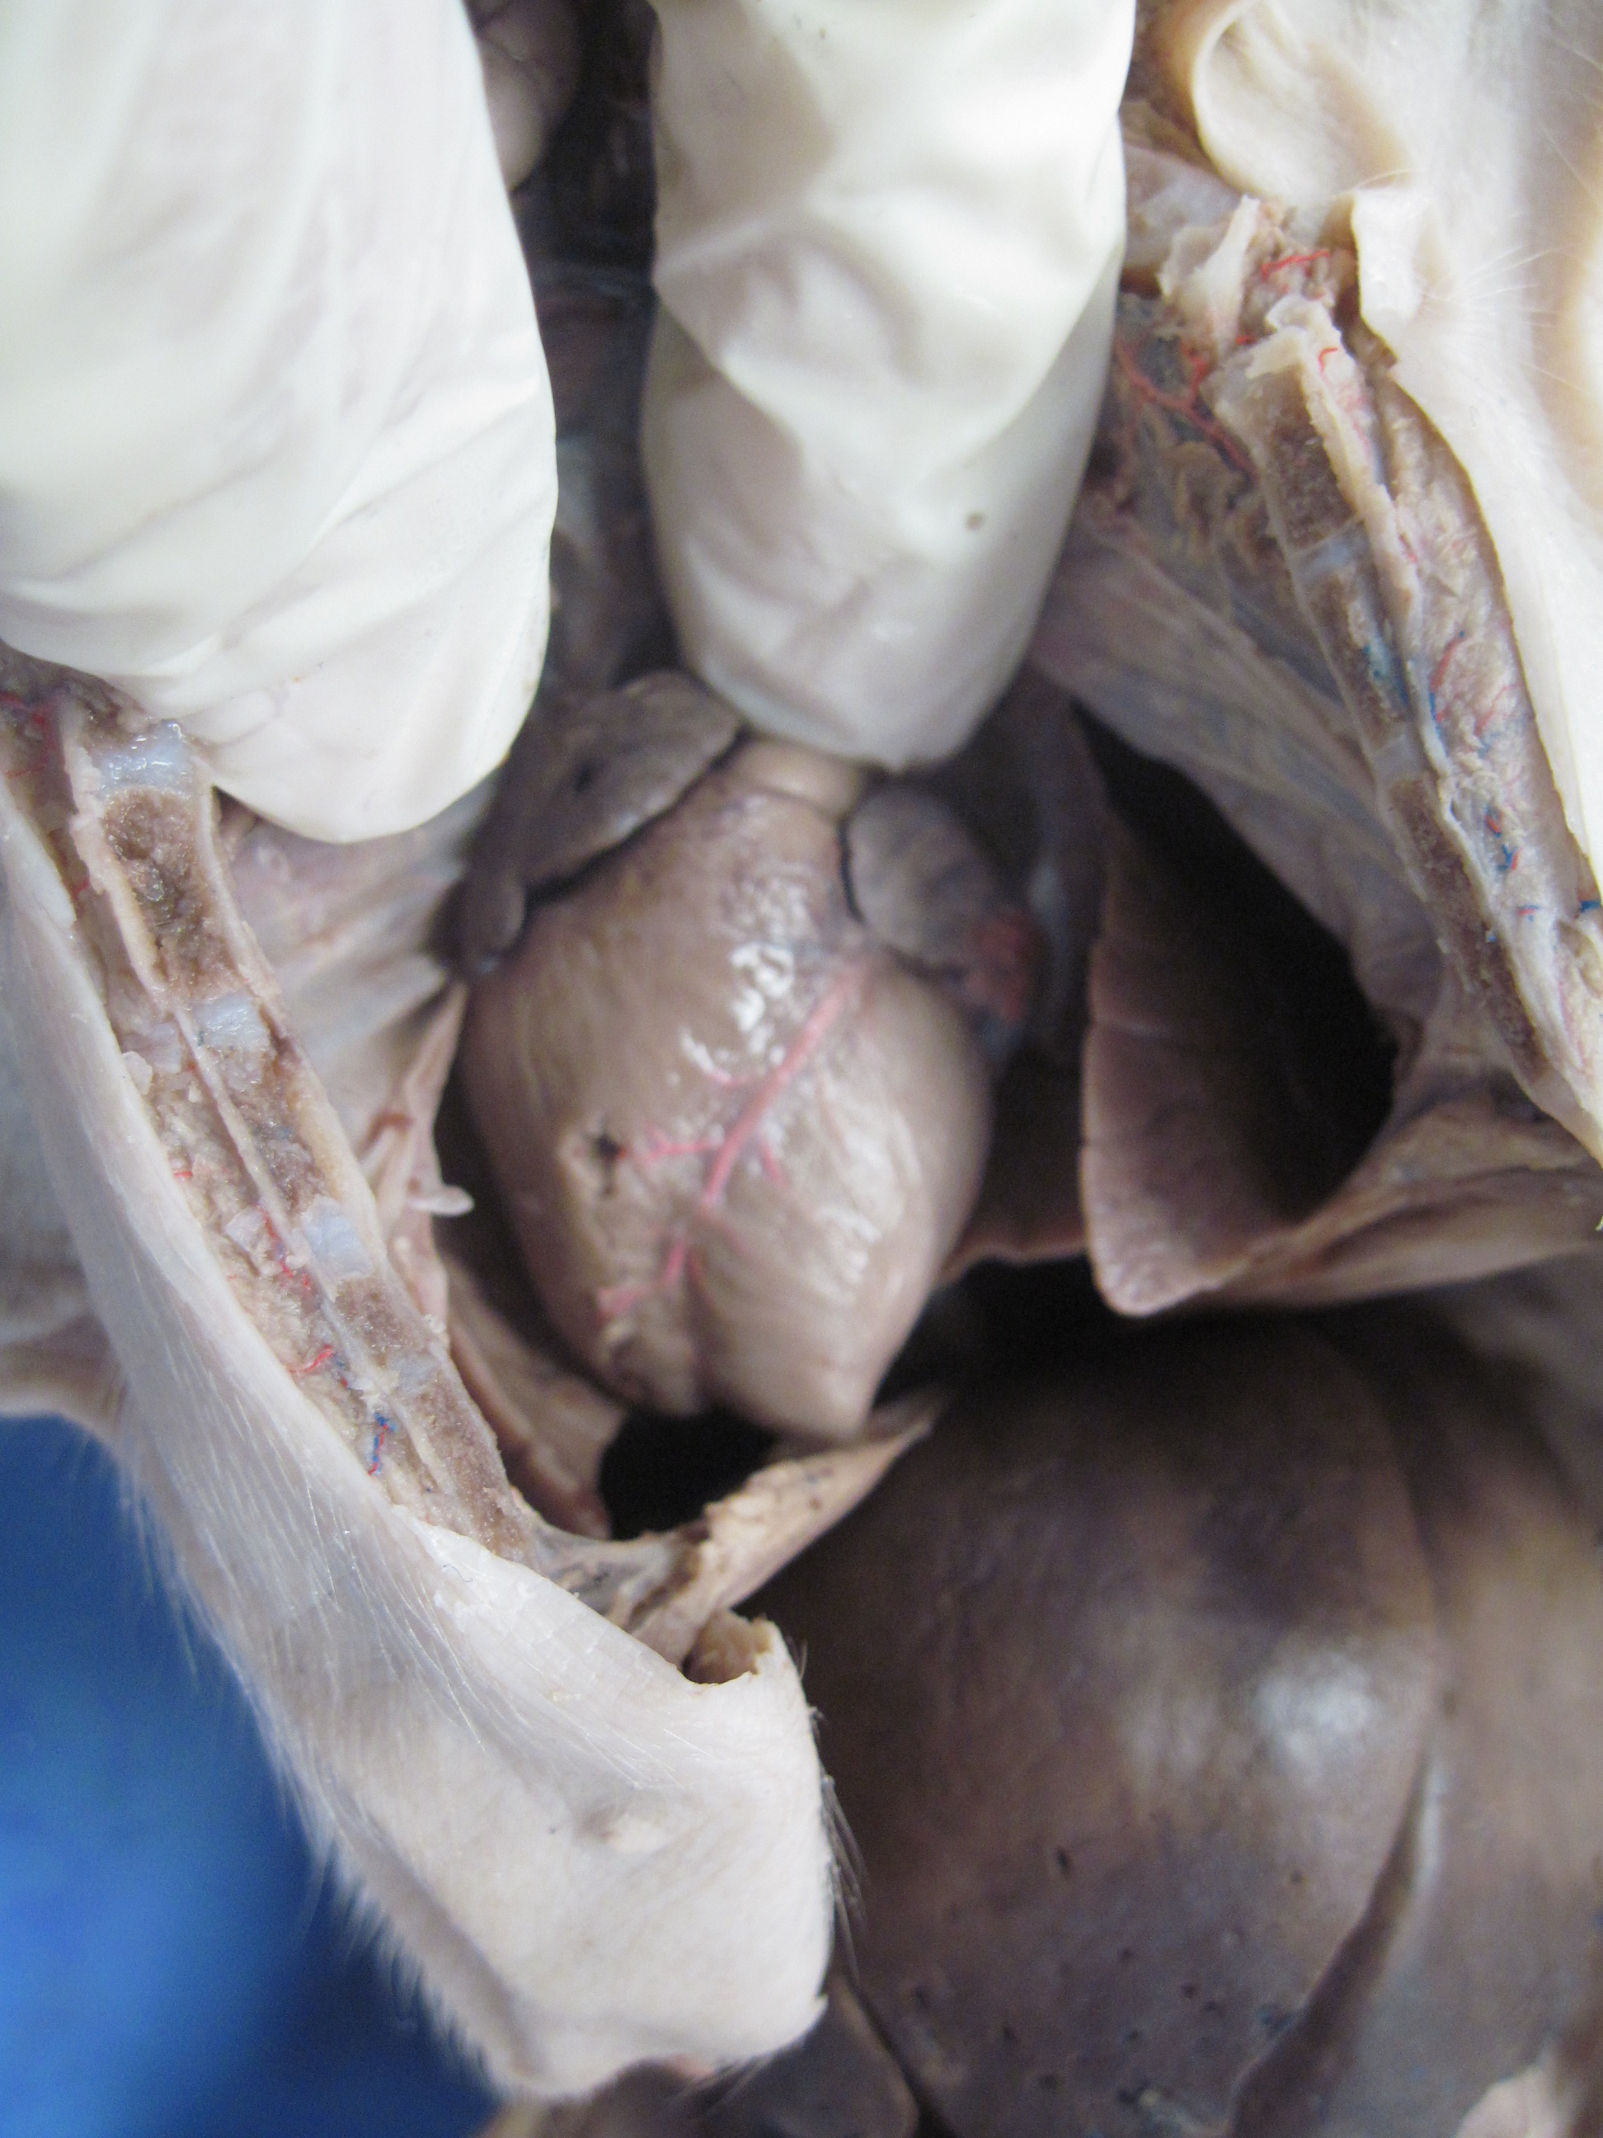
1
2
3
4

Slide 14
1. Right atrium
2. Left atrium
3. Right ventricle
4. Left ventricle

Slide 15
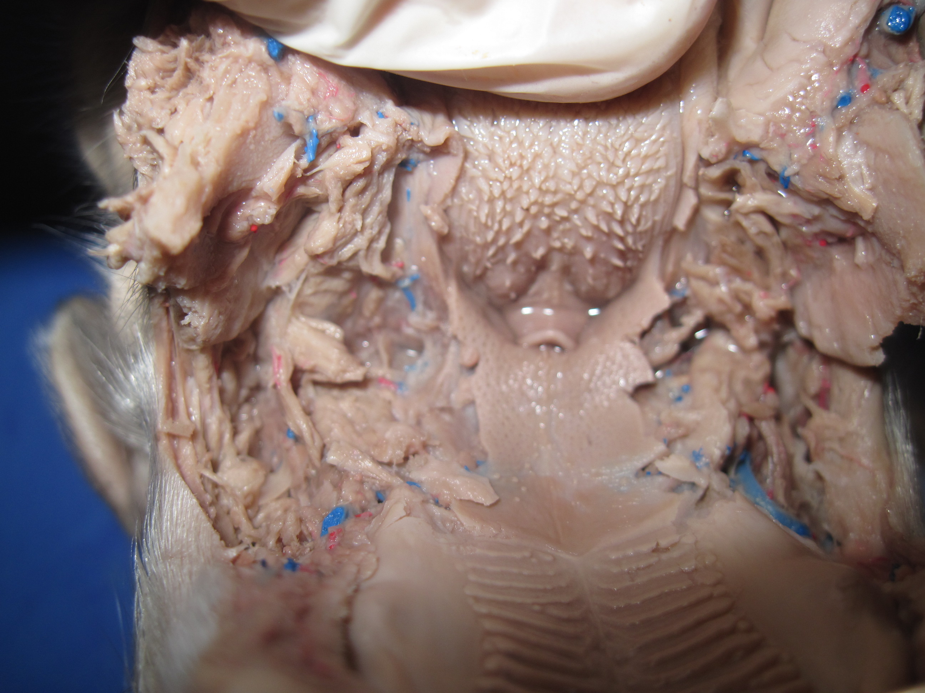
4
1
2
3

Slide 16
1. Soft palate
2. Epiglottis
3. Papillae on tongue
4. Hard palate

Slide 17
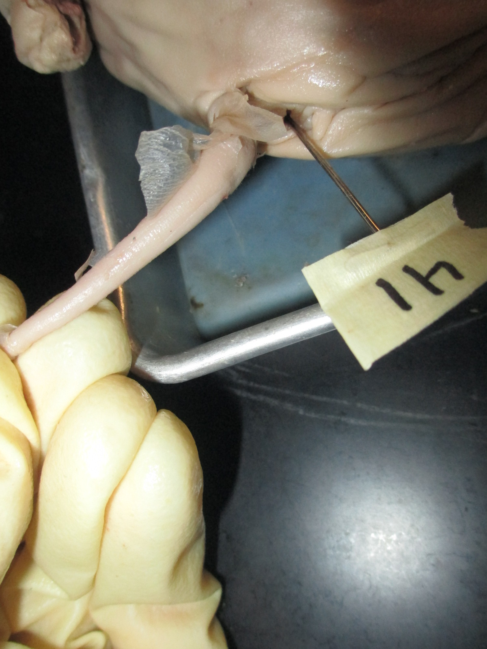
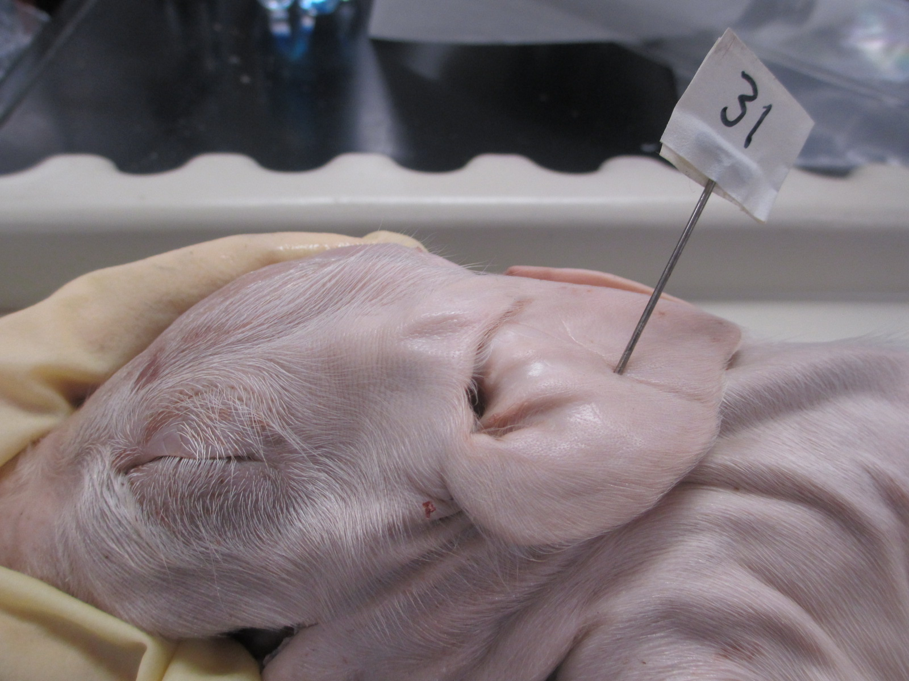
4
3
2
1

Slide 18
1. External pinnae
2. Eyelid
3. Tail
4. Anus

