Slide 1
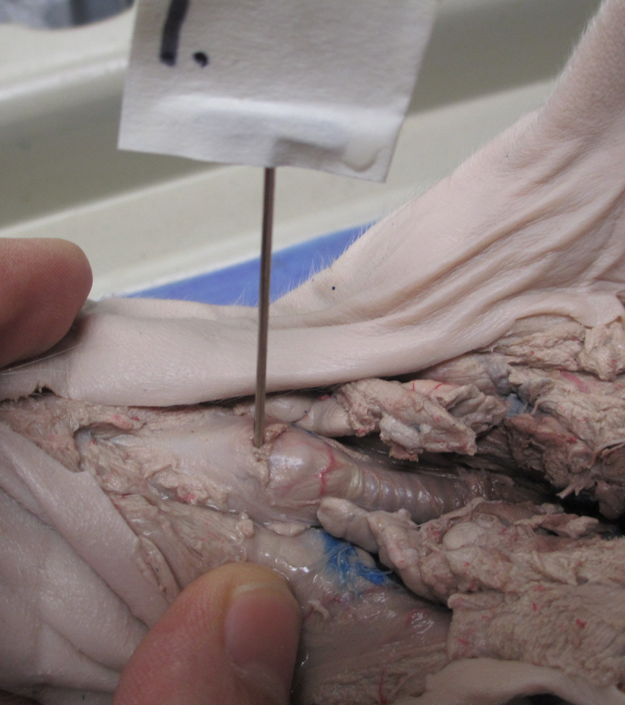
2
1
3

Slide 2
1. Trachea
2. Larynx
3. Thymus gland

Slide 3
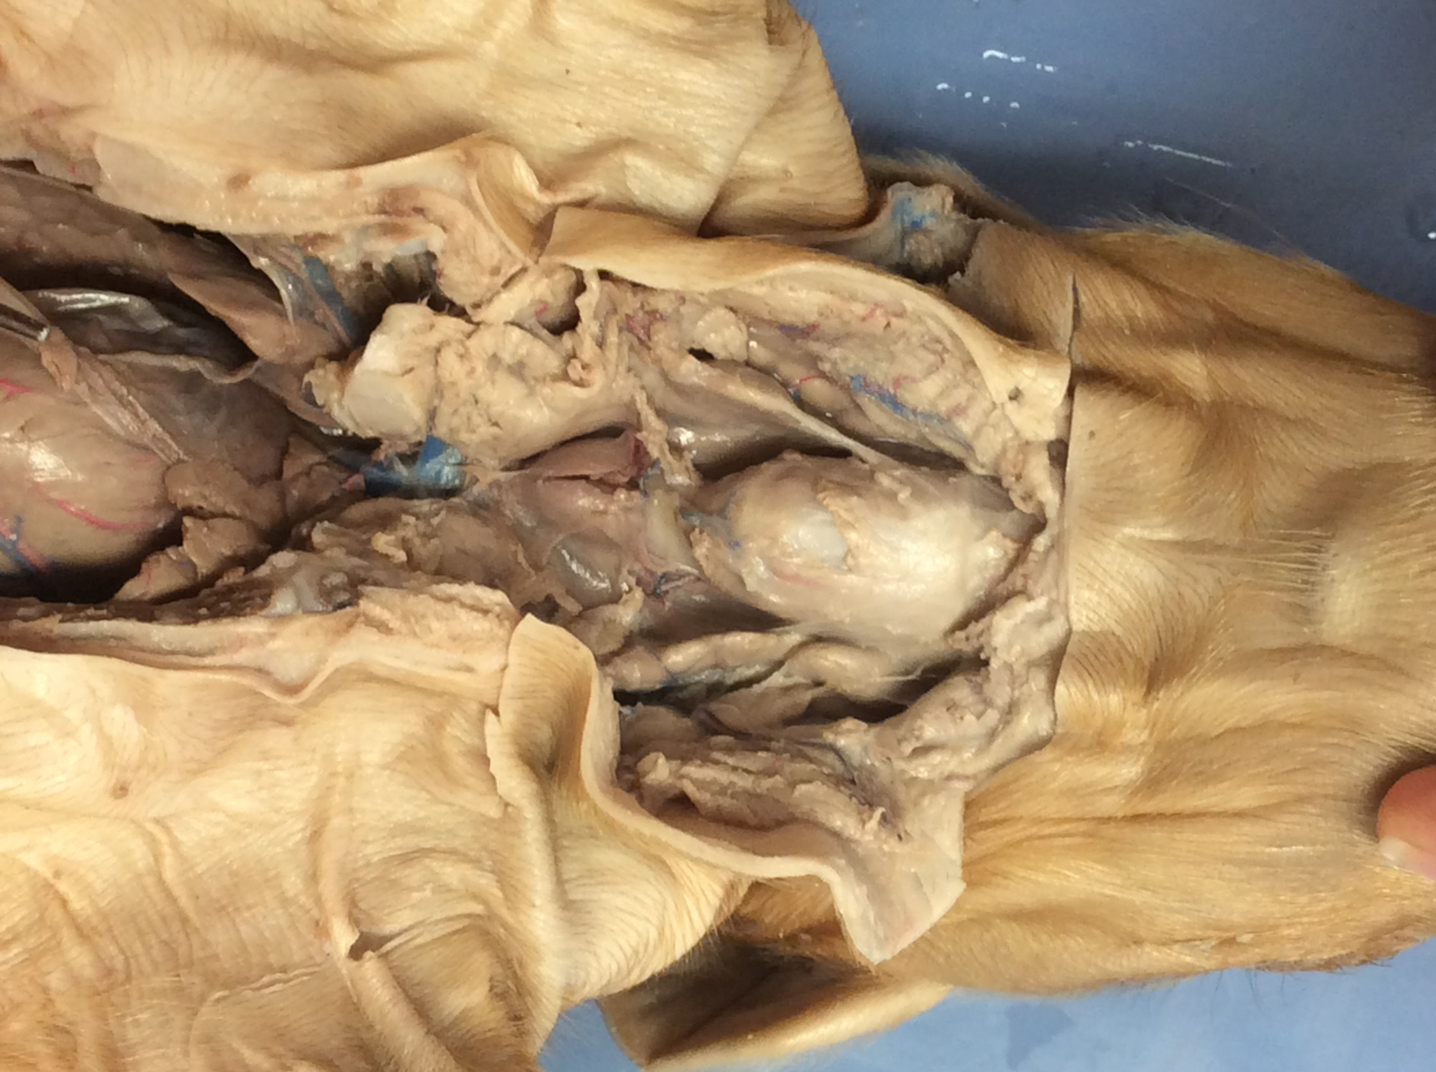
2
3
1
4

Slide 4
1. Larynx
2. Salivary gland
3. Thymus gland
4. Thyroid gland

Slide 5
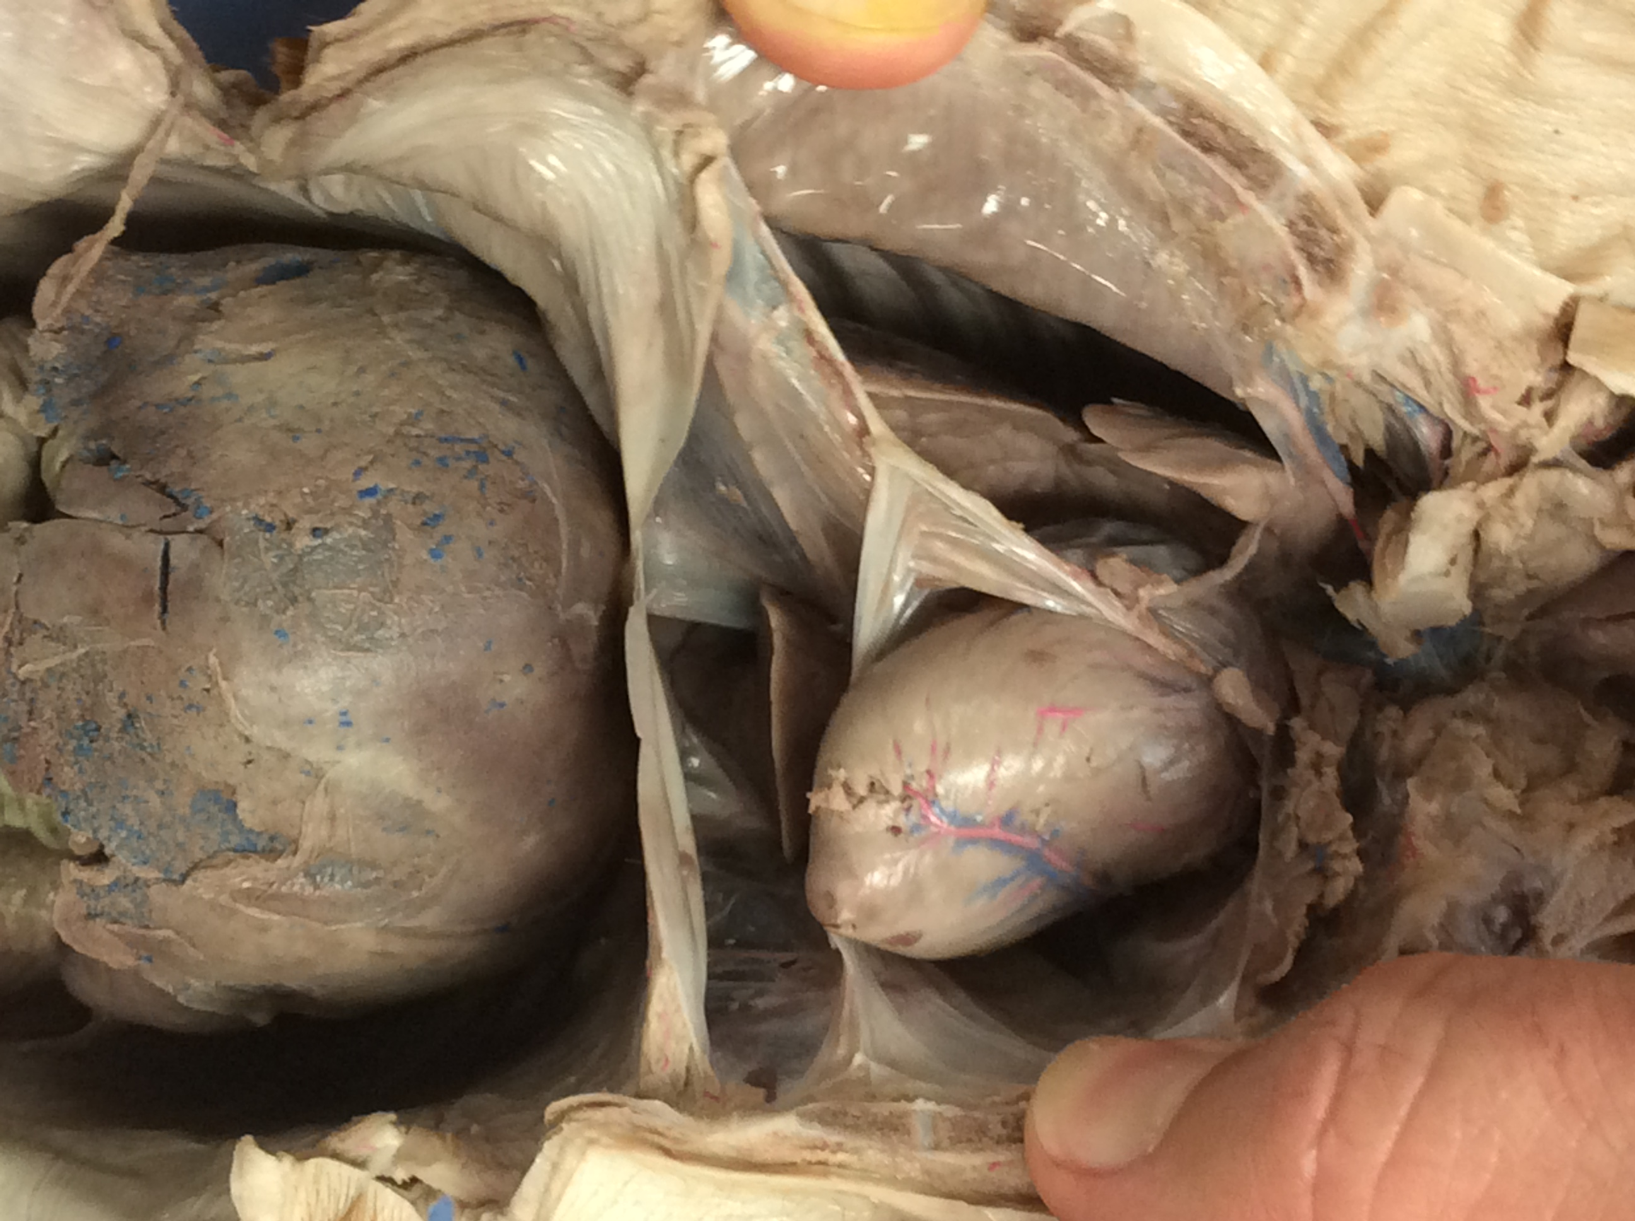
5
2
6
3
tube
4
7
1

Slide 6
1. Pleura
2. Coronary artery
3. Esophagus
4. Pericardium
5. (Left) ventricle
6. Liver
7. Diaphragm

Slide 7
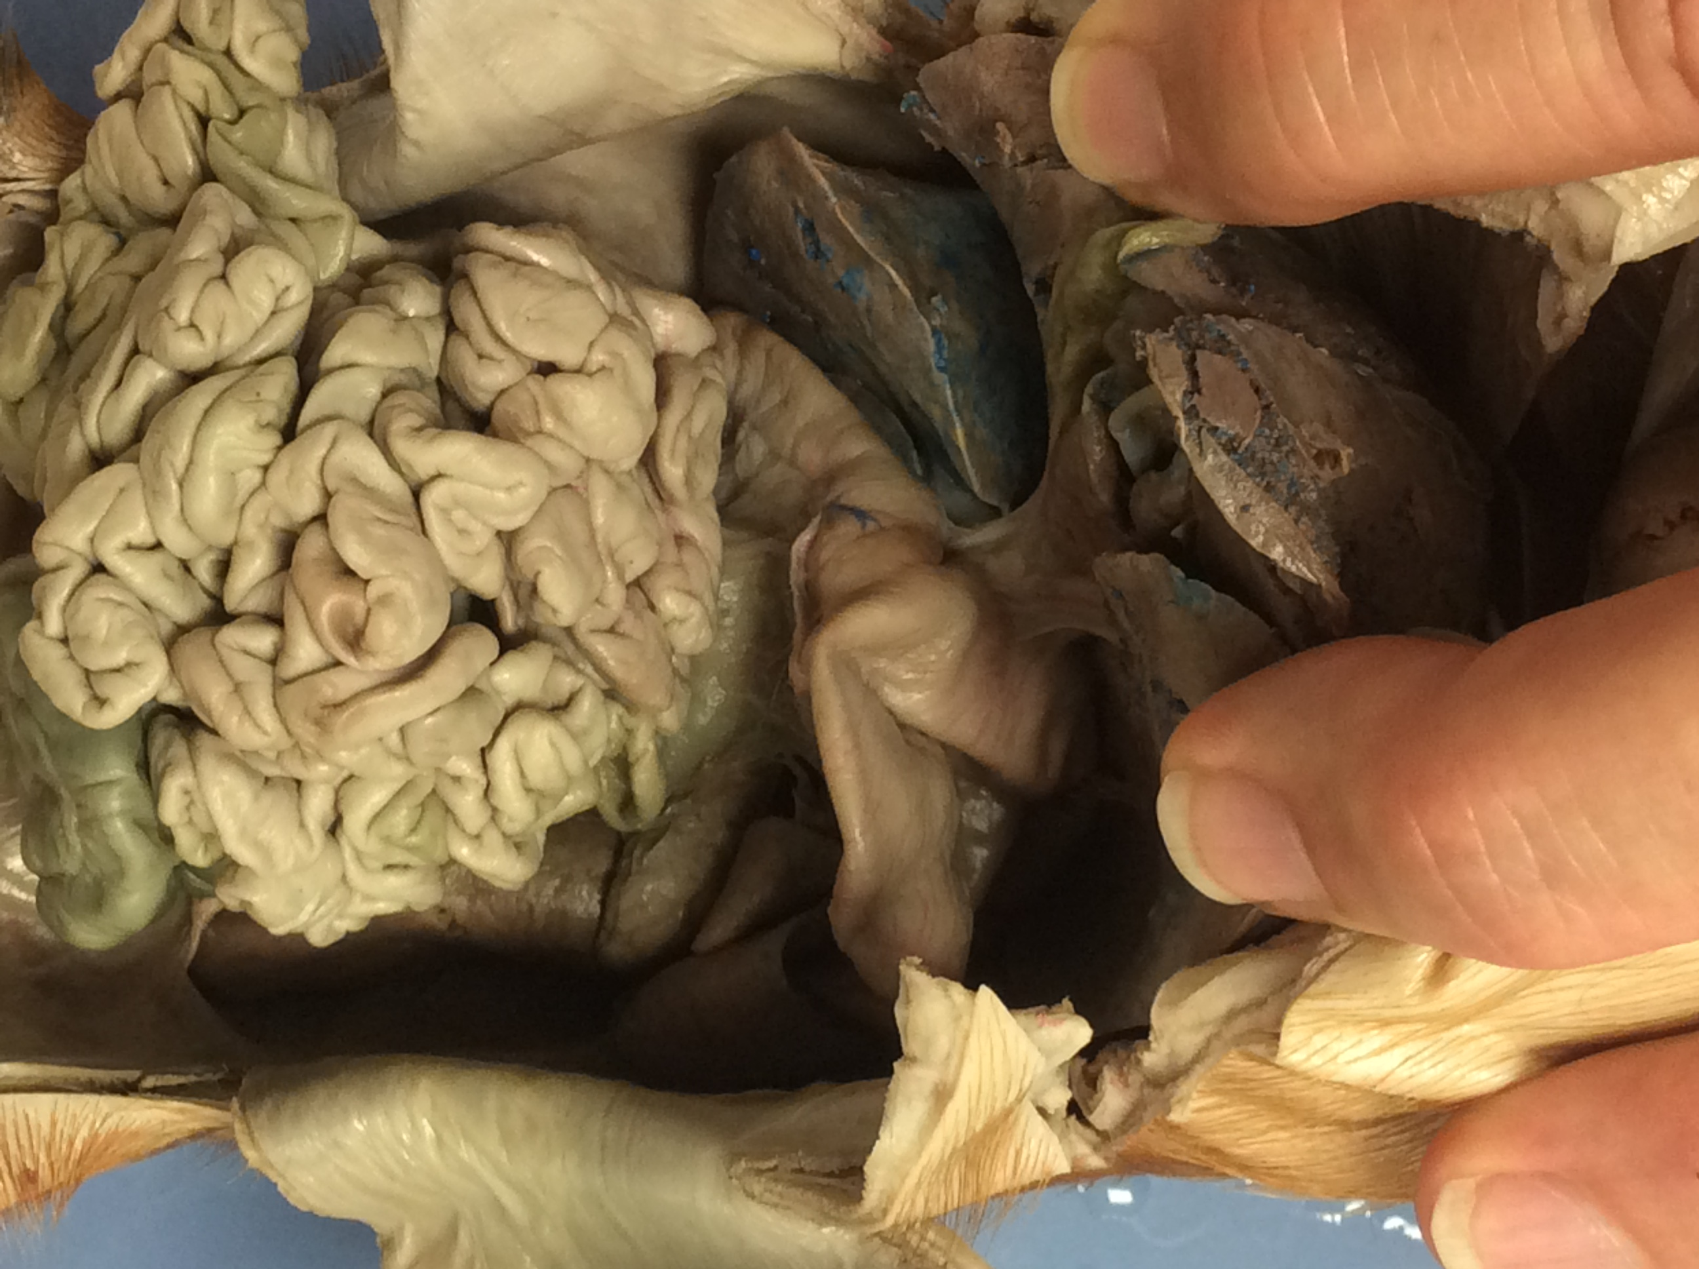
6
5
4
3
7
1
2

Slide 8
1. Ileum/jejunum
2. Liver
3. Gall bladder
4. Bile duct
5. Pyloric sphincter
6. Stomach
7. Duodenum

Slide 9
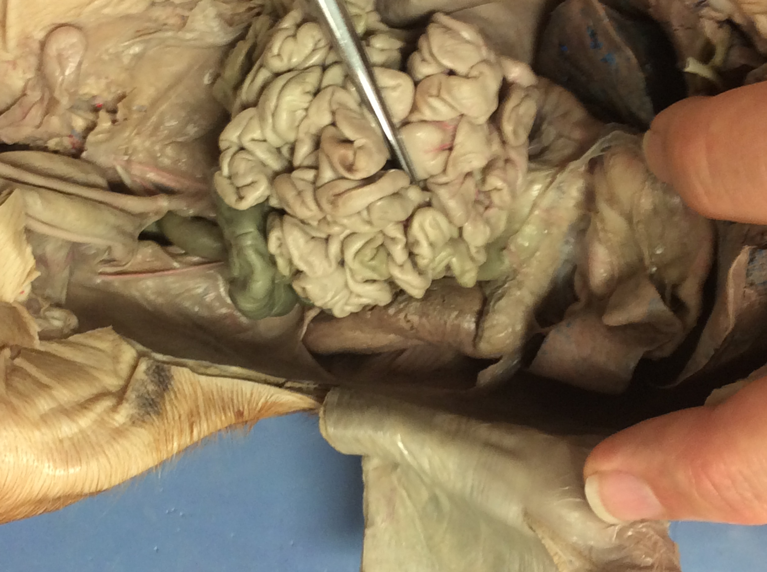
6. Male or female?
4
3
5
1
2

Slide 10
1. Urinary bladder
2. Umbilical arteries
3. Pancreas
4. Spleen
5. Rectum

Slide 11
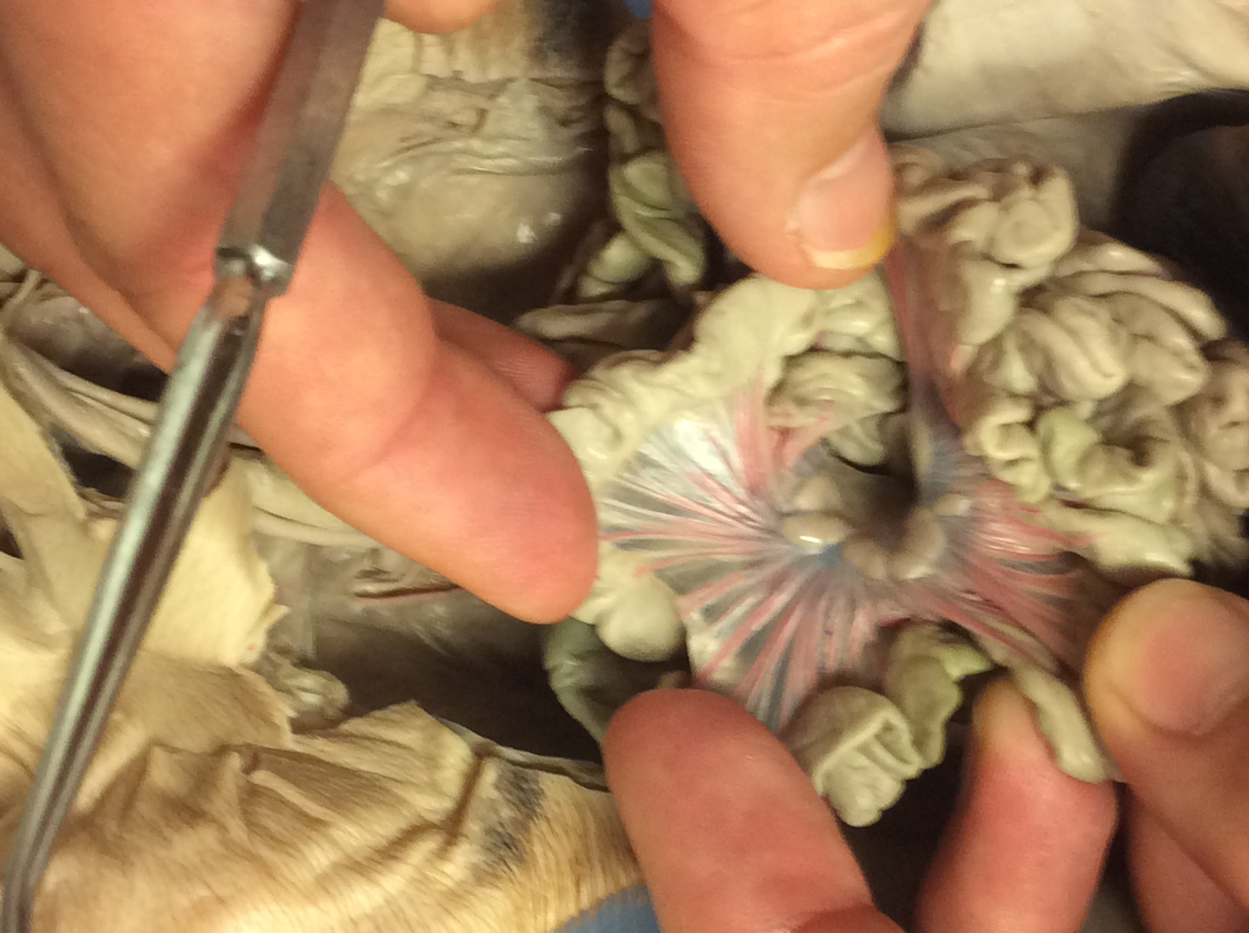
2
3. vessels
1

Slide 12
1. Ileum/jejunum
2. Mesentery
3. Mesenteric
arteries/veins

Slide 13
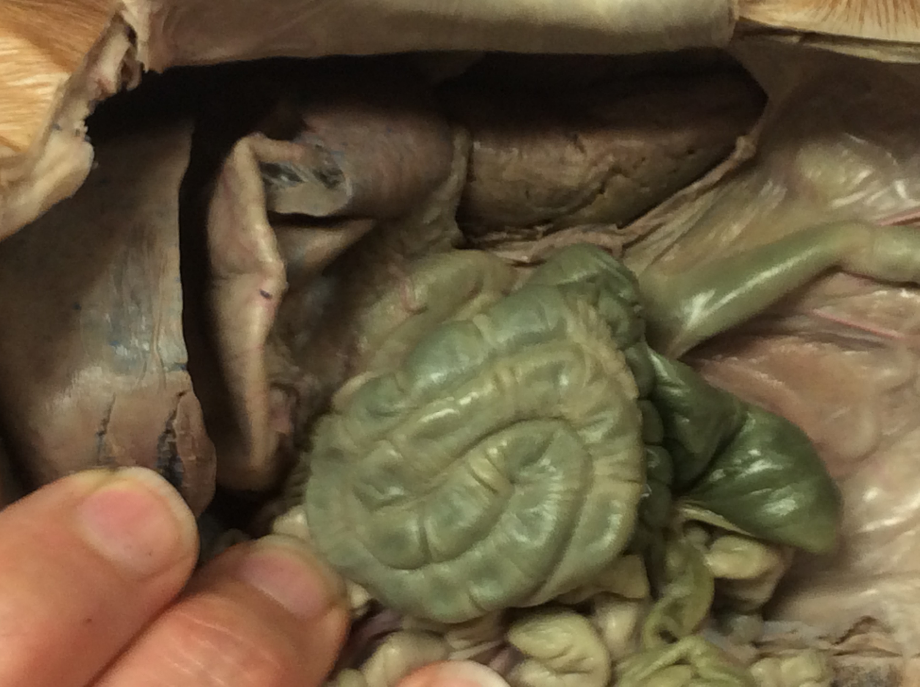
6
3
5
4
1
2

Slide 14
1. Colon
2. Cecum
3. Rectum
4. Liver
5. Stomach
6. Spleen

Slide 15
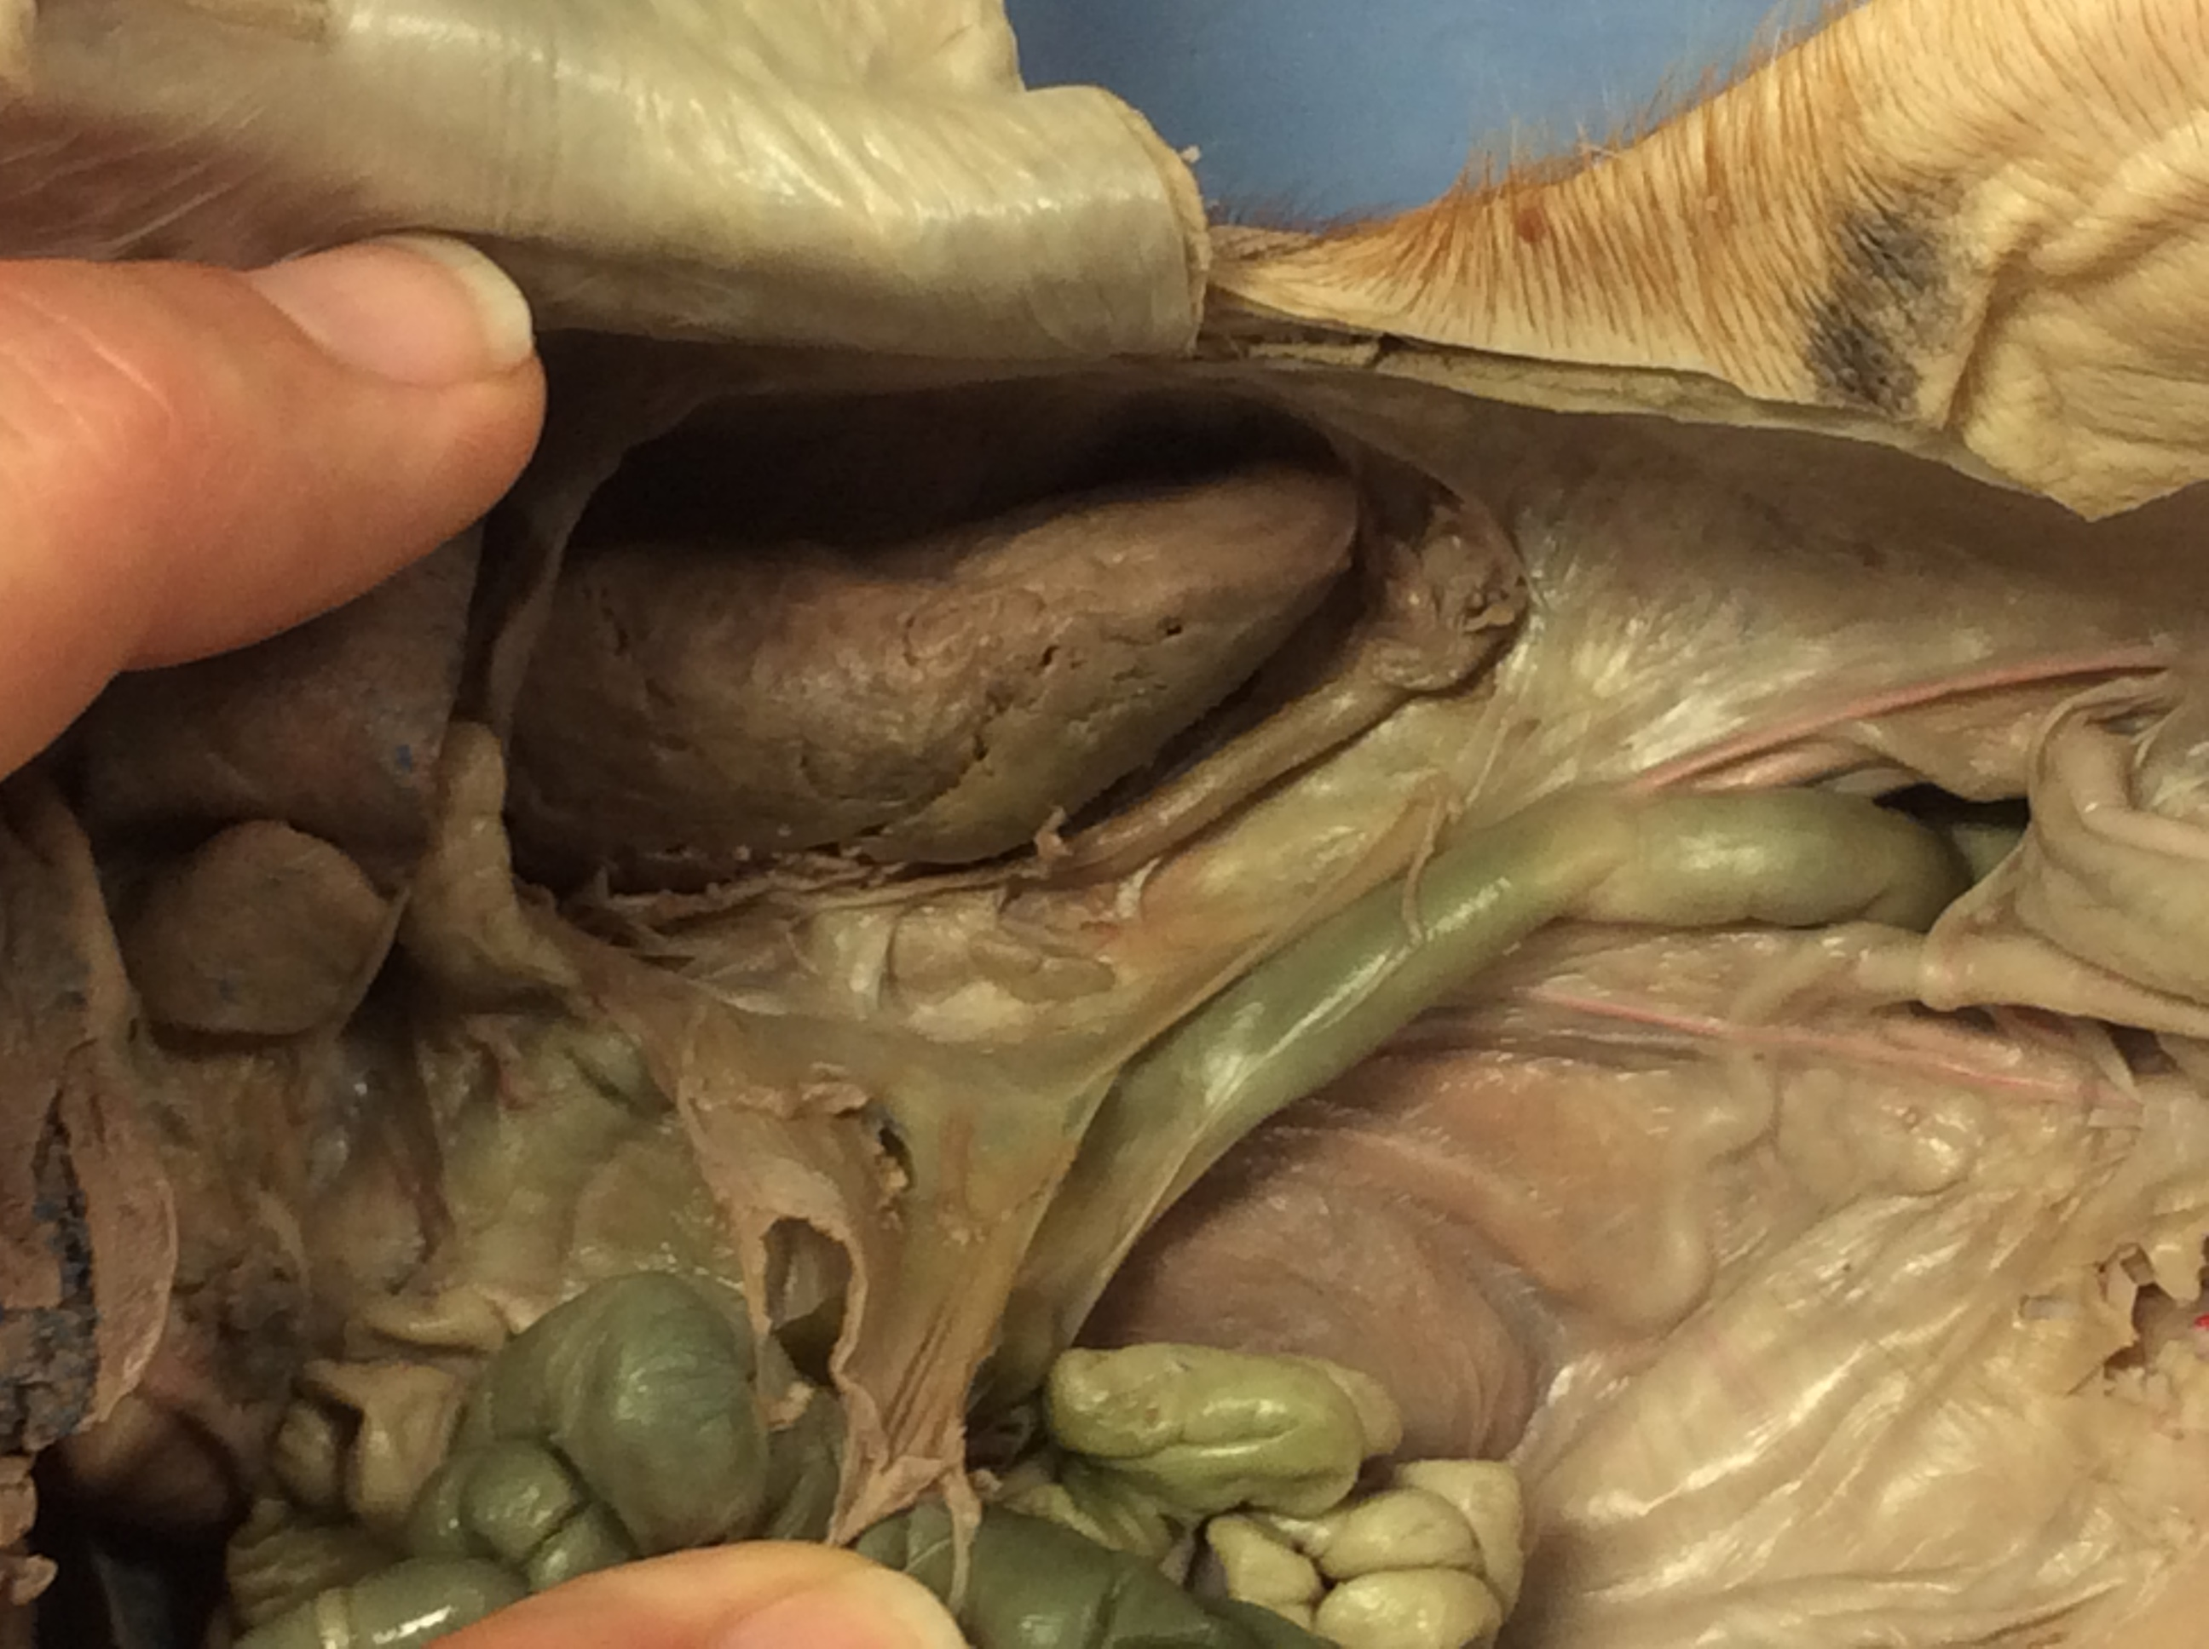
2
3
1
4
5

Slide 16
1. Urinary bladder
2. Kidney
3. Ureter
4. Renal artery/vein
5. Vas deferens

