Slide 1
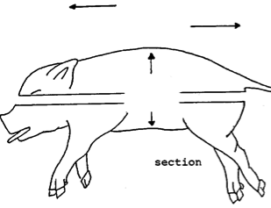
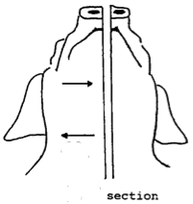
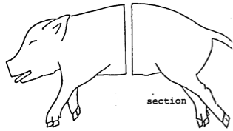
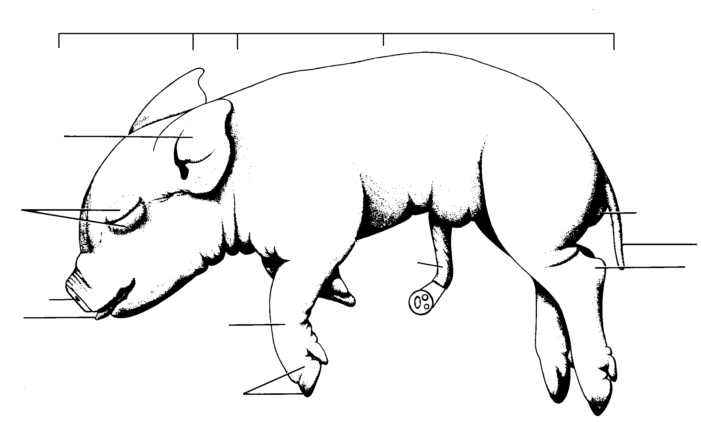
Anterior
Posterior
Superior
Dorsal
Inferior
Ventral
Medial
Transverse
Lateral
Frontal
Sagittal
Cranial
Cervical
Thoracic
Abdominopelvic
External
pinnae
Eyelid
Anus
Umbillical
Cord
Tail
Ankle
External nares
Tongue
“Wrist”
Umbillical
Vein
Toes or
hooves
Umbillical
Arteries

Slide 2
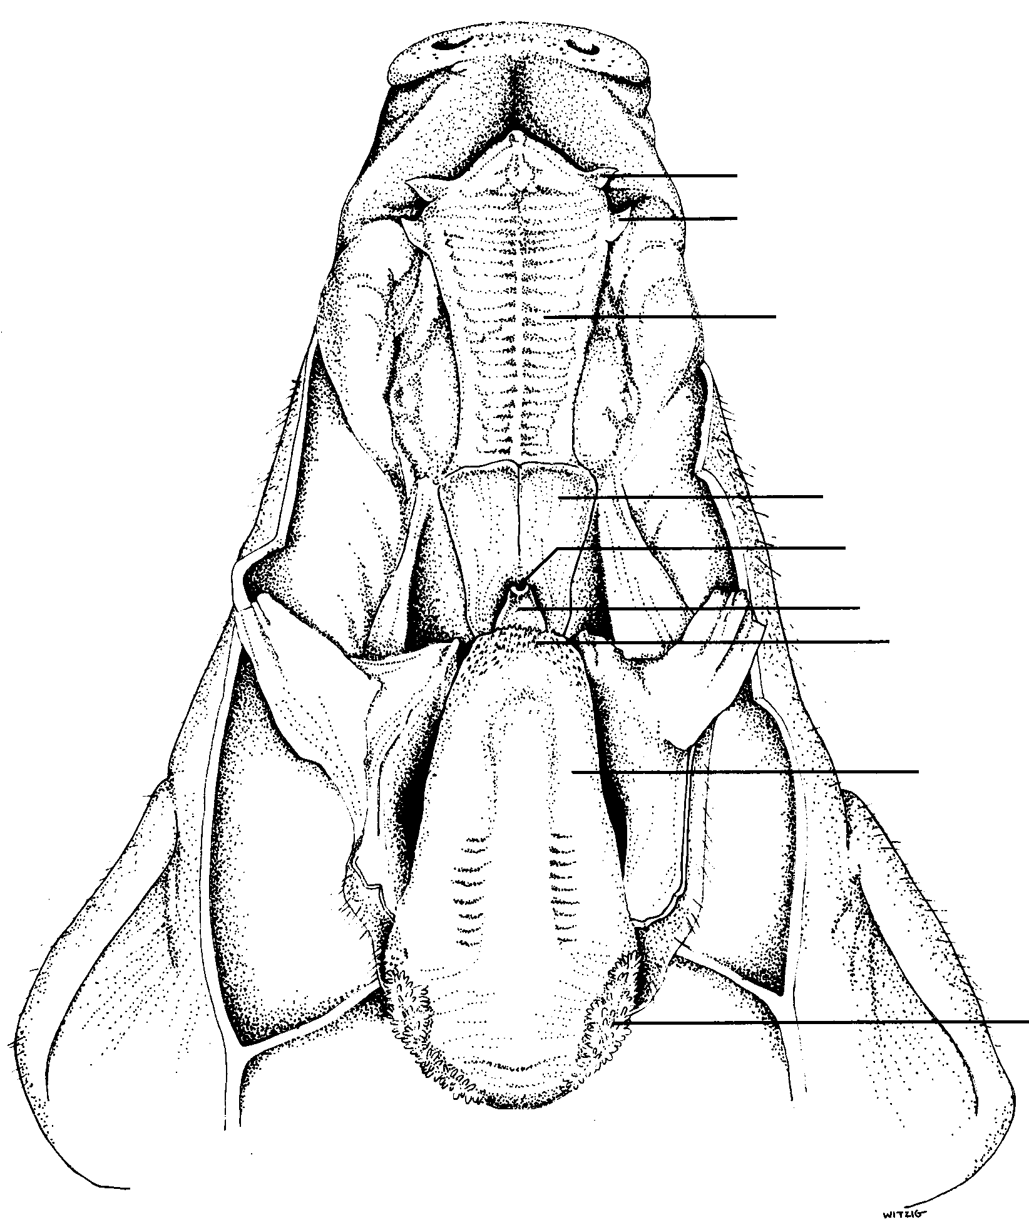
incisor
canine
Hard palate
soft palate
glottis
epiglottis
papillae (taste buds)
tongue
papillae

Slide 3
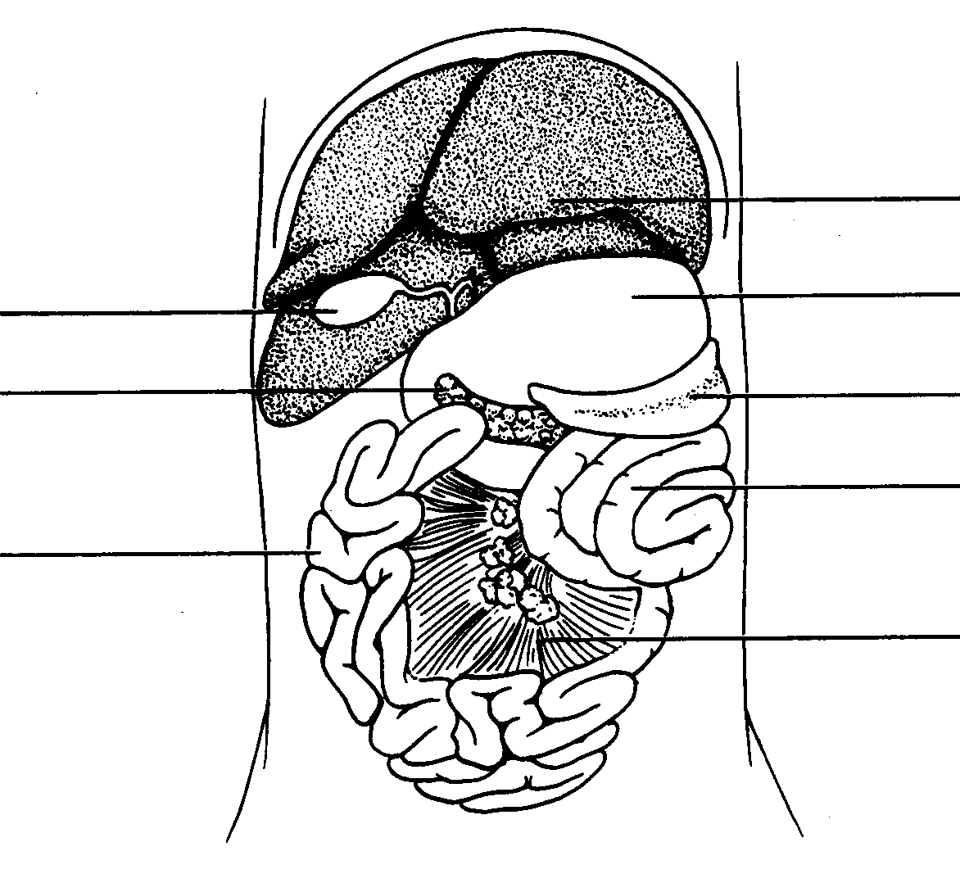
Bile duct
liver
stomach
Gall bladder
pancreas
spleen
Colon (large intestine)
Small
intestine
mesentery

Slide 4
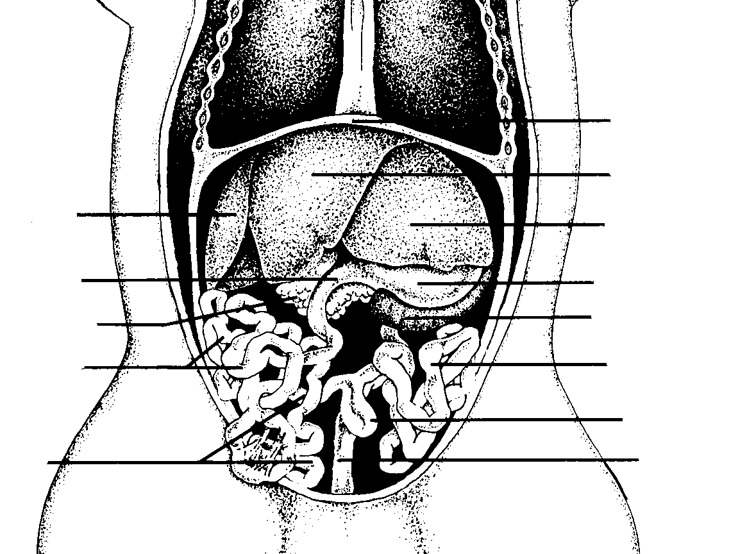
Pyloric
sphincter
esophagus
diaphragm
liver
liver
liver
duodenum
stomach
pancreas
spleen
jujenum
colon
Cecum
(appendix)
ileum
rectum

Slide 5
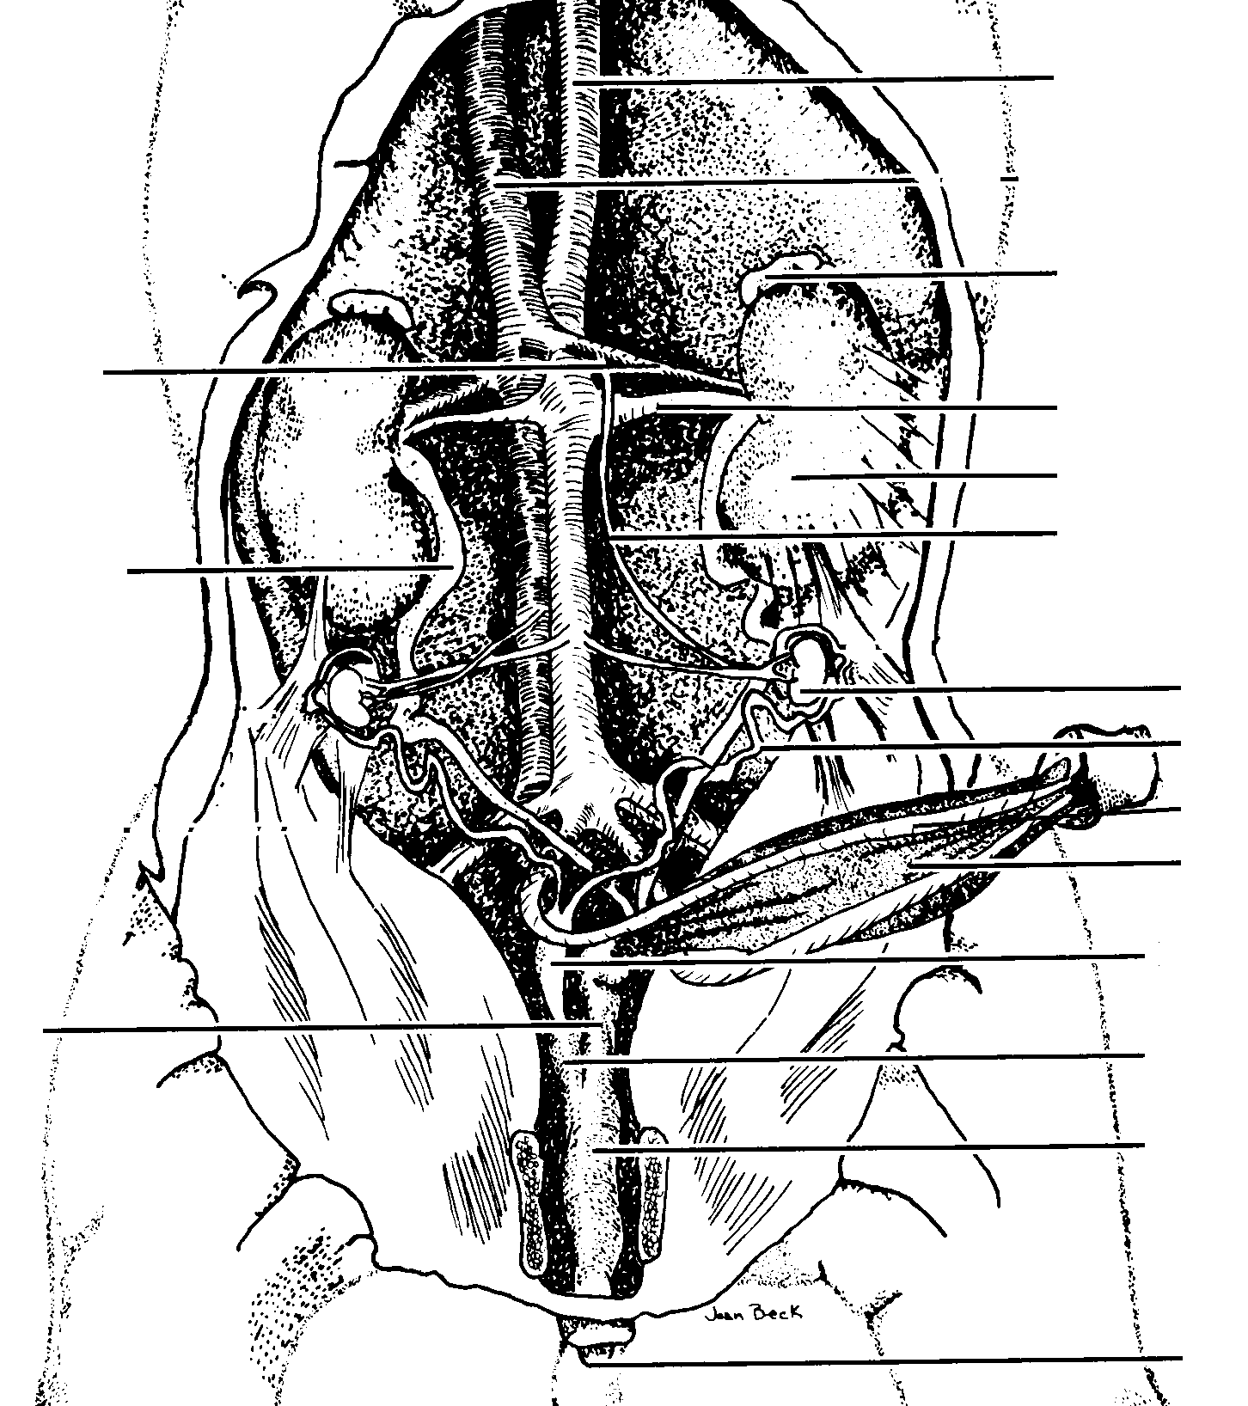
Dorsal aorta
Inferior vena cava
Adrenal gland
Renal vein
Renal artery
kidney
Ureter
ovary
Fallopian tube (oviduct)
Umbilical arteries
Urinary bladder
uterus
Urethera
vagina
Urogenital sinus
Urogenital opening

Slide 6
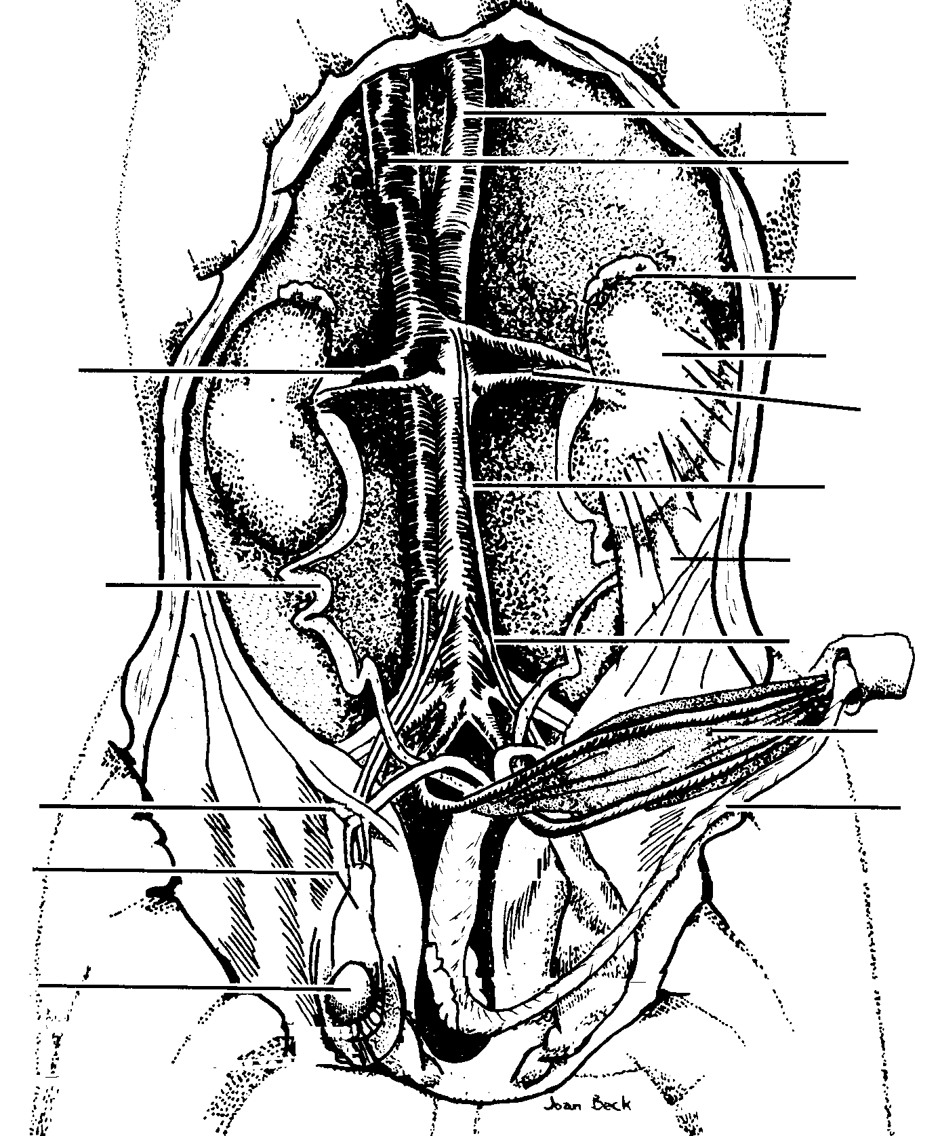
Dorsal aorta
Inferior vena cava
Adrenal gland
kidney
Renal vein
Renal artery
peritoneum
Ureter
Urogential opening
Urinary bladder
Penis (tube)
Urethera (inner)
Vas deferens
epididymus
testes

Slide 7
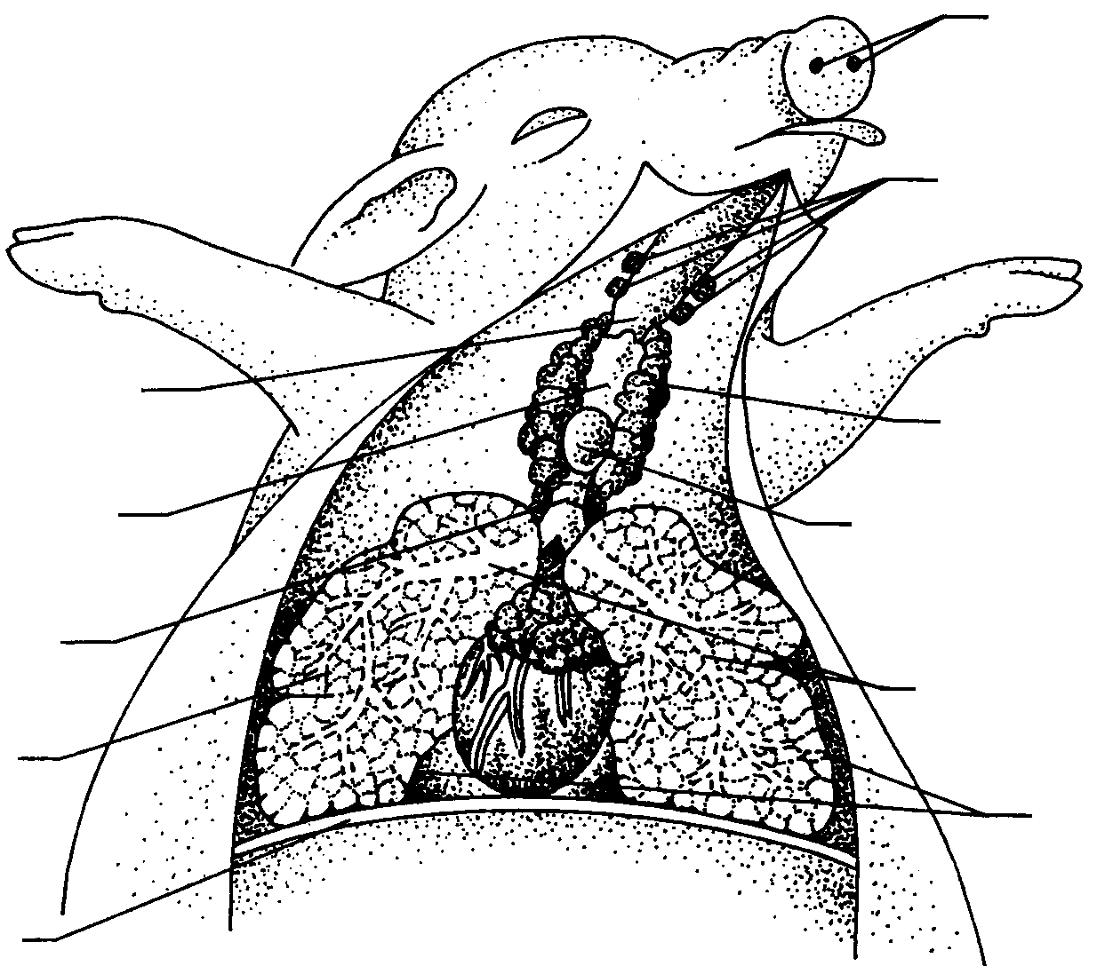
External nares
Salivary glands
Pharynx
Thymus gland
larynx
Thyroid gland
trachea
atria
Bronchus
Bronchioles
ventricles
Lungs
diaphragm
Coronary artery

Slide 8
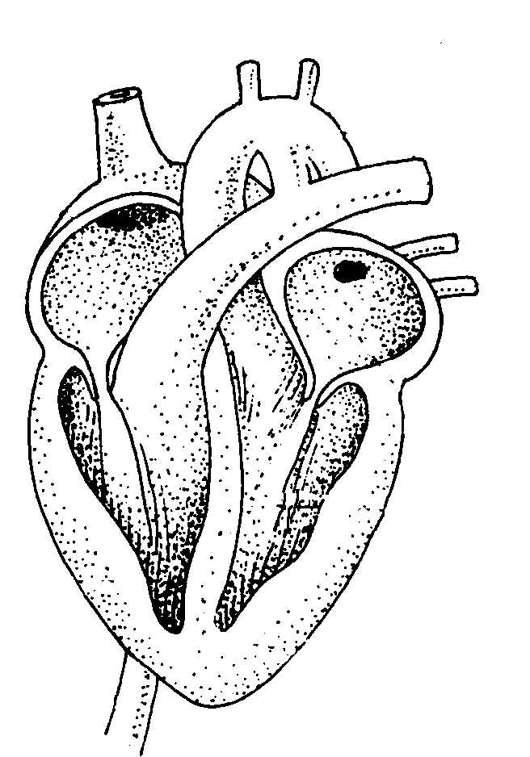
superior vena cava
Blood from upper
body
Ductus
arteriosus
Aorta
Pulmonary
artery
Right atrium
Pulmonary
veins
Left atrium
Right ventricle
Left ventricle
Inferior vena cava
Blood from lower
body

Slide 9
