Slide 1
Skeletal and smooth muscle cells are elongated (muscle cell = muscle fiber)
Contraction of muscles is due to the shortening of microfilaments called myofibrils
  Prefixes myo and mys refer to “muscle”
  Prefix sarco refers to “flesh”

Slide 2
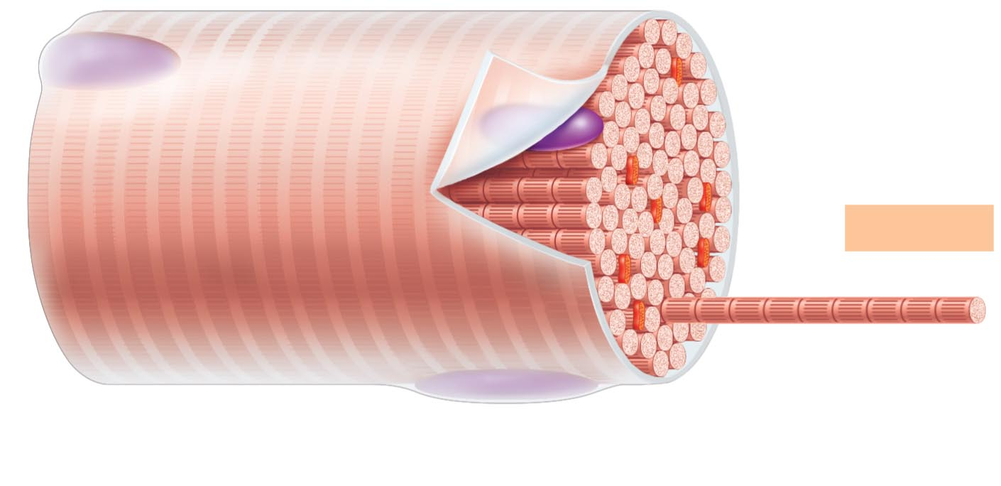
Sarcolemma-plasma membrane
Myofibril
Dark band
Light band
Nucleus
Segment of a muscle fiber (cell)

Slide 3
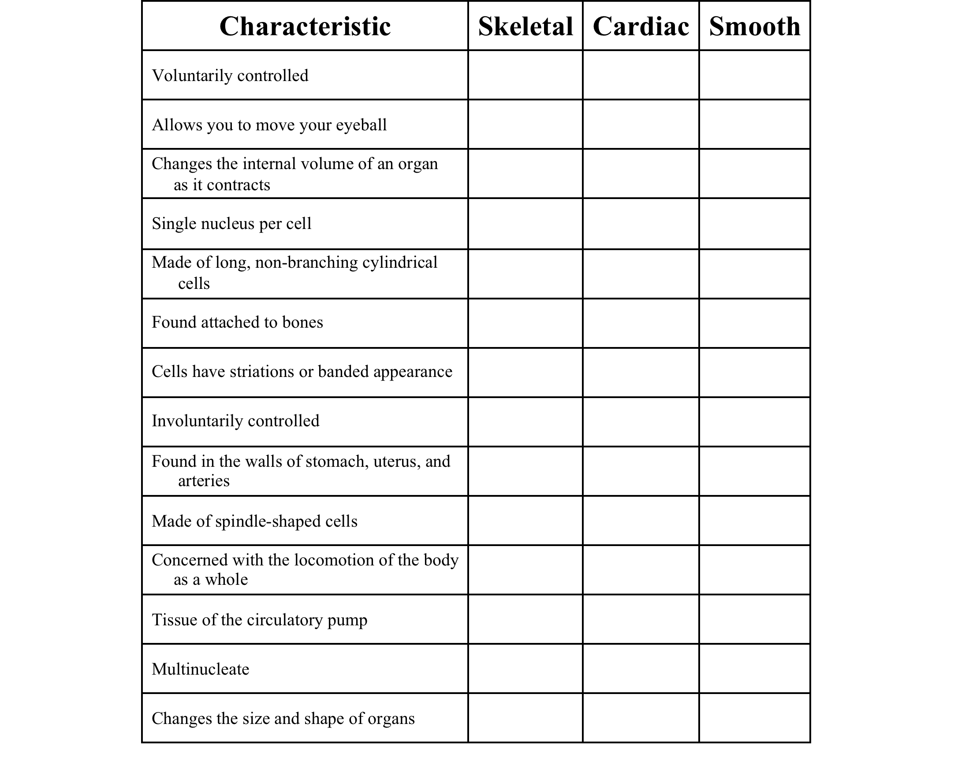
✔
✔
✔
✔
✔
✔
✔
✔
✔
✔
✔
✔
✔
✔
✔
✔
✔

Slide 4
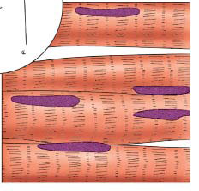
Skeletal Muscle Characteristics
Attached by tendons to bones
Multinucleate
Striated—have visible banding
Voluntary—subject to conscious control

Slide 5
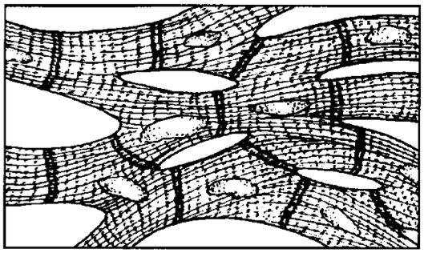
Cardiac Muscle Characteristics
Branching cells
Joined at intercalated discs
Found only in the walls of the heart
Striated w/single nucleus
Involuntary

Slide 6
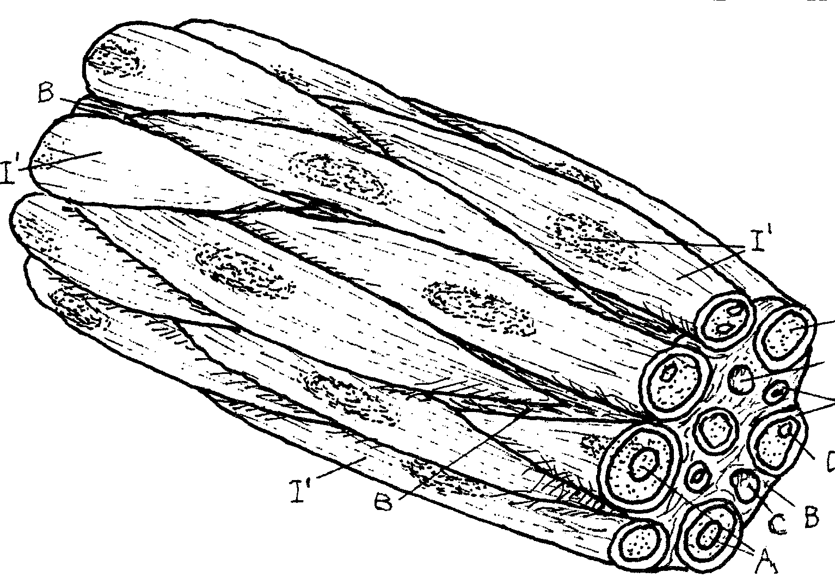
Smooth Muscle Characteristics
Lacks striations
Spindle-shaped cells
Single nucleus
Involuntary—no conscious control
Found mainly in the walls of hollow organs

Slide 7
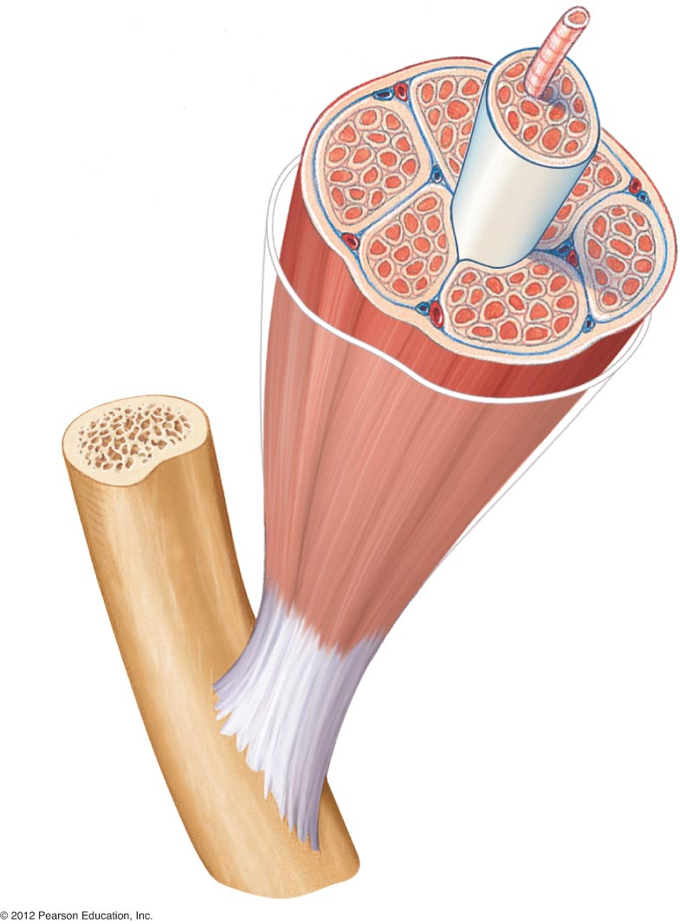
Muscle
fiber
(cell)
Blood vessel
Fascicle (bundle of muscle fibers)
Epimysium
(wraps entire
muscle)
Perimysium
Endomysium
(between
fibers)
Tendon
Bone
Figure 6.1

Slide 8
Connective Tissue Wrappings of Skeletal Muscle
Cells are surrounded and bundled by connective tissue
  Endomysium—encloses a single muscle fiber
  Perimysium—wraps around a fascicle (bundle) of muscle fibers
  Epimysium—covers the entire skeletal muscle

Slide 9
Skeletal Muscle Functions
Produce movement
Maintain posture
Stabilize joints
Generate heat

Slide 10
Contraction of Skeletal Muscle
Graded responses can be produced by changing:
  The frequency of muscle stimulation
  The number of muscle cells being stimulated at one time

Slide 11
Energy for Muscle Contraction
Aerobic respiration
  Uses O₂ to break down glucose (in mitochondria
  Releases energy (about 32 ATP)
  Slower reaction
  CO₂ and H₂O are produced

Slide 12
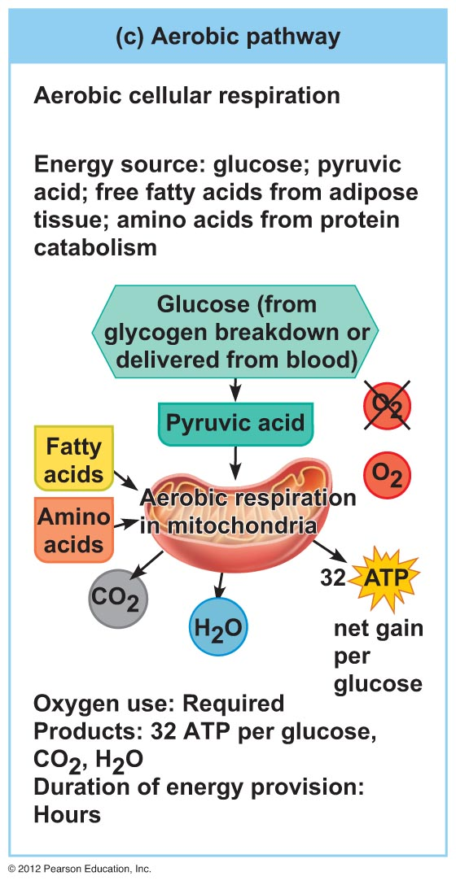

Slide 13
Energy for Muscle Contraction
Anaerobic respiration
  Without O₂, occurs in cytosol
  One glucose produces 2 ATP
  Lactic acid is produced which causes muscle fatigue
  Fast reaction but uses lots of glucose

Slide 14
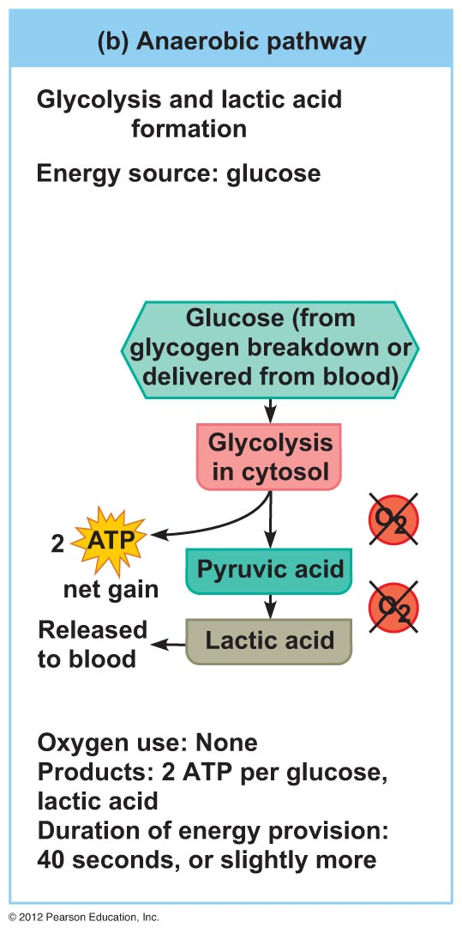
Figure 6.10c

Slide 15
Muscle Fatigue and Oxygen Deficit
Muscle fatigue - muscle is unable to contract even when stimulated.
  Caused by oxygen debt or deficit
  Increasing lactic acid and lack of ATP causes the muscle to contract less

Slide 16
Types of Muscle Contractions
Isotonic contractions
  The muscle contracts and movement occurs
Isometric contractions
  Pushing against an unmovable object.
  Muscles do not contract building tension in the muscles.

Slide 17
Effect of Exercise on Muscles
  Aerobic (endurance) exercise - (biking, jogging)
  - results in stronger, more flexible muscles with greater resistance to fatigue
    - More efficient body metabolism
    - Improves digestion, coordination
    Resistance (isometric) exercise - (weight lifting)
    - increases muscle size and strength
    - by increasing the size of the muscle fibers,

Slide 18
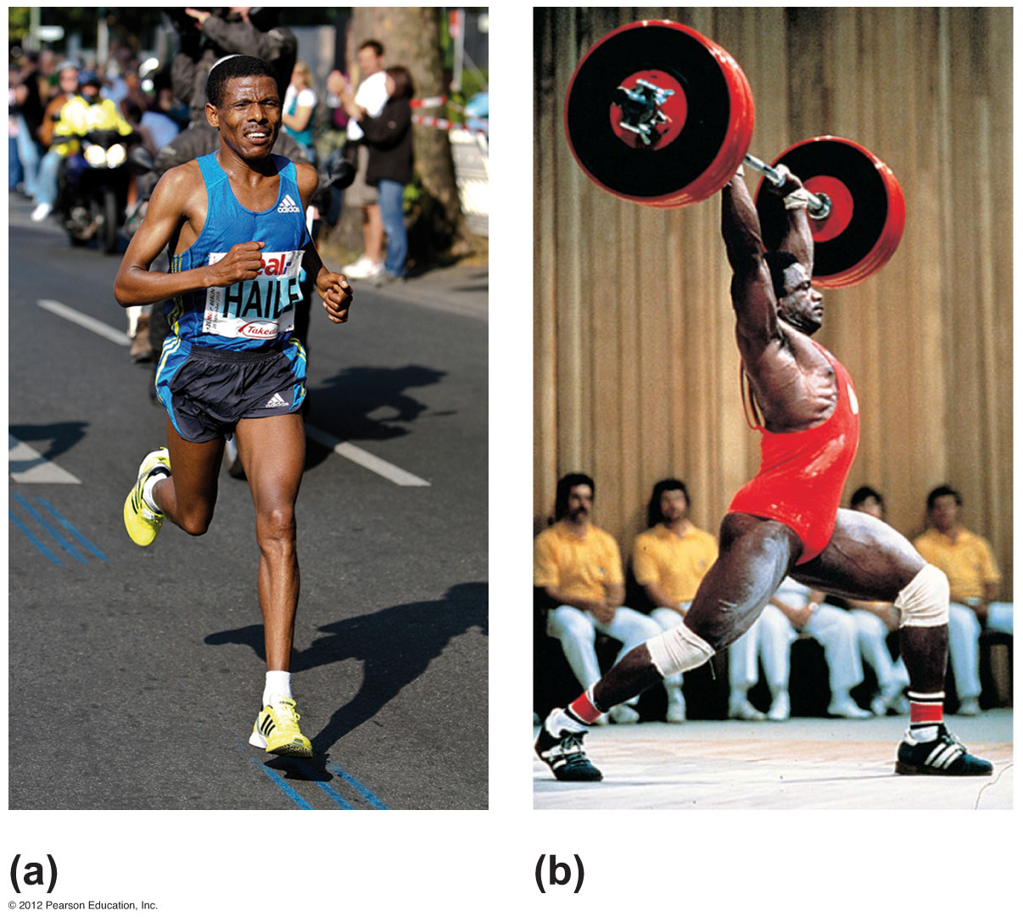
Figure 6.11a-b

Slide 19
Muscles and Body Movements
Muscles are attached to at least two points
  Origin
    Attachment to a immoveable bone
  Insertion
    Attachment to an movable bone

Slide 20
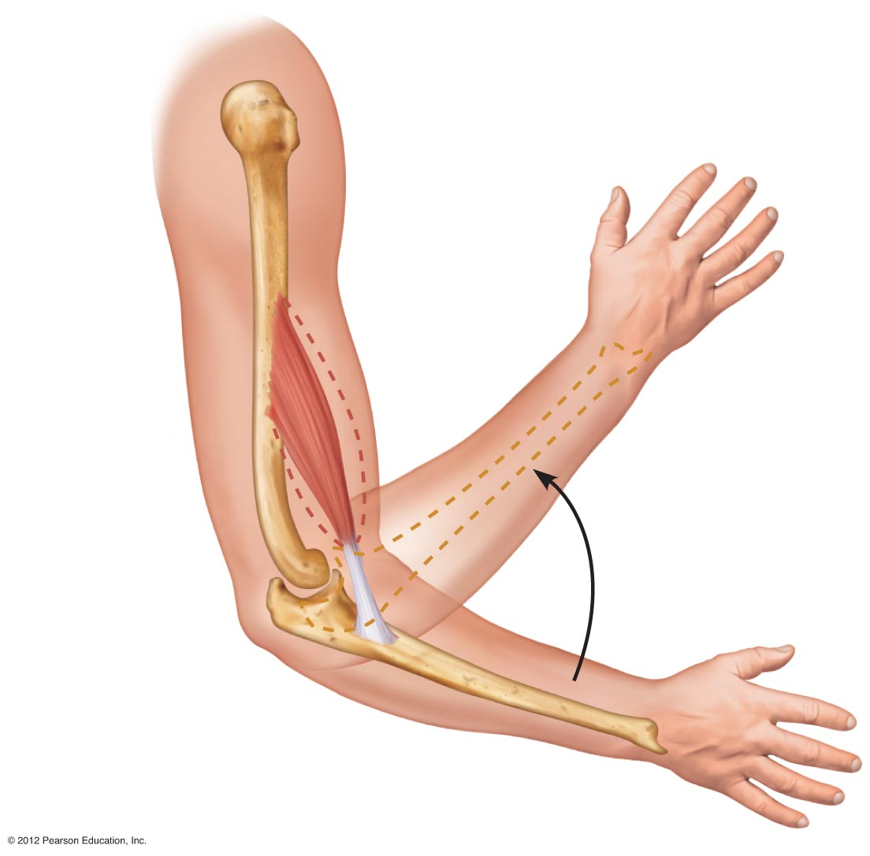
Muscle
contracting
Immovable bone
Origin
Relaxed muscle
Movable bone
Tendon
Insertion
Figure 6.12

Slide 21
Naming Skeletal Muscles
By direction of muscle fibers
  Example: Rectus (straight)
By relative size of the muscle
  Example: Maximus (largest)
By location of the muscle
  Example: Temporalis (temporal bone)
By number of origins
  Example: Triceps (three heads)

Slide 22
Naming Skeletal Muscles
By location of the muscle’s origin and insertion
  Example: Sterno (on the sternum)
By shape of the muscle
  Example: Deltoid (triangular)
By action of the muscle
  Example: Flexor and extensor (flexes or extends a bone)

Slide 23
Types of Body Movements
Flexion
  Decreases the angle of the joint and brings two bones closer together
Extension
  Increases angle between two bones
  Extension beyond 180° is hyperextension

Slide 24
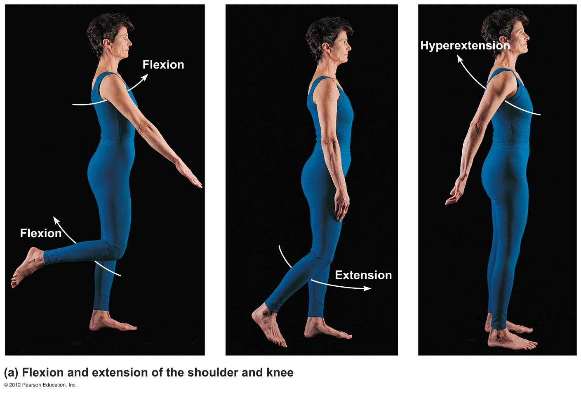
Figure 6.13a

Slide 25
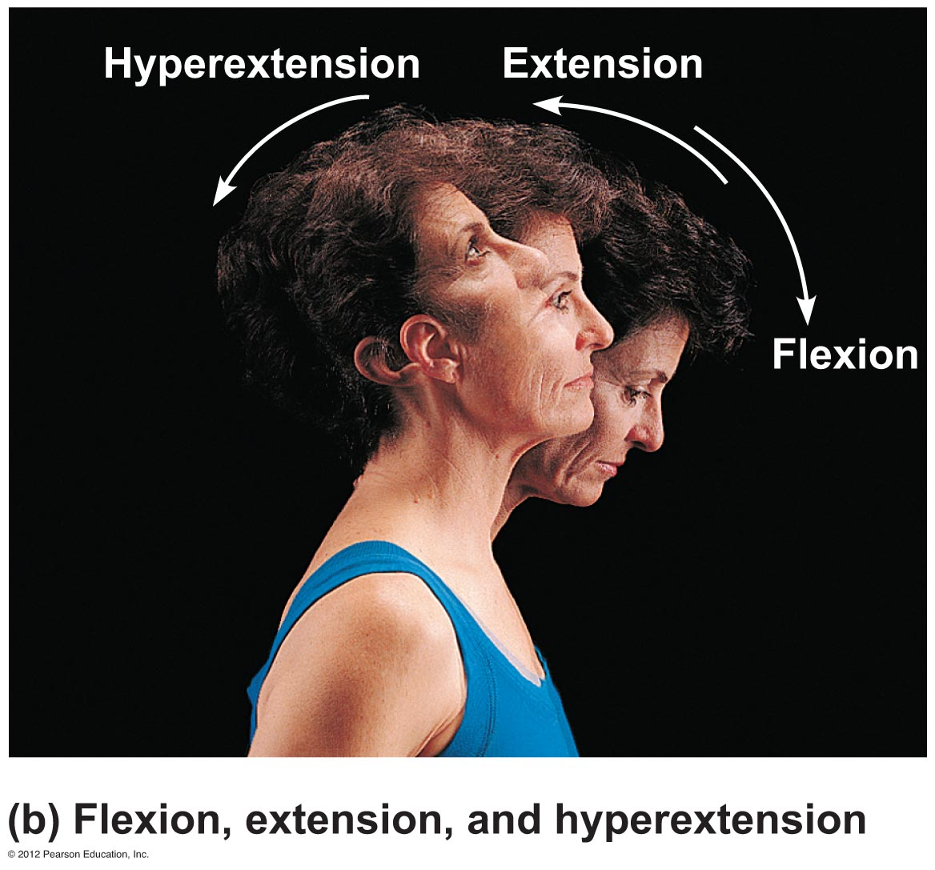
Figure 6.13b

Slide 26
Types of Body Movements
Rotation
  Movement of a bone around its longitudinal axis

Slide 27
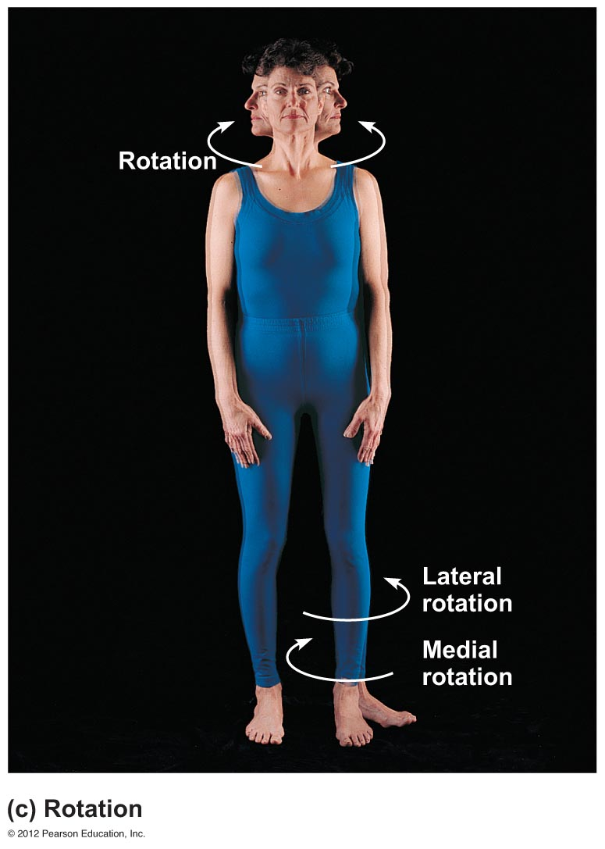
Figure 6.13c

Slide 28
Types of Body Movements
Abduction
  Movement of a limb away from the midline
Adduction
  Movement of a limb toward the midline

Slide 29
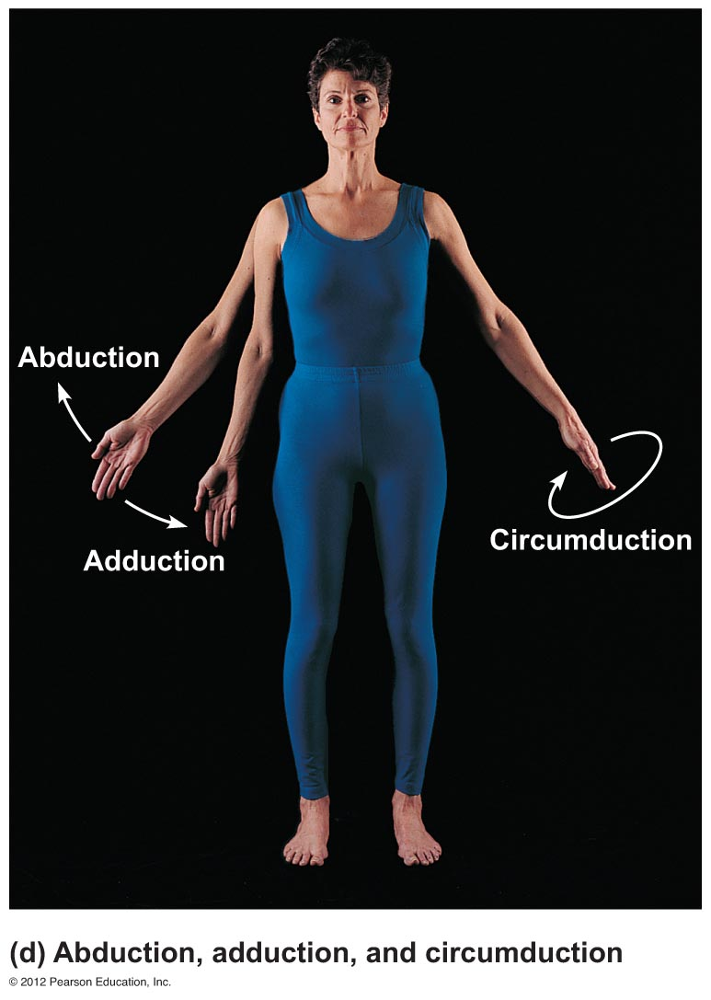
Figure 6.13d

Slide 30
Types of Body Movements
Circumduction
  Common in ball-and-socket joints

Slide 31
Figure 6.13d

Slide 32
Special Movements
Dorsiflexion
  Lifting the foot so that the superior surface approaches the shin (toward the dorsum)
Plantar flexion
  Depressing the foot (pointing the toes)
  “Planting” the foot toward the sole

Slide 33
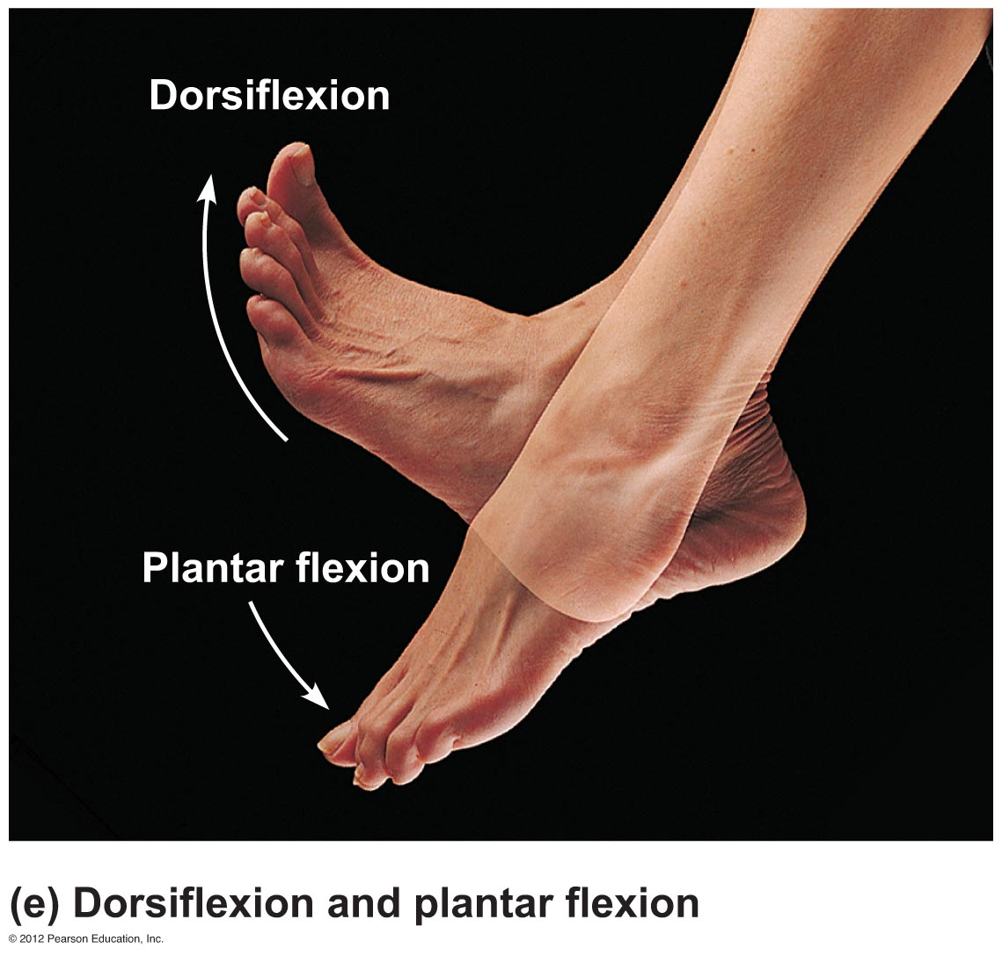
Figure 6.13e

Slide 34
Special Movements
Inversion
  Turn sole of foot medially
Eversion
  Turn sole of foot laterally

Slide 35
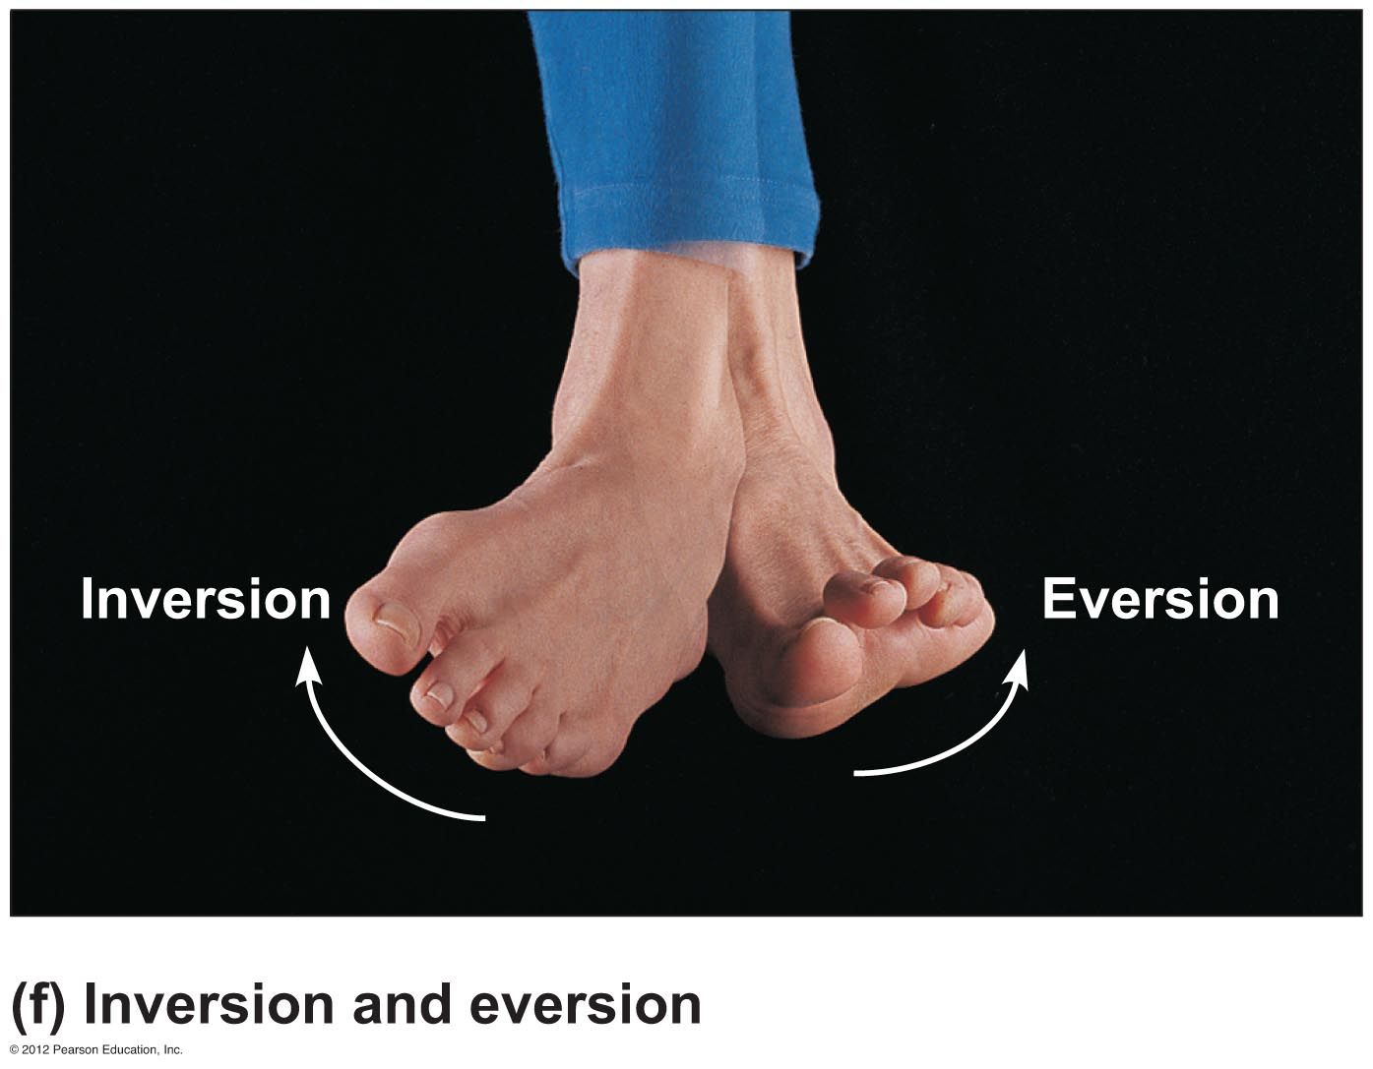
Figure 6.13f

Slide 36
Special Movements
Supination
  Forearm rotates laterally so palm faces anteriorly
  Radius and ulna are parallel
Pronation
  Forearm rotates medially so palm faces posteriorly
  Radius and ulna cross each other like an X

Slide 37
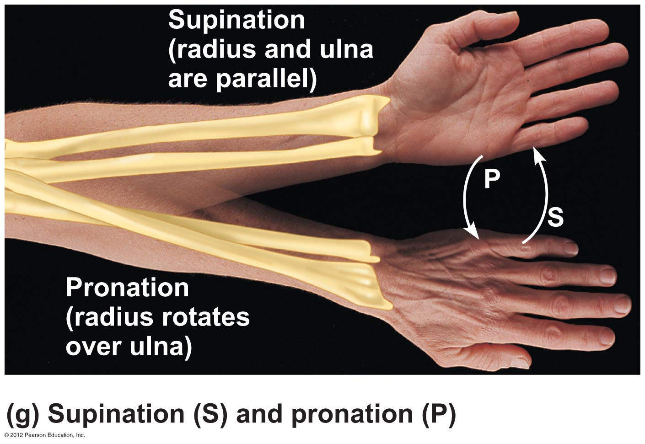
Figure 6.13g

Slide 38
Special Movements
Opposition
  Move thumb to touch the tips of other fingers on the same hand

Slide 39
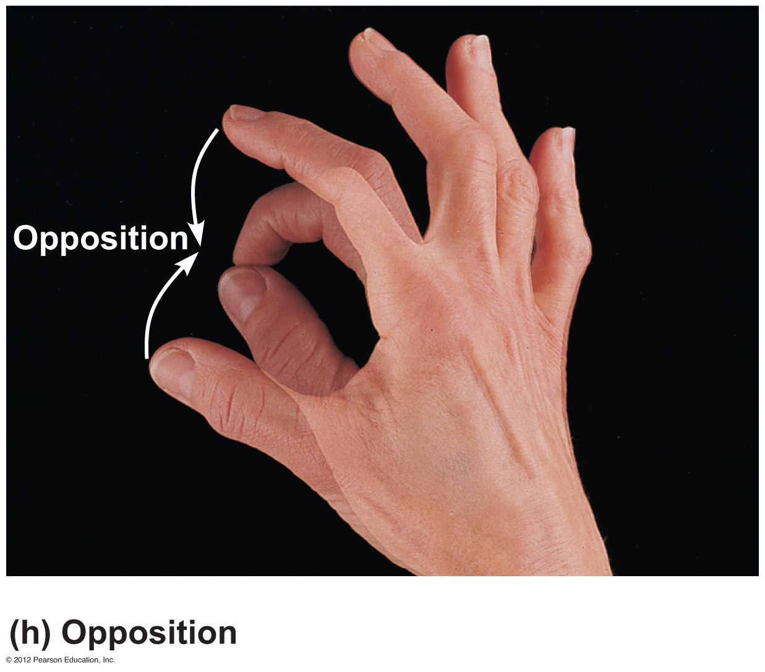
Figure 6.13h

Slide 40
Muscle Tone
Some fibers are contracted even in a relaxed muscle
Different fibers contract at different times to provide muscle tone and to be constantly ready

Slide 41
Microscopic Anatomy of Skeletal Muscle
Sarcomere—contractile unit of a muscle fiber
Organization of the sarcomere
  Myofilaments
    Thick filaments = myosin filaments
    Thin filaments = actin filaments

Slide 42
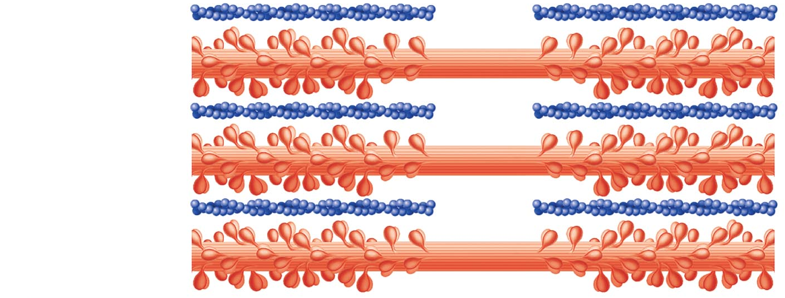
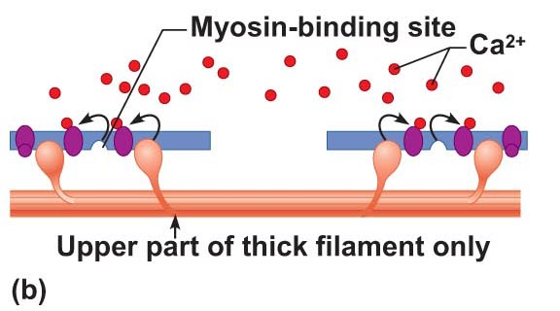
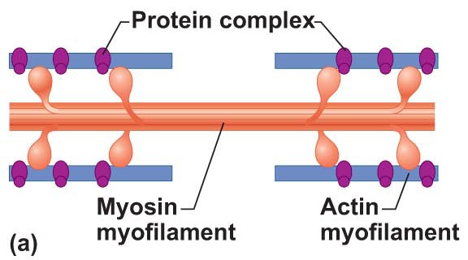
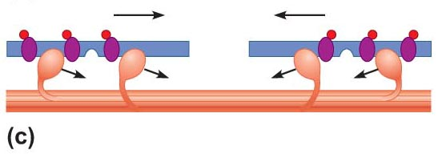
Thick filament
Bare zone
Thin filament
Myofilament structure (within one sarcomere)

Slide 43
Stimulation and Contraction of
Single Skeletal Muscle Cells
Excitability (also called responsiveness or irritability)—ability to receive and respond to a stimulus
Contractility—ability to shorten when an adequate stimulus is received
Extensibility—ability of muscle cells to be stretched
Elasticity—ability to recoil and resume resting length after stretching

Slide 44
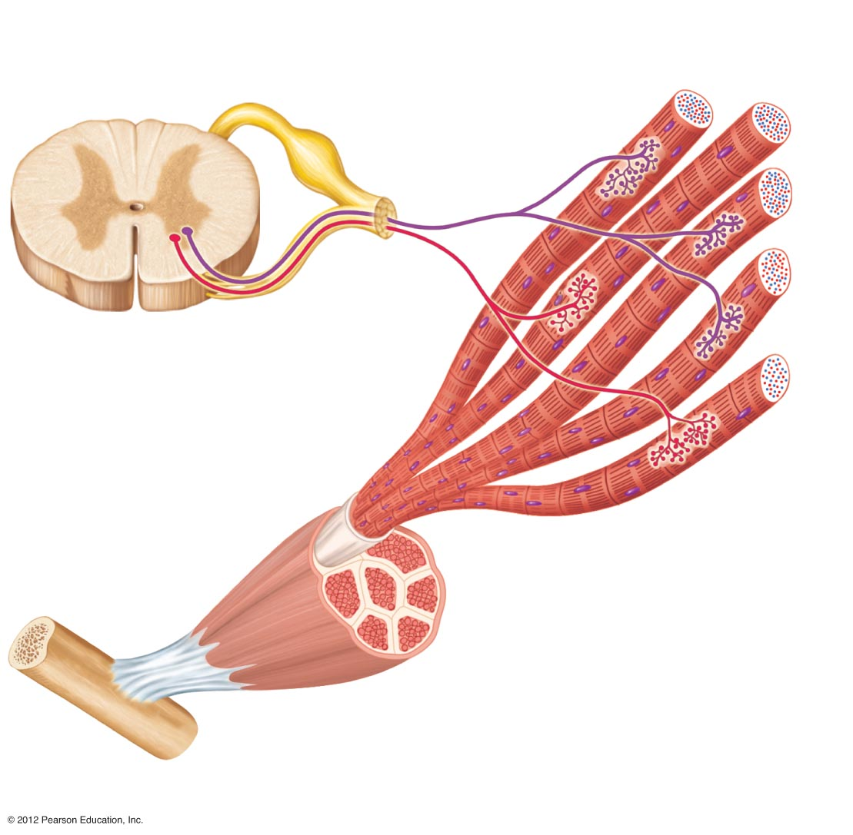
Axon terminals at neuromuscular junctions
Spinal cord
Motor
unit 1
Motor
unit 2
Nerve
Axon of
motor
neuron
Motor neuron
cell bodies
Muscle
Muscle fibers
(a)
Figure 6.4a

Slide 45
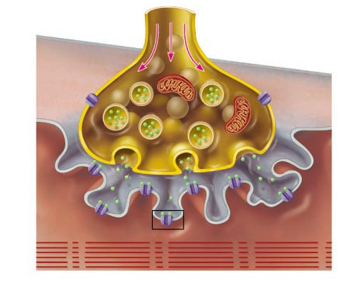
Synaptic vesicle containing ACh
Action potential reaches axon
terminal of motor neuron.
1
Axon terminal of motor neuron
Mitochondrion
2
Ca²⁺
Calcium (Ca²⁺) channels
open and Ca²⁺ enters the axon
terminal.
Ca²⁺
Synaptic
cleft
Sarcolemma
Fusing synaptic
vesicle
Sarcoplasm
of muscle fiber
3
Ca²⁺ entry causes some
synaptic vesicles to release their
contents (acetylcholine, a
neurotransmitter) by exocytosis.
ACh
ACh
receptor
Folds of
sarcolemma
4
Acetylcholine diffuses across
the synaptic cleft and binds to
receptors in the sarcolemma.
Figure 6.5, step 4

Slide 46
}

