Slide 1
Metabolic stage – cell is doing its job
When cell division begins, chromatin (DNA) begins to replicate itself.
Interphase
Chromatin coils up to form 2 copies of each chromosome that are joined together at the centromere and are called sister chromatids
Nuclear membrane breaks down
Centrioles start to form spindle fibers
Prophase
Metaphase
Sister chromatids line up in the center of the cell
Chromatids are split into single chromosomes
Copies go to opposite ends of the cell
Anaphase
Chromosomes → Chromatin
Nuclear membrane reforms
Spindle disappears
Cytokinesis occurs – cytoplasm divides
Telophase

Slide 2
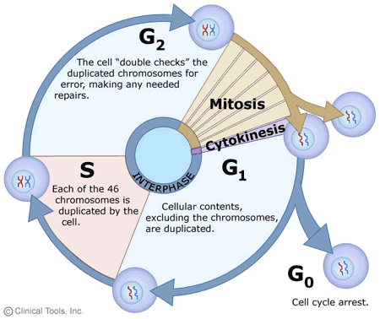

Slide 3
Mitosis/Cancer Notes
I. Two parts of cell division
Mitosis – Division of the nucleus
Cytokinesis – Division of the cytoplasm
-Creates 2 daughter cells with a complete set of chromosomes
II. Cancer (Neoplasm – “New Growth”)
A. Benign
local growths
surrounded by capsule
grow slowly and rarely fatal
B. Malignant
no capsule
invade surrounding cells
break off and spread to other parts of the body – “metastasis”
consume large amounts of nutrients and blood flow
C. Biopsy is a sample of cells that is examined to determine if it is benign or malignant
III. What causes good cells to go bad?
A. Carcinogens (radiation, trauma, some viruses, chemicals (tobacco tars, saccharine) cause mutations in genes that regulate cell division → oncogenes
B. Tumor suppressor genes (“brakes” that stop cell division) quit working
IV. Treatments
A. Surgical removal, if possible is best
B. Chemotherapy or radiation – kills all rapidly dividing cells

Slide 5
