Slide 1
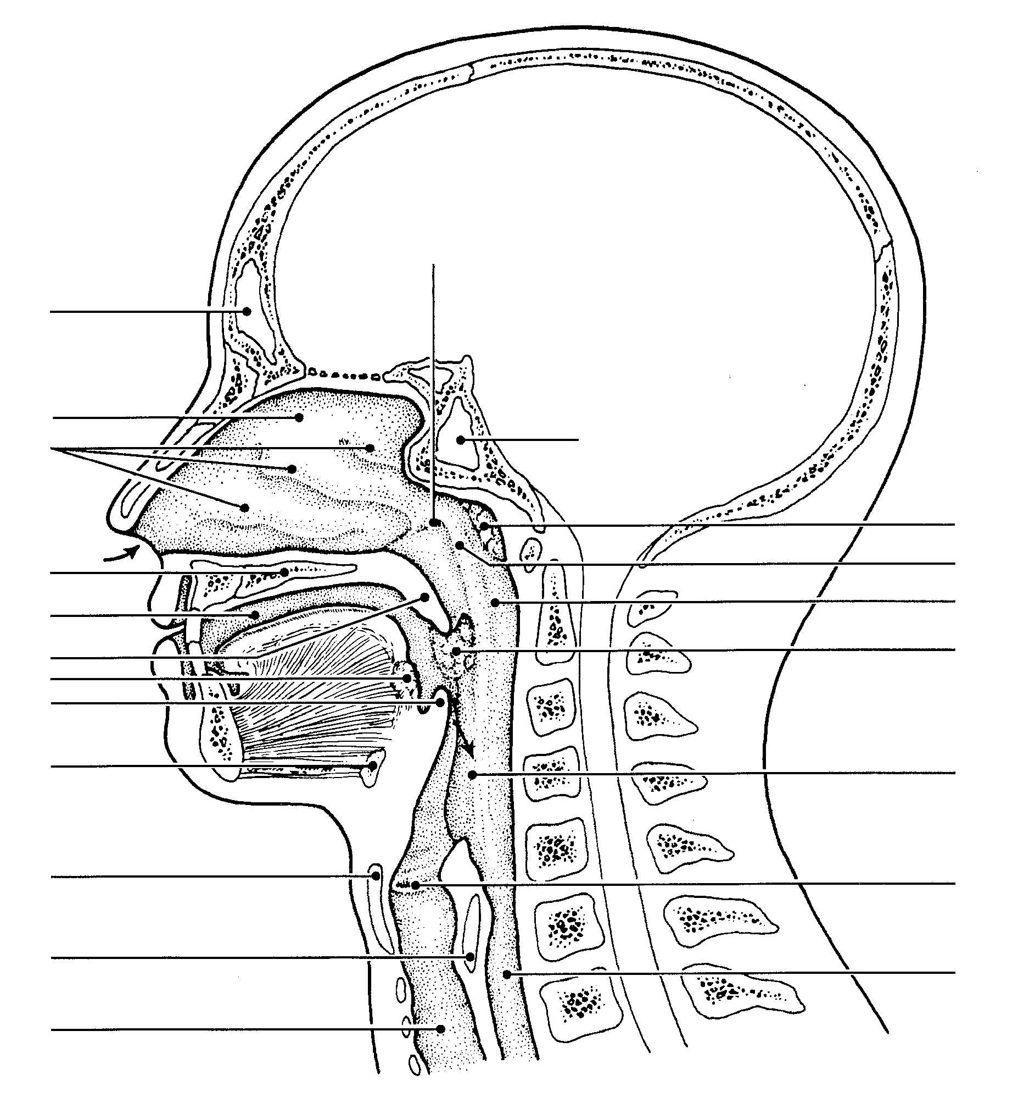
Eustachian (auditory)
tube
sinus
Nasal cavity
sinus
conchae
pharyngeal tonsil
Hard palate
Naso-
Oro-
pharynx
Oral cavity
Soft palate/uvula
palatine tonsil
Lingual tonsil
Epiglottis
Hyoid bone
laryngopharynx
Vocal folds (cords)
larynx
esophagus
trachea

Slide 2
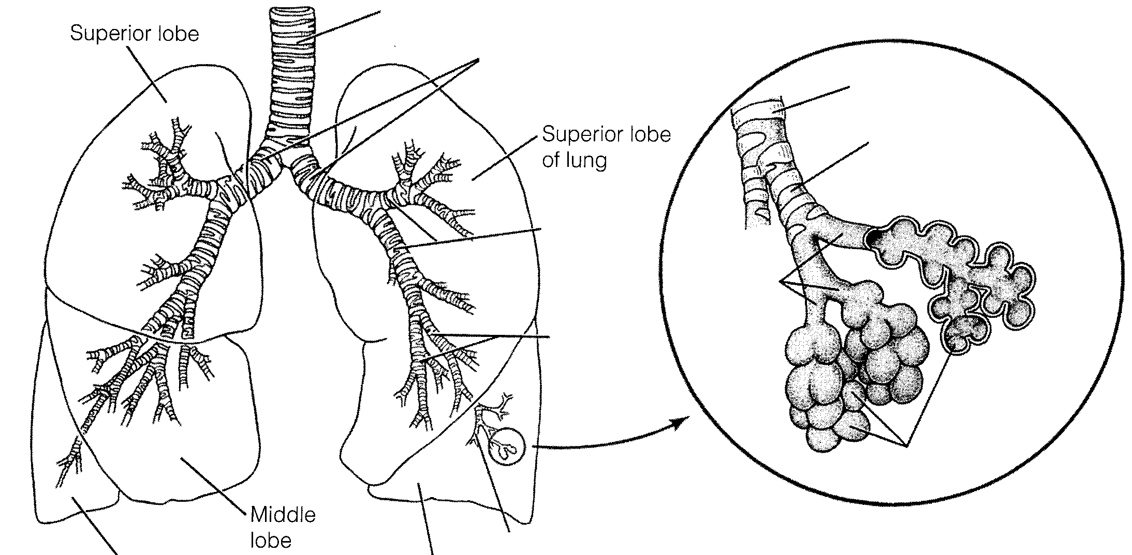
trachea
bronchi
Terminal
bronchioles
Respiratory
bronchioles
bronchioles
Alveolar
ducts
Alveolar
Sacs
or
Alveoli

Slide 3
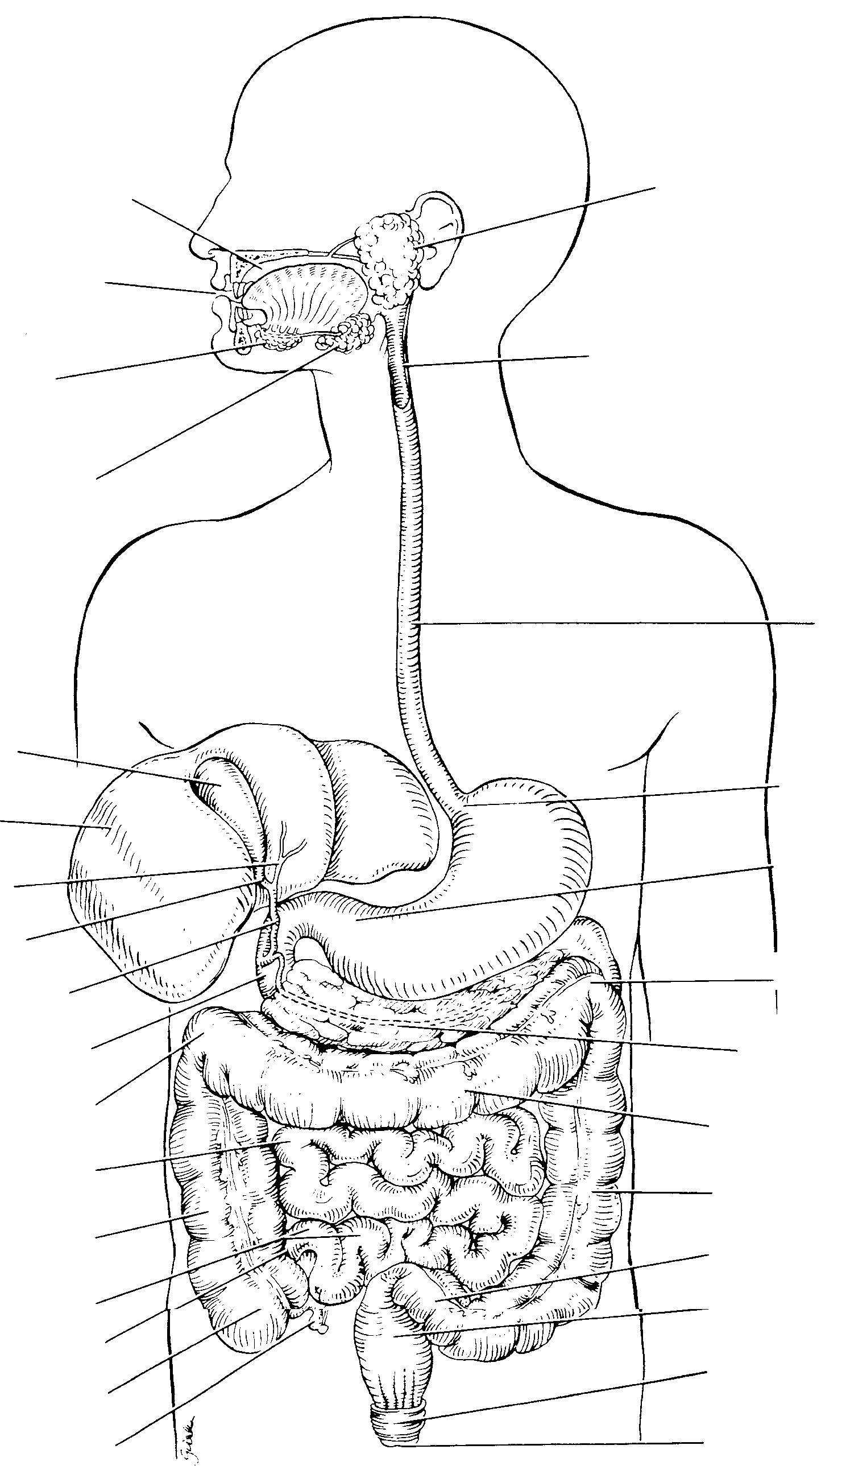
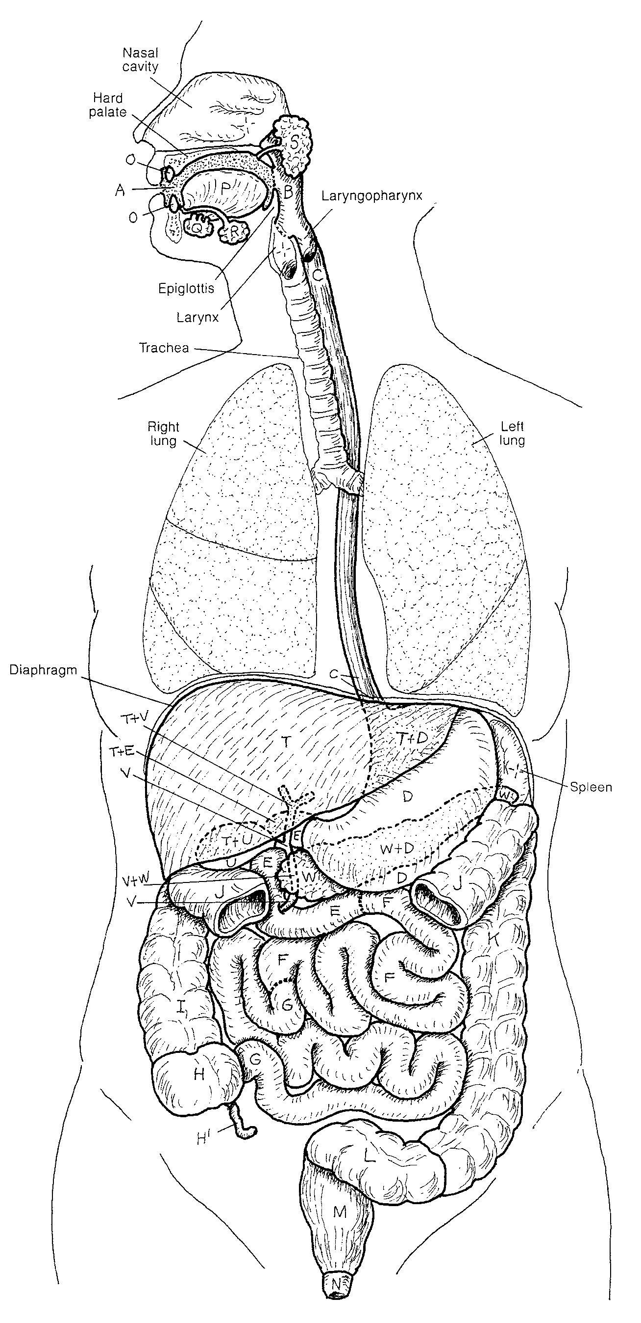
Parotid salivary gland
Sublingual
gland
Laryngopharynx
Submandibular
gland
Esophagus
Gall bladder
Cardiac sphincter
Liver
Pyloric sphincter
Bile duct
Duodenum
Pancreas/pancreatic duct
Transverse colon
Jujenum
Descending colon
Ascending colon
Sigmoid colon
ileum
Rectum
Cecum
Anal external sphincter
Appendix
Anus

Slide 4
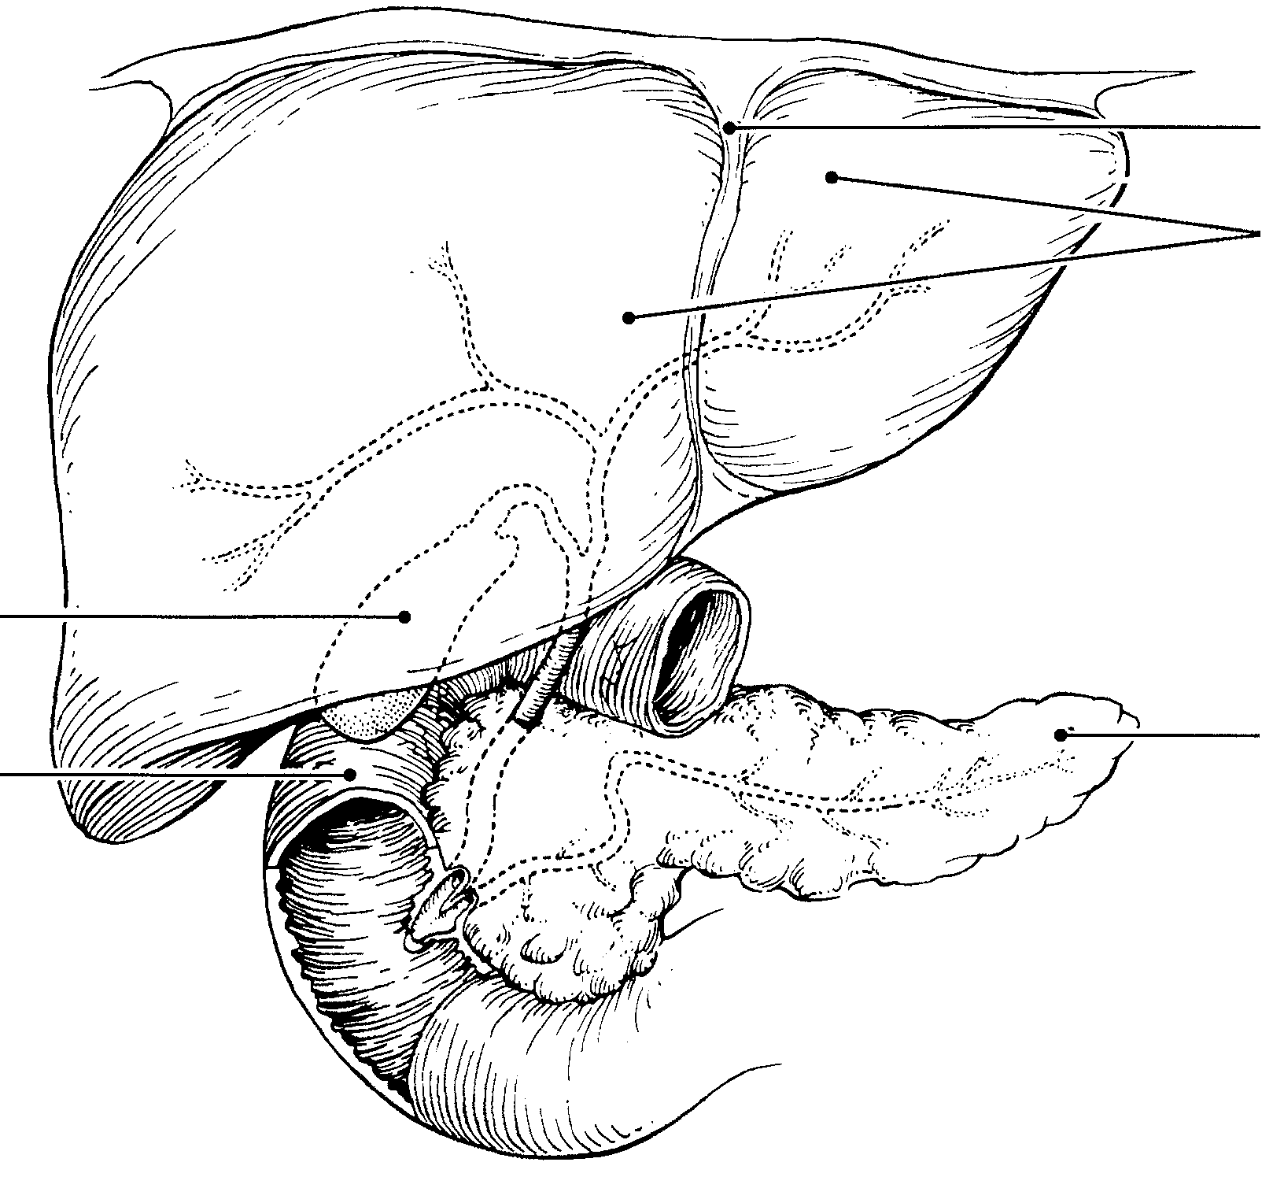
Liver
Gall bladder
Pancreas/pancreatic duct
Duodenum

Slide 5
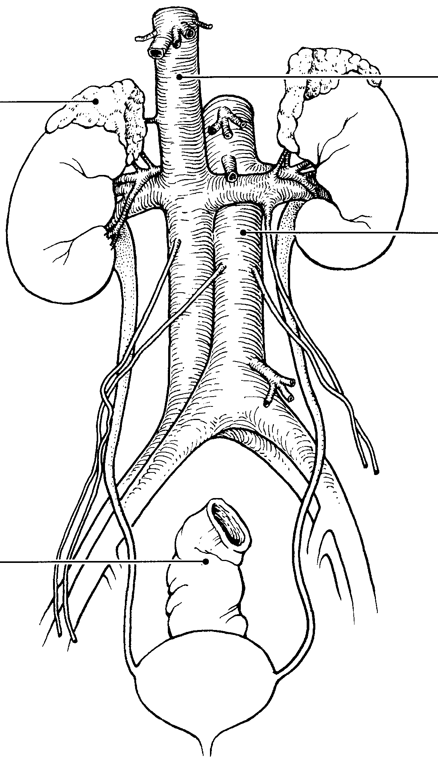
Inferior vena cava
adrenal gland
Renal vein
Renal artery
Kidney
Dorsal aorta
Ureter
Urinary bladder
Urethra

Slide 6
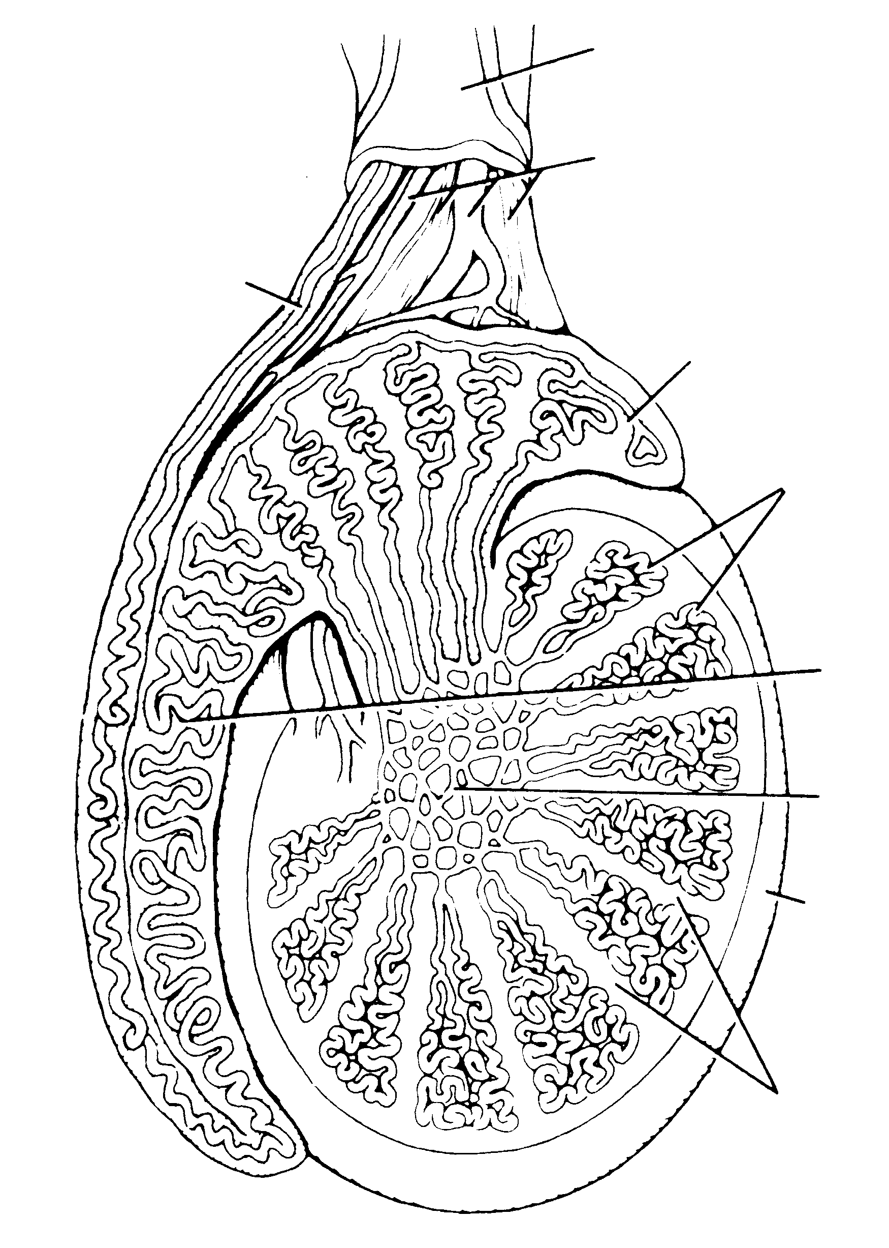
Urinary bladder
Urinary bladder
Seminal vessicle
Prostate gland
Ejaculatory duct
Vas (ductus) deferens
Rectum
Bulbourehtral
gland
Urethra
epididymus
testis
Glans penis
Scrotum
Prepuce

Slide 7
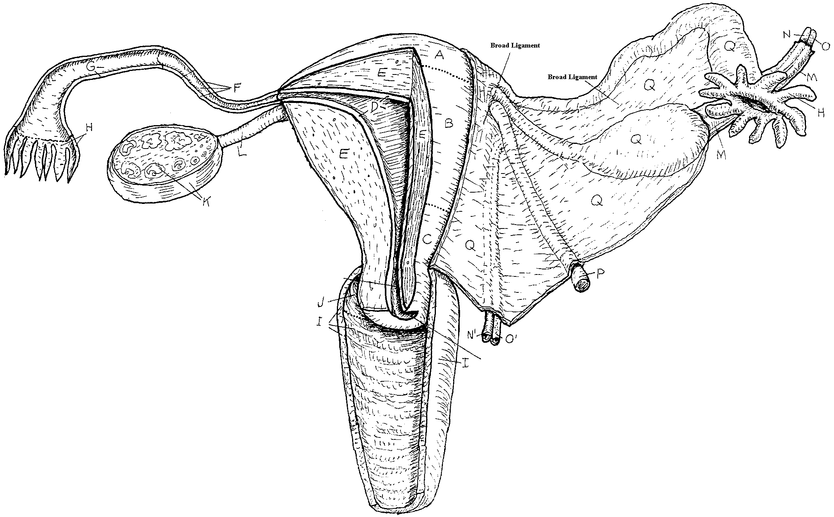
Uterine
(fallopian)
tube
fimbriae
ovary
perimetrium
A – fundus
B – body
C – cervix
D – endometrium
E – myometrium
vagina

Slide 8
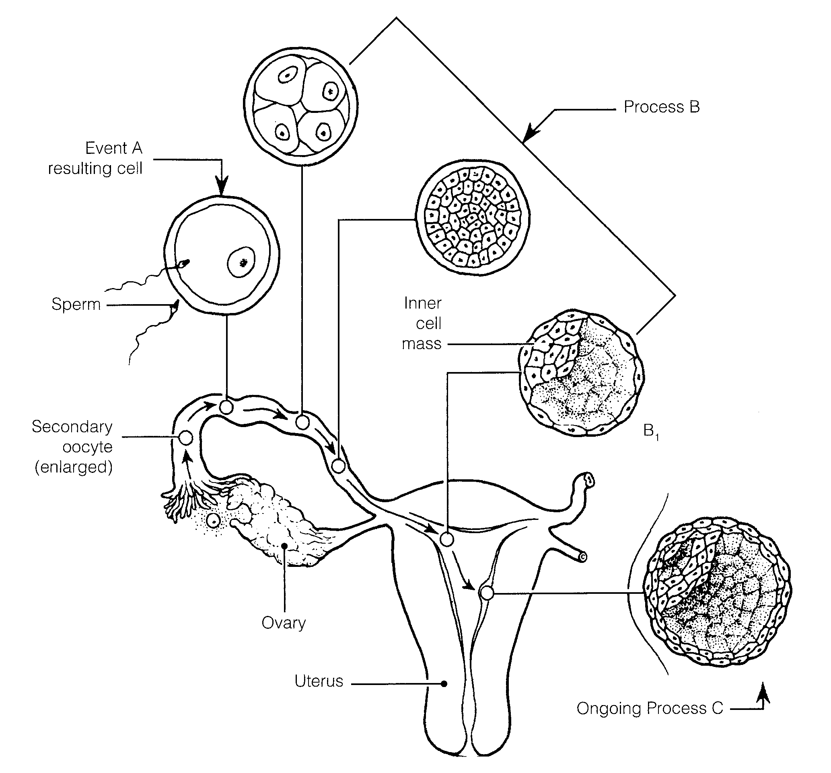

Slide 9
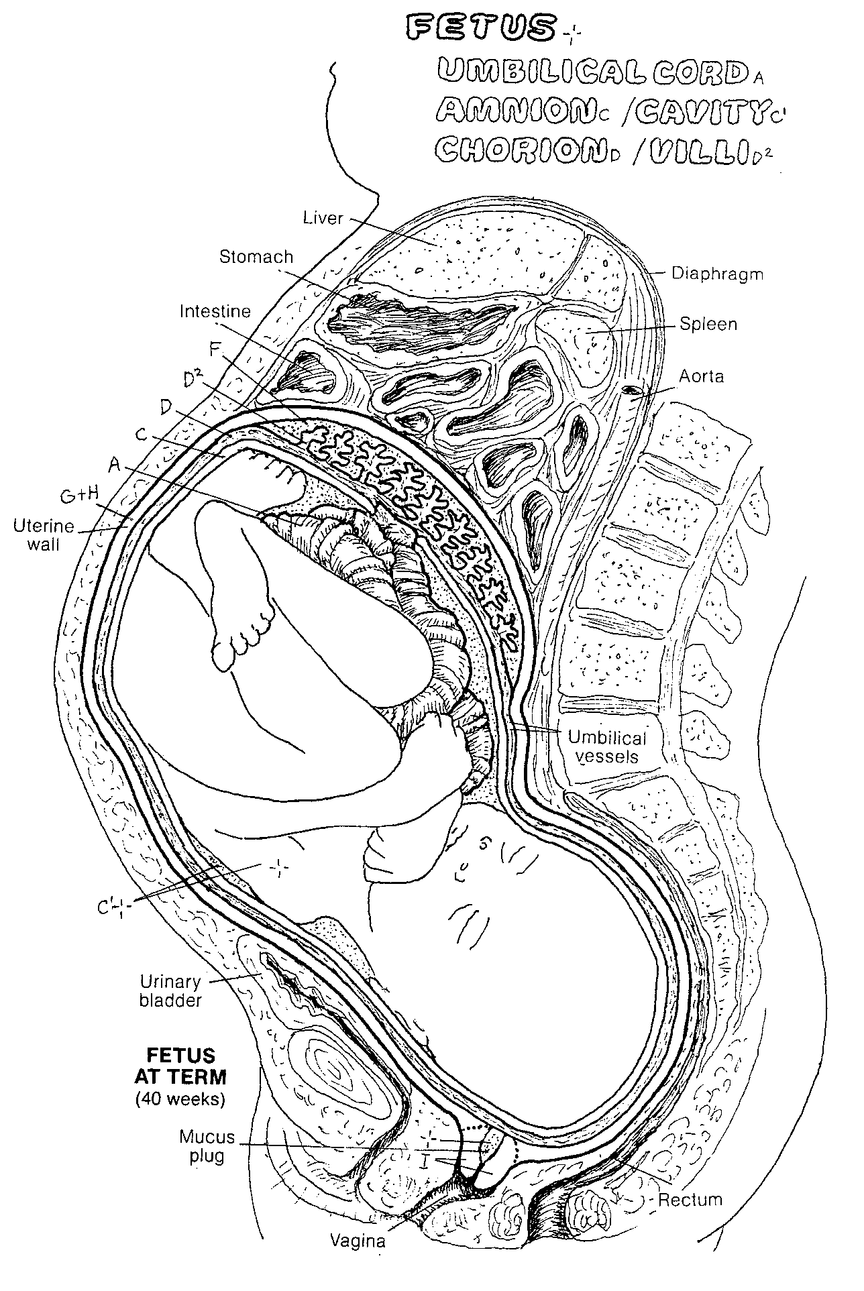
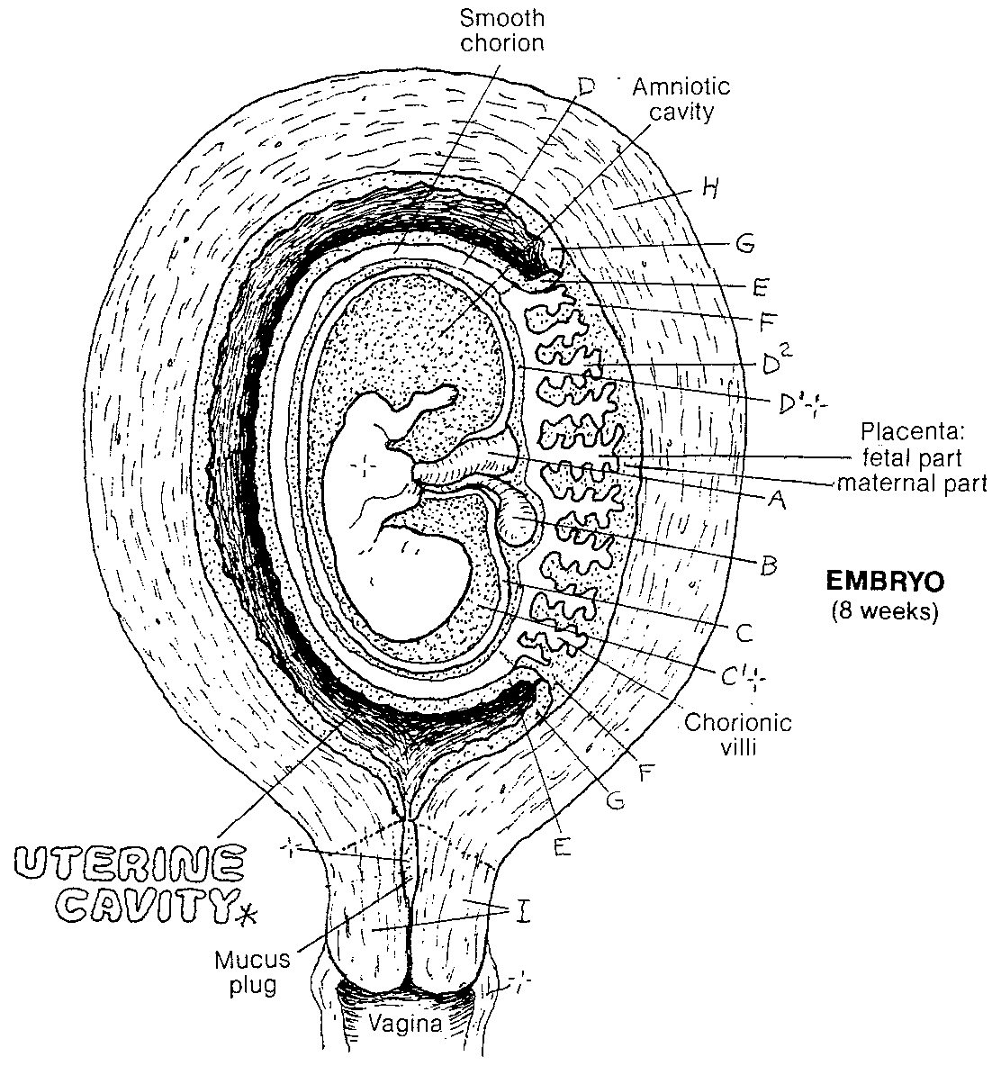
D² –Chlorionic villi
C’ – Amniotic fluid
A – umbilical cord

Slide 10
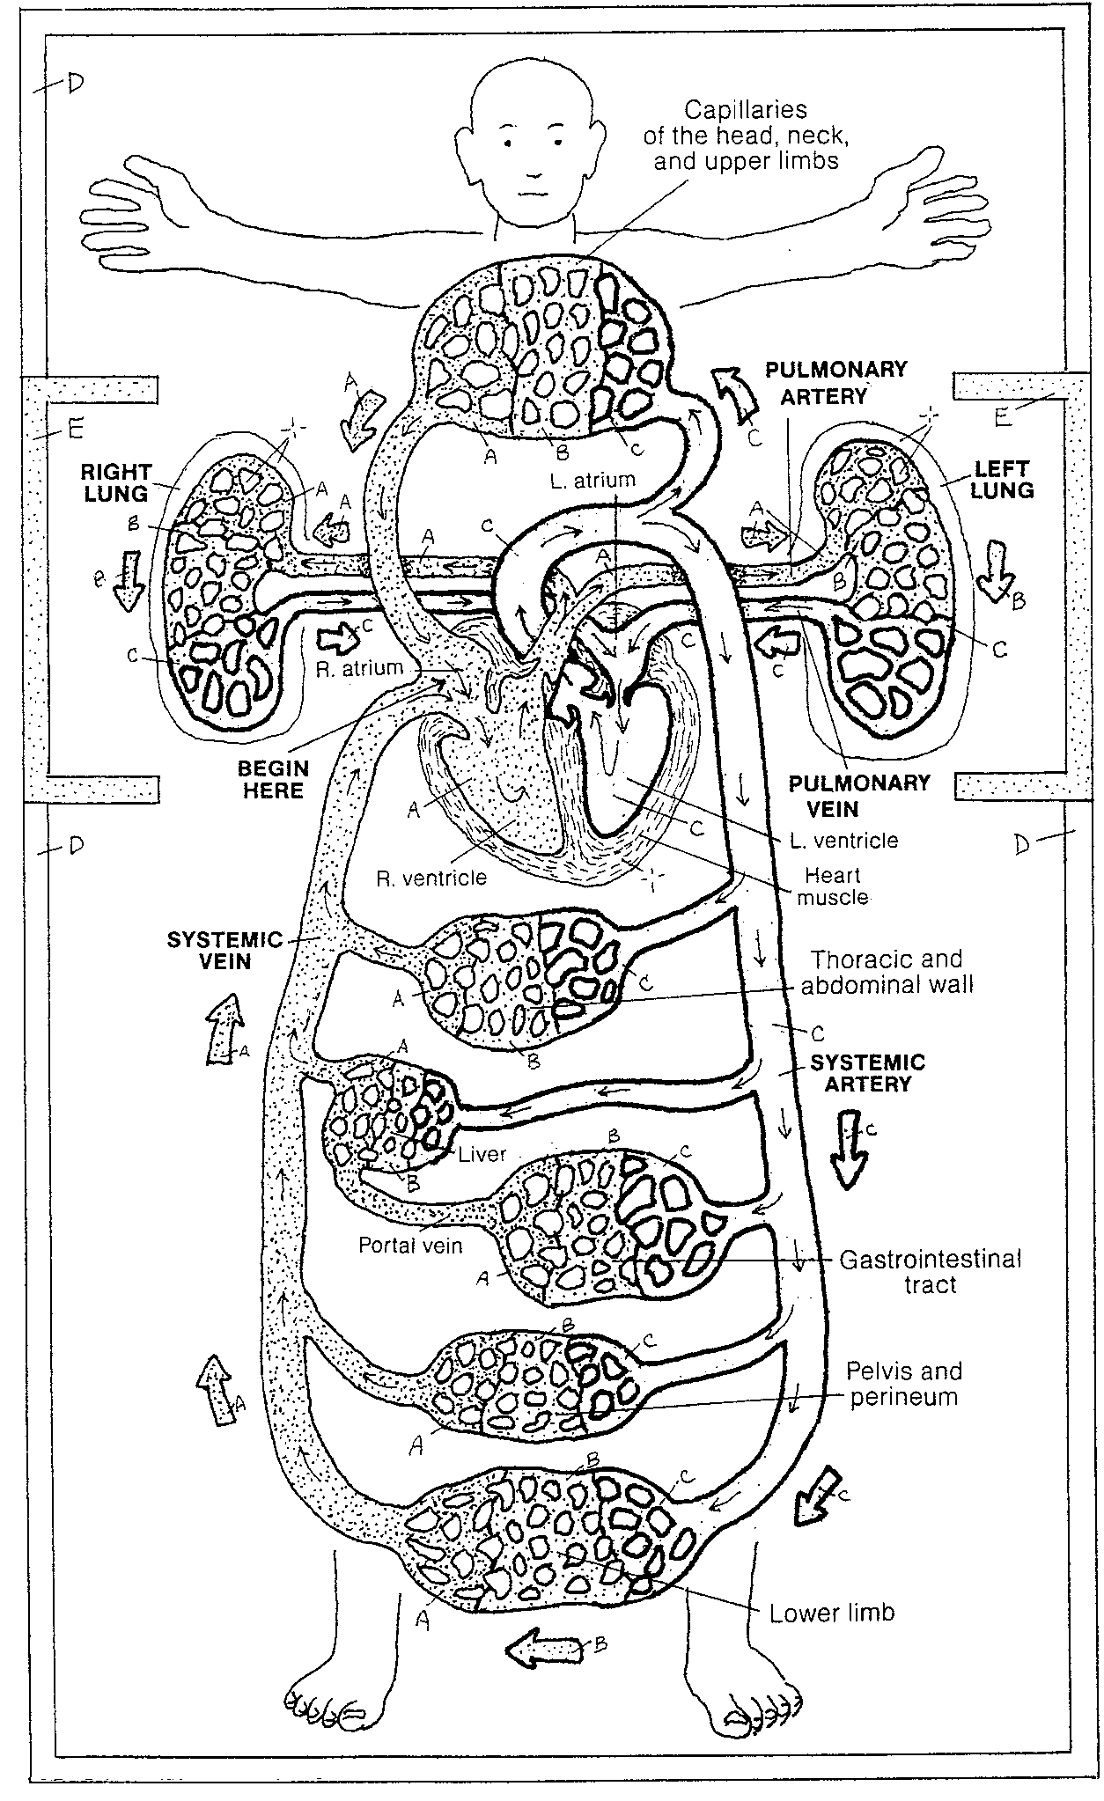
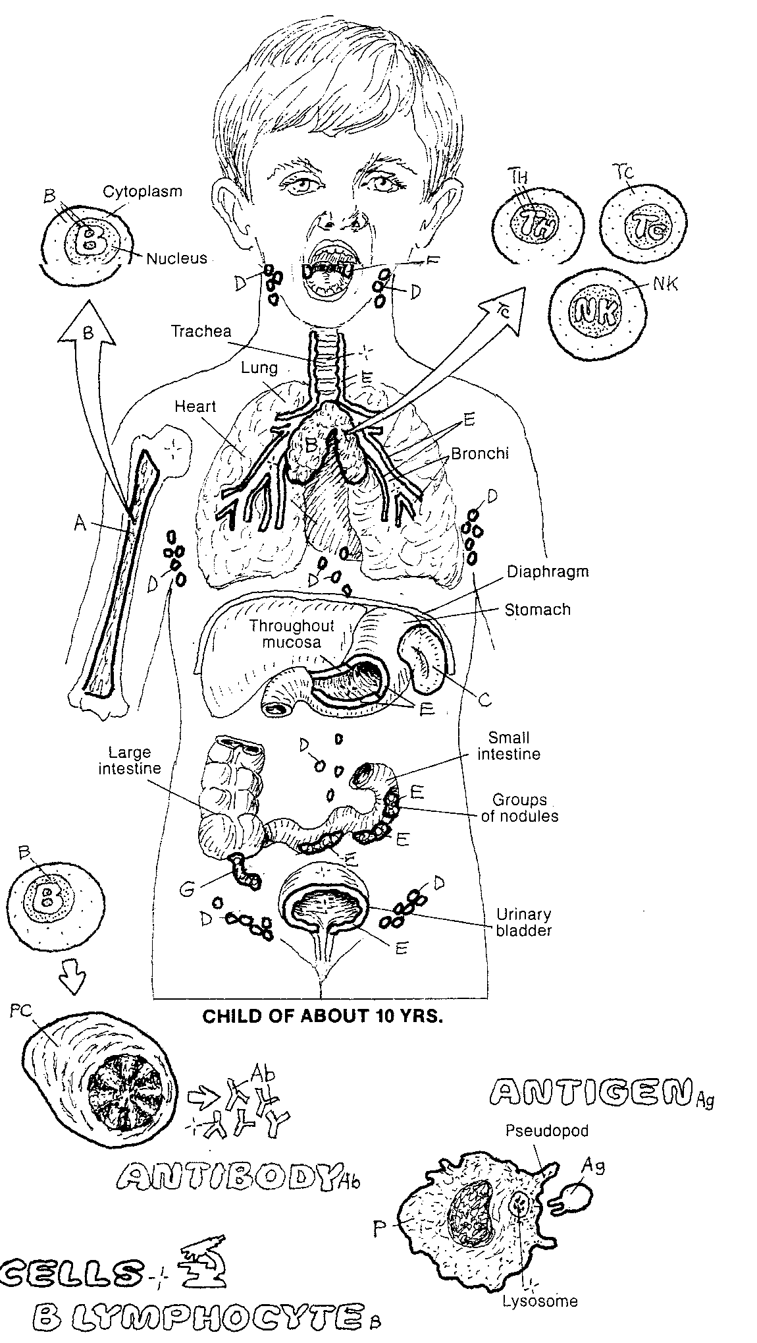

Slide 11
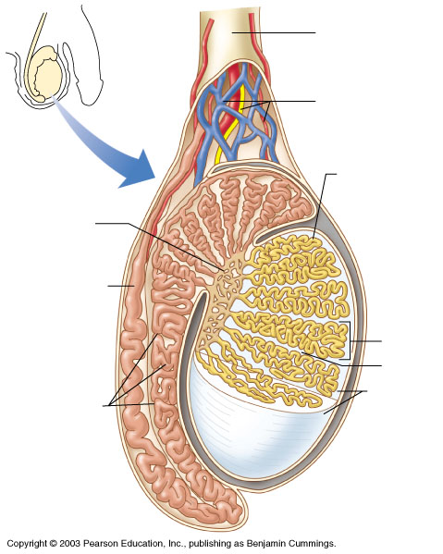
Rectum
Urinary bladder

Slide 12
fimbriae
uterus (perimetrium)
uterine (Fallopian)
tube
ovary
myometrium
endometrium
cervix
urinary bladder
pubic bone
urethra
rectum
vagina
clitoris
hymen

Slide 13
