Slide 1
Ailimentary Canal (Gastrointestinal [GI] tract) – tube that the food passes through
Mouth → pharynx →esophagus→stomach→small
intestine→large intestine→anus
Assesory digestive organs
Teeth, tongue, salivary glands, pancreas, liver, gallbladder
Mouth and Throat
Teeth – cut and grind the food
Tongue – mixes food and saliva(amylase), forms bolus,
swallowing, taste buds
Pharynx – back of mouth where nasal cavities and mouth meet
Esophagus – collapsible tube that connects the mouth and
stomach
Stomach –
cardiac sphincter keeps food from re-entering esophagus
causing “heartburn” or acid reflux
stomach is 6-10 inches long can hold about 1 gallon
has circular, longitudinal, and oblique muscles to churn food
and mix with gastric juices – HCl, pepsin (proteins), intrinsic factor (B₁₂)
food leaves as chyme – a creamy slurry
pyloric sphincter – “gatekeeper” - controls when food leaves
the stomach 4-6 hours for meal to leave stomach
Gallbladder –collects bile from the liver which breaks down
RBC’s
Water removed – Gallstones form out of cholesterol
Blockage causes bilirubin to back into blood
stream causing jaundice.

Slide 2
Gall bladder contracts and Bile is secreted to duodenum –
emulsifies the fats, allows fat-soluble vitamins to be
absorbed
Pancreas – secrete pancreatic juices that digest the protein, fats, NA’s, and CHO’s
-They are alkaline and lower the acidic pH
Secretes insulin – when hyper glycemic
Diabetes Type I and Type II – insulin
glucagon - hypoglycemic
Small intestine – 7 to 13 feet long – small not short
duodenum – 12 finger lengths – 5% of SI
jejunum – “empty” - almost 37%
ileum – “twisted intestine” – almost 58%
Villi, micro villi, and Peyer’s patches
Large Intestine – 5ft,
Absorb water into the body and eliminate waste products
Cecum/appendix→colon(ascending, transverse, descending), sigmoid colon, rectum, anal canal
No villi, lots of mucus
Anus has externalvoluntary sphincter and internal involuntary sphincter
Messentery holds intestines in place
Mesenteric veins carry food to hepatic veins which carry nutrients to the liver to be stored.

Slide 3
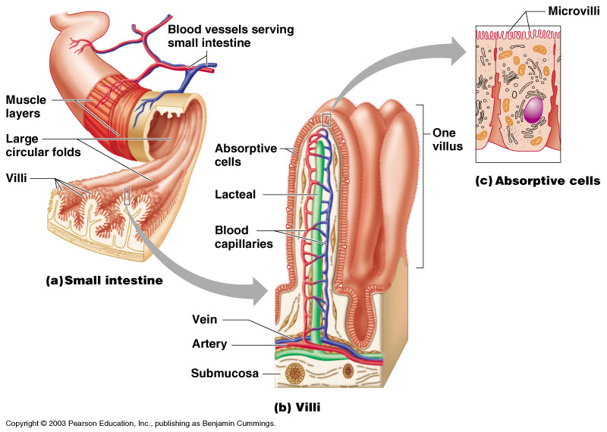

Slide 4
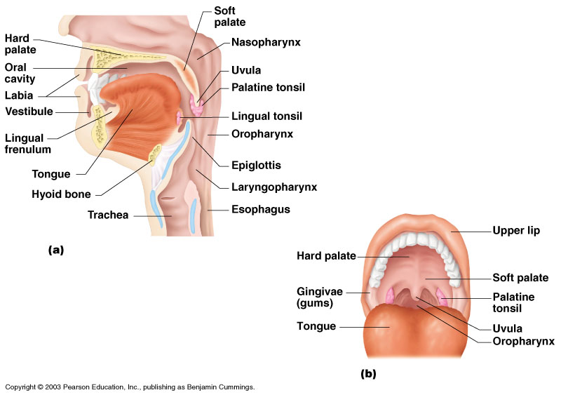

Slide 5
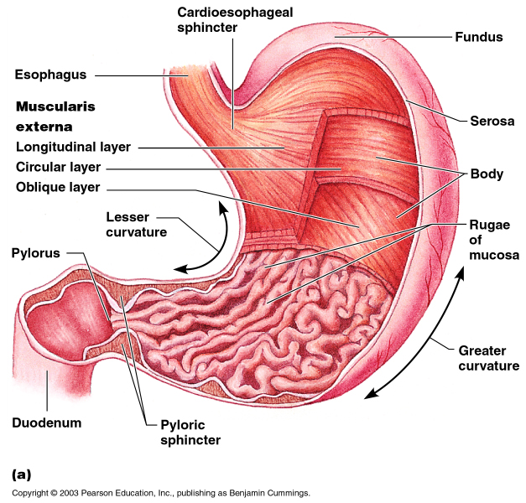

Slide 6
